Slide 1

Preparation of the Forest concession management PLAN (rku)
Pt. restoration ekosistem Indonesia
Patron’s Meeting 5-6 November 2025

Slide 2
Forestry Concession Management Plan Progress
Completed 100%
In Progress 75%
In Progress 65%
Operational Plan
Strategic Plan
Based on Land Use Management
Tactical Plan
Based on Area and Time Management
Land Use Direction (100%)
Core Forest Area
Cultivation/ Rehabilitation area
Challenged Area
Work Area Arrangement
2.1. Based on type management (100%)
Hutan Harapan Protected Area
Self-Managed Protection Area
Partnership Protection Area
Hutan Harapan Production Area
Self Managed Production Area
Partnership Production Area
Business Cooperation Production Area
PPKH Area
2.1. Based on Utilization (100%)
Area Utilisation
Environmental Service
NTFP Utilization
NTFP Collection
2.3. Work Area Arrangement based on Time/Block/Compartment (100%)
Work Area for HH area 10 years of work
Work Area HH area becomes working/patrol block
Work area smallest area of block
Forest Planning (50%)
Forest and Biodiversity Protection Plan
Rehabilitation and Restoration Plan
Forest Utilisation Plan and Business Development plan
Partnership and Cooperation Plan
Conflict Management Plan
RKU dan RKT Draft have been discussed 50%
Operational Plan 2025 not yet ready 60%
Annual Workplan and Budget (AWPB) based on agreed target and duties is in progress.
Notes:
Strategic Plan:
Tactical Plan: annual
Operational Plan: based on daily, weekly, and monthly

Slide 3
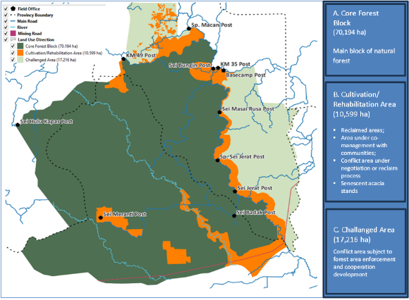
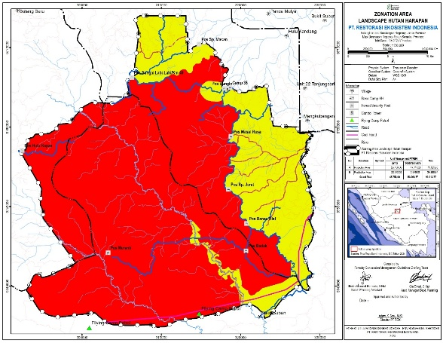
Forestry Concession Management Progres
Strategic Plan
Based on Land Use Management
Land-use Management Direction (100%)
Work Area Arregement (100%)
Based on type management
Based on utilization
Protection Areas
73,689 ha
A
A
C
Production Areas
24,325 ha
B
B
Strategic Plan
Based on Land Use Management
Completed 100%

Slide 4
Forestry Concession Management Plan Progress
Tactical Plan
Based on Area and Time Management
Draft Forest Planning Document UpToDate
Work Area Arrangement Based on time/block/ compartment
Forest Planning Document (In Progress)
Forest and Biodiversity Protection Plan
Rehabilitation and Restoration Plan
Forest Utilization Plan and Business Development plan
Partnership and Cooperation Plan
Conflict Management Plan
Forest Protection
Budget Needed
Output Annual
Result indicator
Forest Utilization
Strategic Program
Duties
Yearly Activities
10 Year Activities
Integrated Program
Component program
Social
Budget Structure
Company
Draft RKUPH

Slide 5
Ten Year Plan (RKUPH) Progress
Operational Plan
Draft RKUPH Revision Completed
RKUPH Revision Progress
Draft Consultation with Ibu Listya completed in October 2025
Land Cover analysis and maps from appointed consultant (Completed)
Updating land cover data to the Work Area Arrangement (Completed)
Updating the Draft RKUPH (in Progress)
Internal meeting for the Draft Revised RKUPH for All Departments (Completed)
Informal meeting with Ministry of Forestry staff to review the draft and ensure completeness before moving on to the next stage (completed)hings
Based on the meeting with the ministry of forestry staff, we need to revised several items
Submission target/ 5 Nov 2025
Submission via online or hard copy depending on direction from Ministry of Forestry
An online process require validation of existing RKUPH that is currently underway in the system (SIPASHUT)

Slide 6
Forestry Concession Management Plan Progress
Operational Plan : RKUPH Revision
Draft RKUPH Revision Completed
Company Identity
Investment Plan
A. General Data
Forest Conditions based on Forest Area Maps
Potential Data
Precondition Aspects
Production Aspects
Draft RKUPH Revision REKI Jambi and Sumsel
Evaluation of the previous RKUPH Plan and Realization
Environmental Aspects
Social Aspects
Developed multi-business
Forest Utilization Business Work Plan
Boundaries
Arrangement of Work Area

Slide 7
