Slide 1

community livelihood development
Patron’s Meeting 5-6 November 2025

Slide 2
Outline
CRMA Update
Livelihoods
  Rubber
  Agroforestry
  3. Capacity Building
  4. Networking with Stakeholders
  5. Health and Education

Slide 3
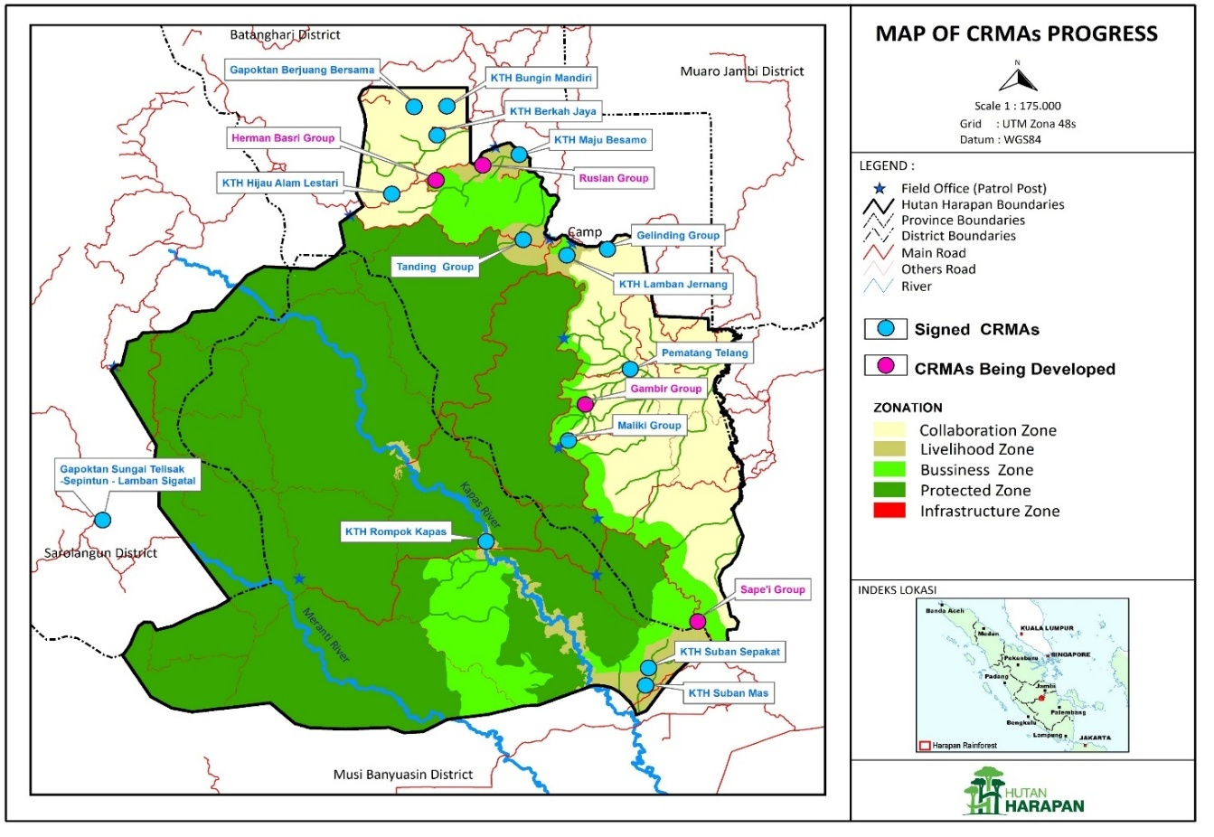
V/CRMAs in Hutan Harapan
There are14 CRMAs totaling 6,169.26 ha with 506 households)
6 CRMAs are being negotiated (77 households)
1 VRMA has agreement, Bungku village
2 VRMAs being explored with villages Sepintun and Sako Suban

Slide 4



CRMA DASHBOARD
BATIN SEMBILAN
Signed CRMAs 6
Participating households: 240
Total area: 5,213 Ha
CRMAS SIGNED
Signed CRMAS: 14
Participating households: 506
Total area covered by CRMAs: 6,169.46 Ha
Migrant and Melayu
Signed CRMAs: 8
Participating households: 266
Total area: 956.46 Ha
CRMAs Under Negotiation
Totals CRMAs under negotiation: 9
3 Batin, 5 Migrant and 1 Melayu
Approximate number of households: 232

Slide 5
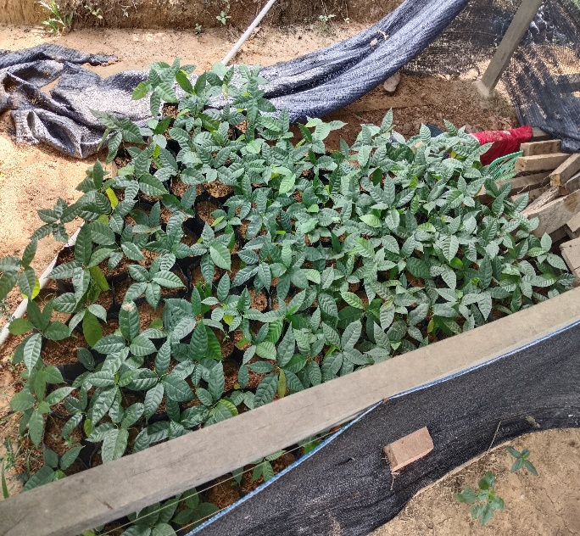
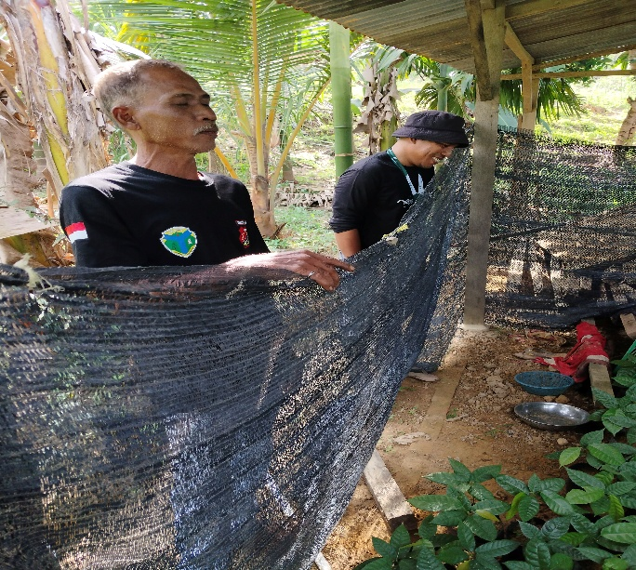
Community Livelihood Development
PT REKI has taken concrete action to empower local communities and help them to become self-reliant.
Key initiatives include:
  Support for community development and respect for community rights, in line the company’s Human Rights policy
  Build community partnerships through the establishment of Village/Community Resource Management Agreements (V/CRMAs) also known as Farmer Group Agreements (KTH) which provide land security
  Support community economic development through establishment of cooperatives, agroforestry, employment as Community Wardens
  Training in Good Agricultural Practices (GAP)
  Financial Literacy
  Promote primary school education
  Promote access to primary healthcare
  Promote reproductive rights
  Promote equal opportunities to men and women

Slide 6
CRMA Update
PT REKI has delayed the signing of two MoUs because it is not clear whether they will be recognized by the government given the existence of the Forest Area Enforcement Taskforce (PKH).
At the same time 5 number of community groups/individuals with 155 households and 688 ha have approached PT REKI enquiring whether they can sign a MoU with the company.
In Tanjung Mandiri where the PKH has declared an area of over 7,000 ha under its supervision, it appears buying and selling of land has declined due to the presence of PKH.
This is not the case however in the north where buying and selling of land is still taking place.
There have been attempts by groups to open land along the coal road.

Slide 7
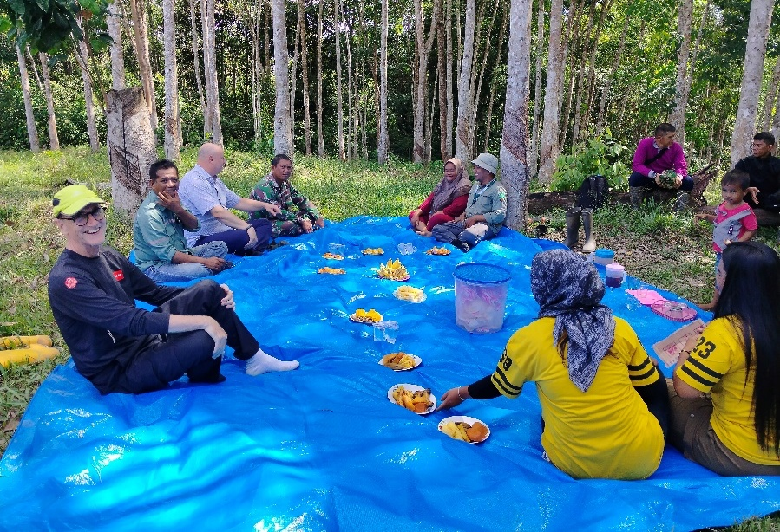
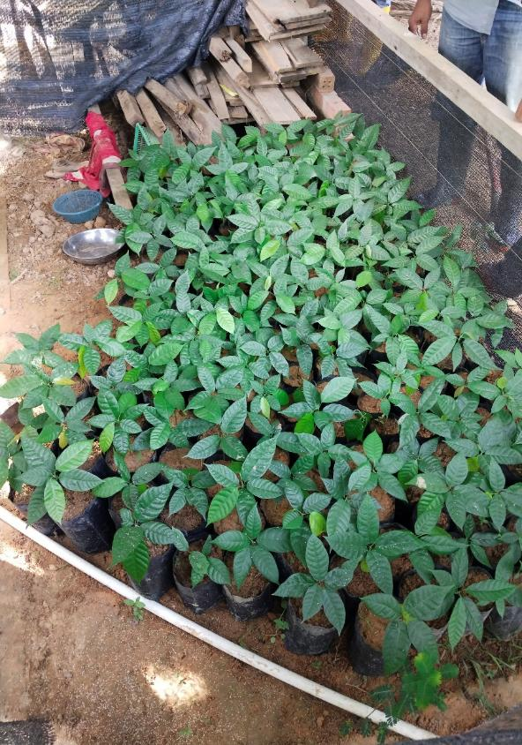
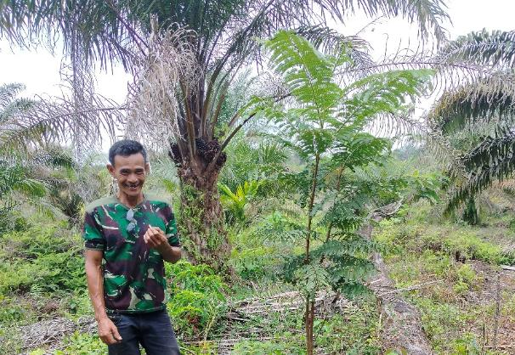
Agroforestry
Number of participating families: 123 Households and 10 Hectares
Types of Seedlings/ equipment's distributed:
2.686 seedlings of Multi-Purpose Tree Species (MPTS) for 47 Households
60 packs of field crops (Palawija Hortikultura) for 16 Households
78 Kg deorub (rubber latex freezer) for 23 Households
Equipment support for rubber culitivation for 28 households
1.614 Kg fertilizer for 9 Household.

Slide 8
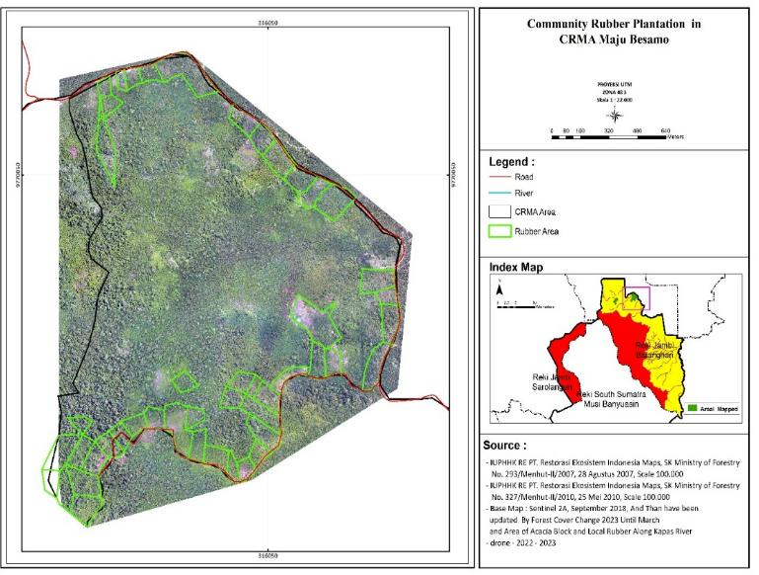
Micro Spatial Planning in the CRMAs
Micro spatial planning process is underway in 4 CMRMAs:
Data analysis and maps of forest cover, rubber plantations and housing areas
Delineation of remaining forest areas based on drone photos as protected zone areas. Garden and bush area as agricultural zone. Residential area as residential zone
Field checks with Team Reki and CRMA members
Agreement on micro spatial planning by CRMA and REKI
Proposal for KLHK approval (RKPS)
Dissemination to all members of the rights and obligations of the zoning.
Build periodic monitoring of the implementation of micro spatial planning.

Slide 9
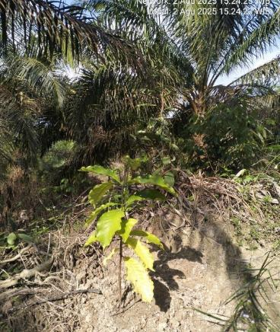
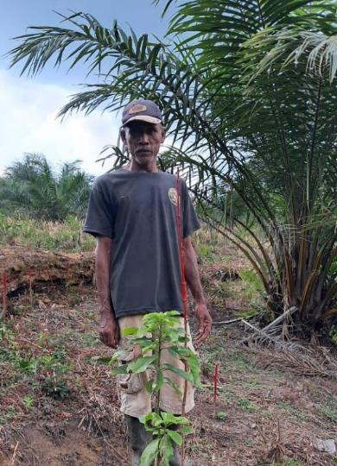
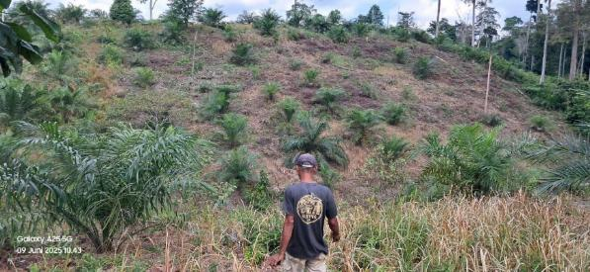
Agroforestry: Transitioning out of Palm Oil
(1) Conversion of palm oil to agroforestry in Tanjung Mandiri with total area of 10 hectares and involving 7 farmers under the Ministry of Forestry’s gradual replacement of palm oil (jangka benah) scheme.

Slide 10
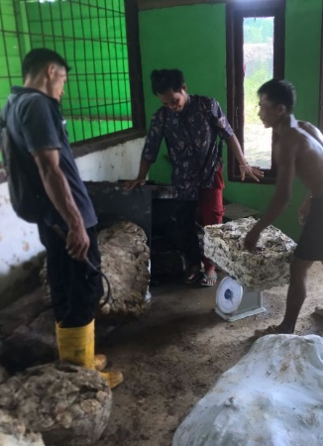
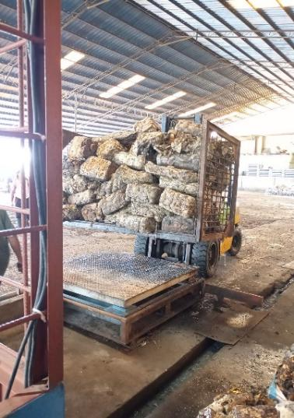
Business unit/Cooperative
Berkah Kunangan Mandiri Cooperative
Cooperative is managed by the members
30 farmers are member of the cooperative
On average 2.5 tons per month are sold to PT. HokTong

Slide 11
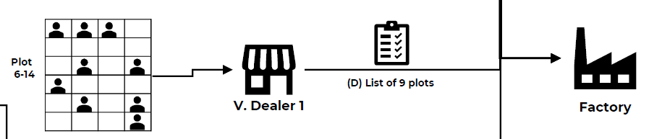

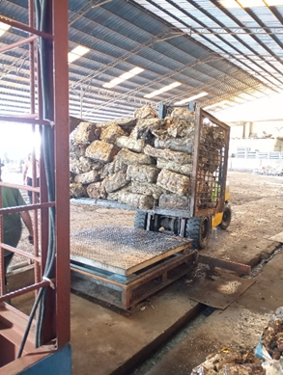
Rubber Supply Chain
Farmers
Cooperative
PT HokTong

Slide 12

Farmers’ Training Dashboard
Good Agricultural Practices (GAP) Training
Clean and Healthy Living Behaviour Training
Women’s Reproductive Health Training
Financial and Adm Training
Cattle farm Management Training
Target: 75 Farmers
Conducted 4 times a year with the same participants.
Target: 60 Farmers
Conducted 4 times a year with the same participants.
Target: 60 Women
Conducted 4 times a year with the same participants.
.
Target: 30 Women
Conducted 4 times a year for the same participant
Conducted 3 times for 3 farmers

Slide 13
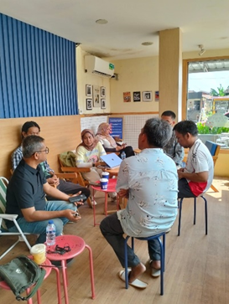
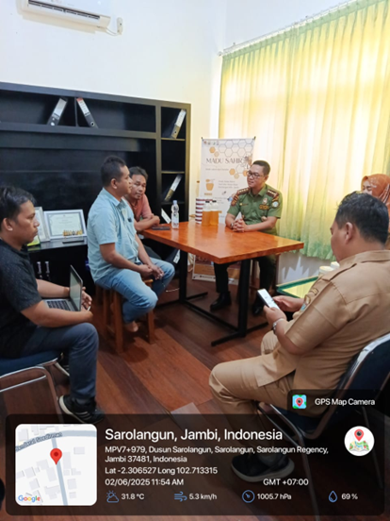
Networking with Stakeholders
Development of a joint plan for Community Empowerment activities with PT MBJ along the coal road.
Collaboration plan with Cappa Keadilan Ecologi to promote village agreements and cooperation through business development in the Besamo MajuForest Management Unit (KTH Maju) and the Sungai Telisak Forest Farmer Group (Gapoktanhut).
Local Governement: Meeting with the Sarolangun Hilir Forest Management Unit (RPHJP) to promote collaboration in the villages of Sepintun and Lamban Sigatal.
Developing financial literacy guide for the Batin Sembilan with finance consultant.

Slide 14
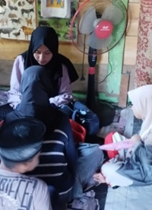
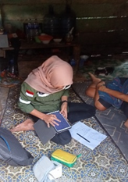
Provision of basic
Health and Education Services
PT REKI is committed to building an enabling environment with communities by investing in:
  Primary health care clinic
  Primary school for Batin Sembilan children
  Financial literacy program
  Reproductive health
  Community outreach to promote clean and healthy living environment.

Slide 15


