Slide 1

1. Human capital & corporate services 2. Digital Technology and data management
Patrons Meeting 5-6 November 2025

Slide 2
PT REKI ORGANOGRAM
RUPS /
Annual General Meeting
(Board of Patrons)
Board of Management
Commissioner
Technical Advisory Board
Director
Site Manager
Department of Planning and Knowledge Management
Department of Human Capital and Corporate Services
Department of Finance and Procurement
Department of Corporate Communication
Department of Forest Restoration and Monitoring
Department of Research and Conservation
Department of Forest Protection
Department of Community Livelihood Development
Department of Corporate and Community Business
Staffs
Staffs
Staffs
Staffs
Staffs
Staffs
Staffs
Staffs
Staffs

Slide 3


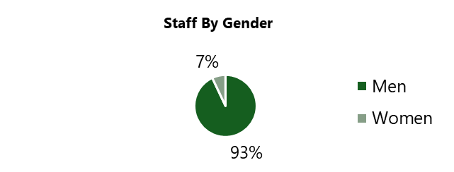
HUMAN RESOURCES 2025
192 Employees 10 Departments
178 Male
14 Female
29 Employees resigned
29 New Employees

Slide 4
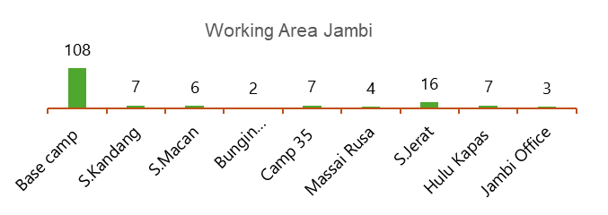

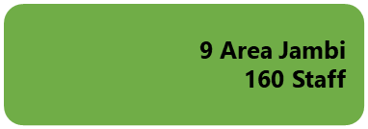
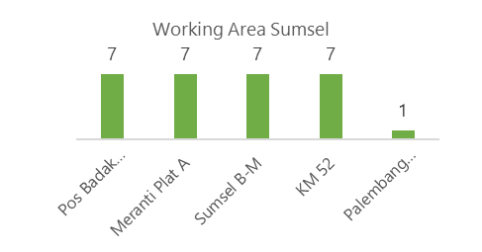

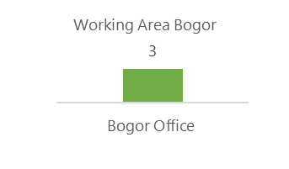

WORKING AREA 2025

Slide 5





Training Dashboard
Employees Trained
Training conducted
in 2025
Training Plan in 2026
Total employees trained 117
Total training hours 462
Negotiation and Mediation
Forest Security Guard
Forest and land Fire Fighting
QSHE Training
Conflict Management
Tax regulation
Community Development
Biodiversity and Carbon Credit
Forestry Technician
Drone Training
Forest and land Fire Fighting
Human-Elephant Conflict Mitigation
Bioacoustic training
Coretax for taxation
Community Development

Slide 6
Environment
Integrated Waste Management (garbage, hazardous materials, wastewater, composting)
Invasive Species
The ESMS Implementation
01
Social
Strategic Community Development Plan
Vulnerability Framework
Security Management Plan
Stakeholder Engagement Plan
Indigenous People Planning Framework
02
The ESMS documents divided into Environment, Social, Governance (ESG).
Governance
Process Framework
Risk Register
Emergency Response Plan
Grievance Mechanism
Human Rights Policy
03

Slide 7
THE ESMS ACTION PLAN 2026
Emergency Response | Grievance Mechanism | Human Right Policy | Integrated Waste Management (IWM)
Purchasing HSE and Emergency response Equipment Conduct HSE and Emergency response training | Update grievance document Regular socialization | Engage with Labor Agencies | Monitor the implementation of waste management Maintenance trace bins, washing facility and generator house Constructing a waste treatment facility Regular socialization

Slide 8
THE ESMS ACTION PLAN 2026
Invasive alien species Mitigation | Stakeholder Engagement | Vulnerability Framework | Strategic Community Development
Reassessment of invasive species threats Maintenance of forest plants on 50 ha of land dominated by invasive species. | Update stakeholder data Maintenance contact with stakeholder as needed | An intensive and long-term integrated empowerment program (food supplies, education, health) | increased household income through the collection of NTFT products, agroforestry, and silvopasture

Slide 9
Grievance Mechanism Update
In The fourth week of May 2025, 1 complaint was received from Mang Pendi’s Wife (one of the communities living in Simpang Roni) regarding the oil palm plantation was destroyed by elephants.
Department Involved in the Investigation/Resolution
Community livelihood and Research and Conservation
Description of Proposed Resolution
Educating them that their plantations should not be planted with oil palms
Educating them that they should not kill or harm elephants.
Conducting them on how to repel elephants from plantations.
Encouraging them to plant crops other than oil palms.

Slide 10
MAINTENANCE INFRASTRUCTURE & FACILITIES 2025
Place | Activity | Results
Post Sei Jerat | Bathroom, casting the floor, making the position of the water tank | Done
Post Bungin | Bathroom and toilet repairs | Done
Post KM32 Fleet B | C | Location Setup
Post Sembilu | Construction | Location Setup
Post Makela | Construction | In PROGRESS
Compost bin processing house | Making steel frame posts and roof | Done
Herbarium | Roof renovation and second floor construction of the herbarium | Done
Camp 35 employee mess | Door, ceiling, bathroom repairs | Done
VIP Building | Ceiling, Roof and Door Repairs | Done
Water Treatment Plant | Steel Frame and Roof Repair | Done
Public toilet Base Camp (Next To The Employee Mess) | Installation of closed, sower, and paint | Done
Mini Gas Station | Addition of a house for filling up mini fuel and installation of a fuel machine | Done
Canteen | Ceiling Repair | Done
Logistics, Transport, Infra & IT office | Office wall and floor repairs | ON PROGRESS

Slide 11
PT. REKI VEHICLE INVENTORY: 2025
No | Type | Year Of Purchase | Rental | Condition
1 | Triton Double Cabin Car Rental (BH 8903 MM) |  | 2025 | Good
2 | Triton Double Cabin Car Rental (BH 8769 BM) |  | 2025 | Good
3 | Triton Double Cabin (BH 8698 MZ)​ | 2024 |  | Good
4 | Triton Double Cabin (BH 8465 MZ)​ | 2024 |  | Good
5 | Triton Single Cabin (F 8110 BF)​ | 2023 |  | Good
6 | Innova (F 1598 AAB)​ | 2019 |  | Good
7 | Hino Dump Truck​ | 2012 |  | Good
8 | Hino Water Truck for Firefighting | 2014 |  | Good
9 | Triton Double Cabin (BH 8057 BN)​ | 2019 |  | To be auctioned (Vehicle no longer operatable)​
10 | Triton Double Cabin (BH 8056 BN) | 2019 |  | To be auctioned (Vehicle no longer operatable)​

Slide 12
GUEST VISITS JANUARY - OCTOBER 2025
Guest List | Gender |  | Amount
 | Male | Female
Government | 83 | 21 | 104
Educational institution | 28 | 26 | 54
Partner | 20 | 11 | 41
TOTAL AMOUNT | 131 | 58 | 199

Slide 13
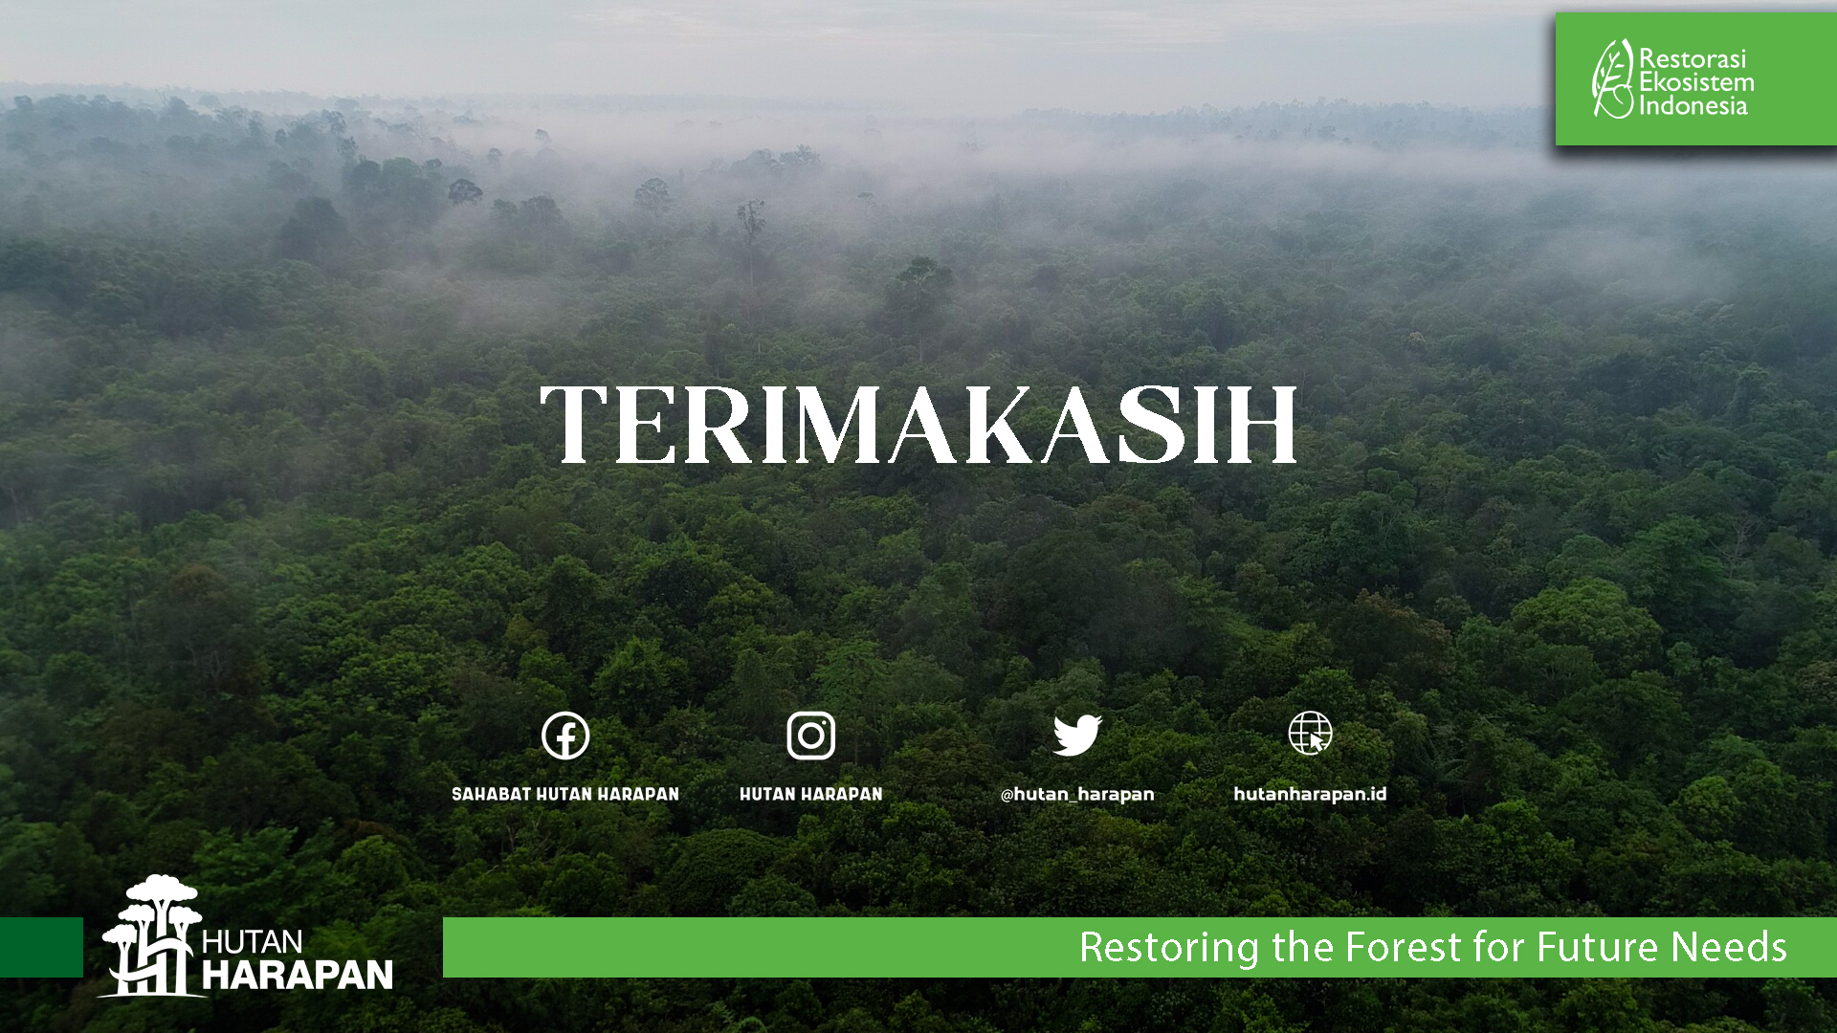

Slide 14

Digital Technology and data management Data Management support

Slide 15
Data Management Framework | Introduction & Framework Overview
Empowering Data-Driven Decisions for Forest Conservation
The Data Management Framework (DMF) provides a structured approach to managing data assets for the organization.
Vision/Mission: Empowering Hutan Harapan’s departments with valid data to accelerate decision-making and advance the company.
Core Business Value: To realize data-driven decisions for a better tomorrow and Hutan Harapan’s long-term success.
Focus Team: The Digital Technology, Data and Knowledge Management Team.

Slide 16
Data Management Framework | Core Components of the Data Management Framework
The DMF is built upon five foundational pillars to support sustainable landscape management:
Policy and Procedure: Developing the data and information strategy, policy, and procedures.
Institutional and Technical Capacity: Strengthening the capacity of stakeholders to be actively involved in data management processes using modern technology.
IT Infrastructure: Provisioning and utilizing the Information Technology infrastructure to operationalize the system.
System Application: Developing and utilizing software to support independent, effective, and efficient data management.
Data and Metadata: Managing data, master data, and metadata according to applicable standards on the data catalog.

Slide 17
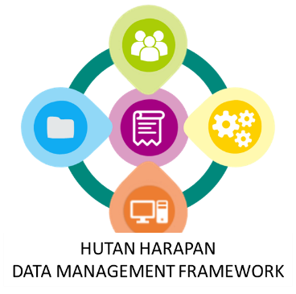
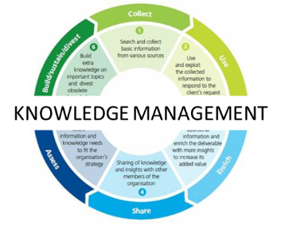
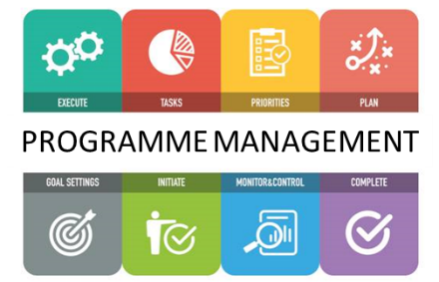

Data Management Framework | Introduction & Framework Overview
ACTIVITY DATA
PROGRAMME/PROJECT DATA
CORPORATE DATA
Data Management System
Knowledge Information System
Programme Management System
Corporate Management System
System Operation Infrastructure

Slide 18
Data Management Framework | ERP System Implementation: Corporate Service Management System (CSMS)
This initiative centralizes and streamlines core business processes, moving the organization toward data-driven operational efficiency.
Feature | Benefit
Centralized Platform | Provides a single source of truth for all corporate data, eliminating data silos and improving accuracy.
Modular Implementation | Initial rollout focusing on Human Resources Information System (HRIS), Finance Accounting System, Assets Management, and Reporting.
Improved Efficiency | Automation of administrative and financial tasks, leading to better productivity and cost-effectiveness.
Enhanced Reporting | Enables faster, more transparent, and accountable financial and operational reporting.

Slide 19
Data Management Framework | Collaborative Workspace Adoption: Microsoft 365 & Google Service
This initiative centralizes and streamlines core business processes, moving the organization toward data-driven operational efficiency.
Feature | Benefit
Unified Communication | Provides professional email, calendar, online storage and collaboration tools for seamless internal and external communication.
Cloud Document Management | Utilizes SharePoint (M365) and Google Drive (GW) for secure, version-controlled file storage and collaborative editing.
Cost Efficiency | Charity License adoption significantly reduces licensing costs while providing access to enterprise-grade tools.
Remote Access & Mobility | Enables staff to work and access files securely from any location, supporting field operations and hybrid work models.

Slide 20
Data Management Framework | Forest Monitoring System Dashboard & Data Repository
The system provides near real-time intelligence for forest protection and manages all conservation-related data assets.
Feature | Benefit
Forest Monitoring Dashboard (Online and Mobile) | A visual, interactive platform for near-real-time forest disturbance monitoring (e.g., hotspots, deforestation), verification, measurement and analysis. Biodiversity monitoring and distribution.
Data Repository (Lumbung Data) | Features Lumbung Geodata (spatial data) and Lumbung Dataset (non-spatial data) to manage data according to applicable standards on a data catalogue.
Real-time Alerts | Messaging Services (Chat Bot/Group Chat) sends immediate alerts on disturbances, accelerating coordination with field teams.
Data-Driven Protection | Enables early detection and rapid response to threats, leading to enhanced forest protection and better resource allocation.

Slide 21
Data Management Framework | Infrastructure Improvement and Connectivity
Critical infrastructure upgrades, supported by partners: KFW, Fujitsu, Burung Indonesia, BirdLife, and RSPB, to ensure system operational stability across the working area.
Feature | Benefit
Increased Capacity | Improvement of server services and storage capacity to reliably host the new ERP and Forest Monitoring Systems.
Extended Network Coverage | Deployment of internet radio WIFI and Radio Towers to ensure internet connectivity and WIFI coverage across key working areas.
Site Connectivity | Coverage extended to remote locations like Simpang Macan, KM 49, and Sei Jerat (including power management with a solar energy system).
Operational Stability | Provides a robust and reliable foundation for all digital systems, ensuring continuous operation of field and corporate activities.

Slide 22
Data Management Framework | Training and Capacity Building
A focused program to ensure successful adoption and utilization of the new systems by all Hutan Harapan member.
Feature | Benefit
Targeted Training | Programs focused on the core modules of the Data Management and Repository, ERP System (Finance, Asset Management, and Human Resources).
Digital Literacy | Training on Microsoft 365, Data Collection for field activities, Camera Trap detection with AI, forest threat with Monitoring Dashboard System and other online collaboration tools to maximize user proficiency.
Institutional Capacity | Strengthening institutional and technical capacity of relevant stakeholders to be actively involved in data management processes.
Maximizing ROI | Ensures the new technology investments are fully utilized, leading to effective and efficient data management and operational processes.

Slide 23


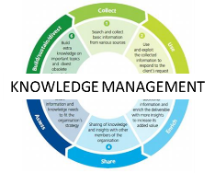

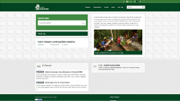
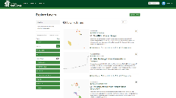




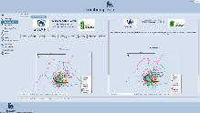



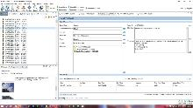



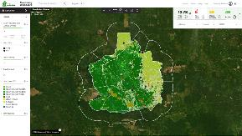
Data Management Framework | Data and Knowledge Management
Data management systems
Acts as the main database, where forest-related data is collected, stored, and managed. It provides baseline data essential for other subsystems.
Data management systems
Messaging services
Utilizes data from the Data Management System to send real-time alerts about hotspots, deforestation, and illegal activities, enabling immediate user response.
Monitoring dashboard
Users verify received data through an intuitive visual interface, monitoring and analyzing forest conditions for initial verification of reports and alerts.
Messaging services
SMART Platform
Spatial Monitoring and Reporting Tools (SMART)
Conducts field checks to validate data. Field teams collect data on-site, which is then fed back into the Data Management System, ensuring a continuous cycle of accurate data.
Monitoring dashboard
Forest Monitoring System - Technical Guidelines | 4

Slide 24

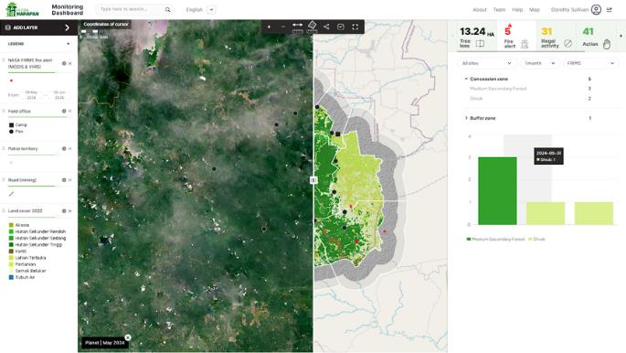

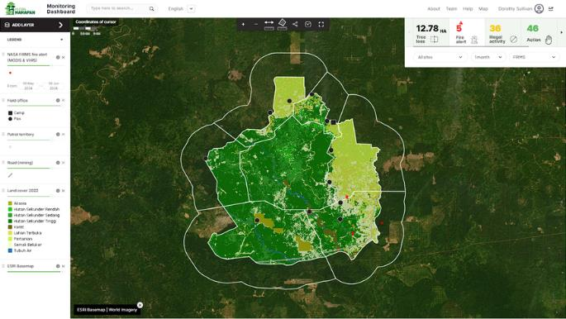


Forest Monitoring System | Monitoring dashboard
The monitoring dashboard is a Web GIS for near-real-time forest disturbance monitoring using high-resolution imagery, radar data, ground patrols, and mobile app integration.
High resolution imagery and radar:
Leverage public satellites data and ground patrol to capture detailed visuals, enabling precise monitoring and assessment of forest cover, health and activity, and empowering stakeholders with actionable insights
Interactive online platform:
Provides a user-friendly interface that can be accessed from anywhere with internet connectivity, providing smooth navigation and comprehensive access to monitoring tools and data, driving an efficient decision-making process
Near-real-time data visualization:
Display key metrics like deforestation alerts, fire hotspots, and biodiversity indicators through interactive manner and allow users to stay informed of important developments and trends, facilitating proactive intervention and resource allocation
Mobile app integration:
Send personalized notification messages about critical events directly to relevant team smartphones using common messaging apps to ensures timely communication of critical events and facilitates rapid response actions

Slide 25
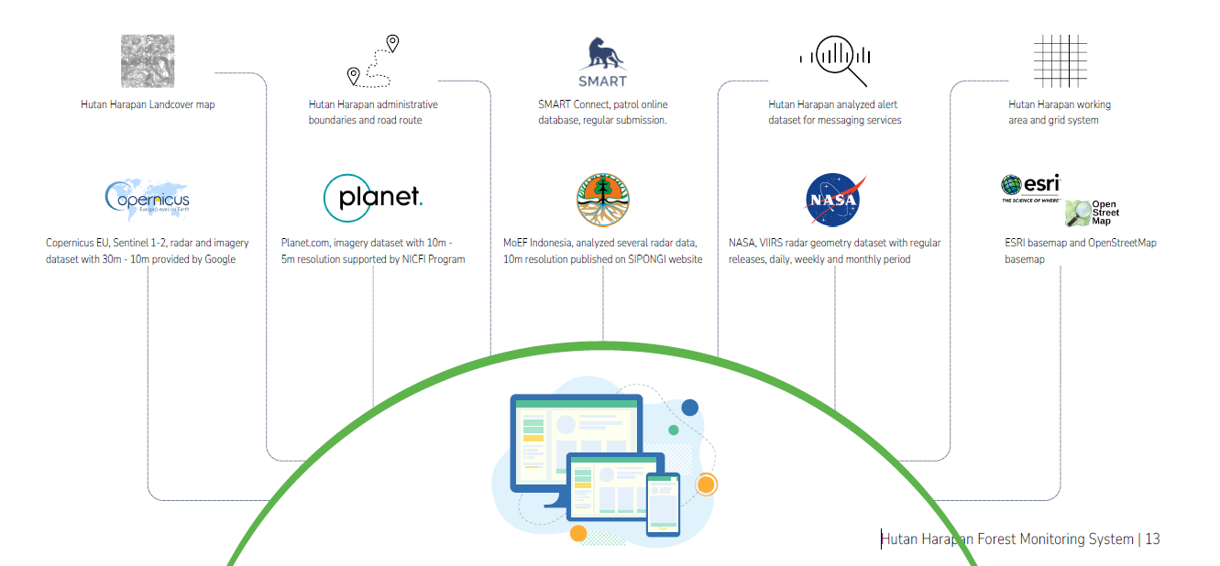
Forest Monitoring System | Data sources
Notes:
The system has not only utilized primary dataset produced internally but also several public datasets accessible online.

Slide 26





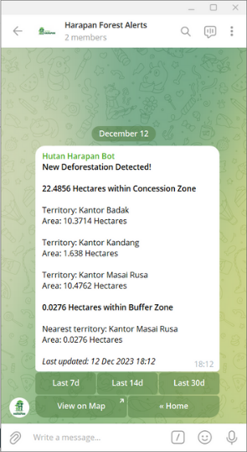





Forest Monitoring System | Messaging services
The Messaging service on Telegram combines chat bot and group chat functions to deliver information on hotspots, deforestation, and summaries of SMART reports on Hutan Harapan.
Fire hotspots:
Receive near-real-time alerts on detected hotspot with notifications cover both concession and buffer zones, ensuring immediate awareness. Explore alert from daily up to 30 days of hotspot history to gain insights into fire patterns
Change/deforestation:
Stay informed of change and deforestation with near-real-time notifications covering concession and buffer zones, providing alert from daily up to 30 days of deforestation history for a comprehensive understanding of land use change
SMART report:
Get a quick summary of SMART's Incident, Observation, and Patrol field reports with information that provide a snapshot of environmental efforts, and review summarized reports from daily up to 30 days for trend analysis and insights
Chat box:
Communication media between the Operation Team and Field Team to inform forest disturbance events in the field and coordinate prevention, control, and rapid response efforts

Slide 27
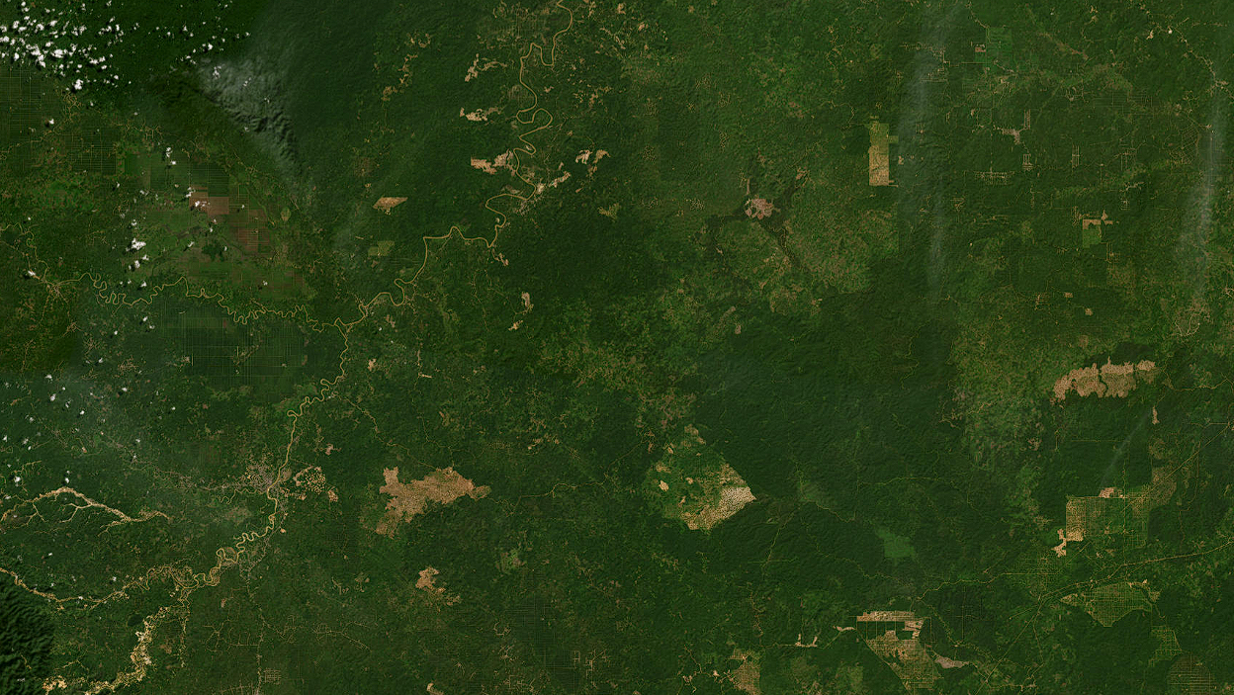



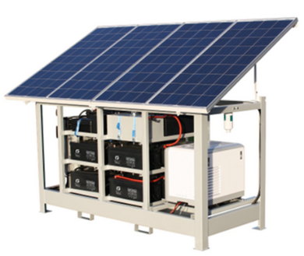
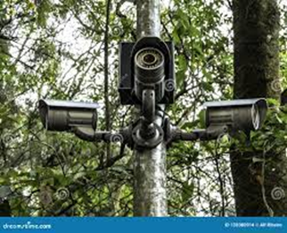
Site management approach | Data interconnection
Post - Sei Bungin
Working Area Interconnection:
Internet radio WIFI for each site.
Power management with solar energy system
Radio tower
Surveillance (*)
Working Area:
Bungin Area
Kandang Area
Meranti Area (*)
Bato Area (*)
Badak Area (*)
Jerat Masai Rusa Area (*)
Hulu Kapas Area (*)
Post - Simpang Macan
Post - KM 35
Post - KM 49
Kandang
Bungin
Basecamp
Post - Sei Hulu Kapas
Post - Sei Masai Rusa
Hulu Kapas
Masai Rusa
Post - Simpang Sei Jerat
Bato
Post - Sei Jerat
Badak
Meranti
Post - Sei Badak
Post - Sei Meranti
Hutan Harapan Forest Monitoring System | 14
Notes:
Forest Monitoring System need an infrastructure support to streaming the information into targeted audience and supported by team on the field.

