Slide 1
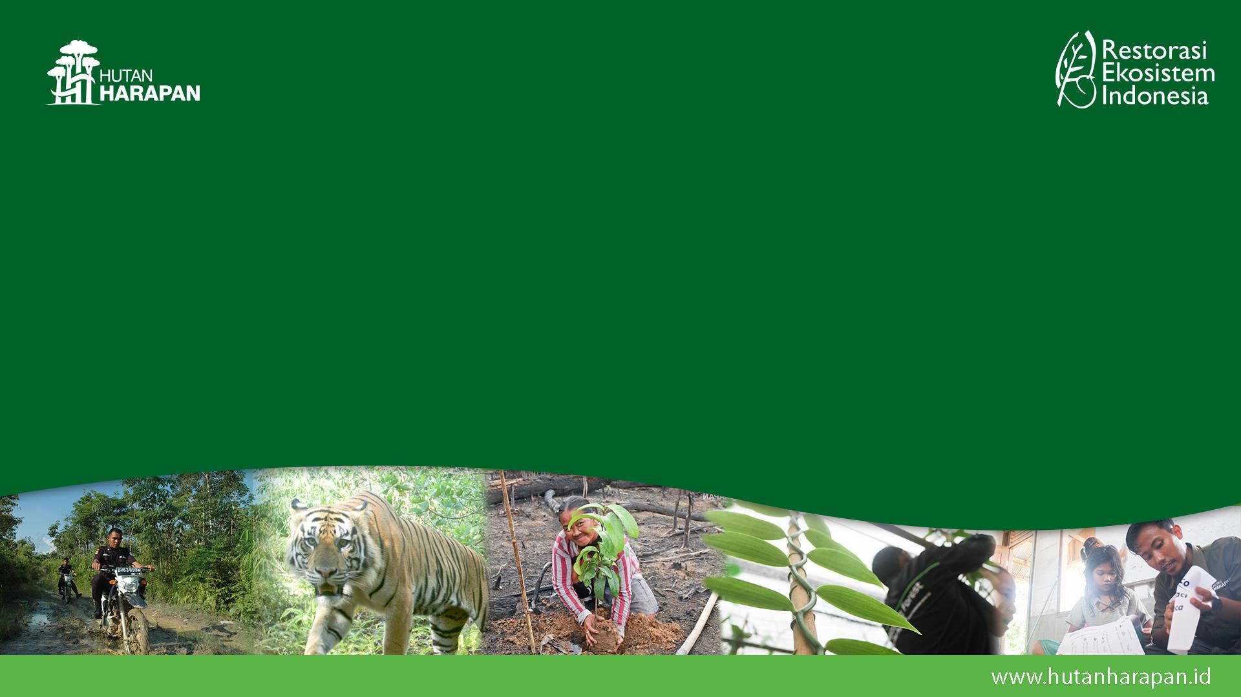
CORPORATE BUSINESS UPDATE
2025
Presented to BOP Meeting 5-6 Nov 2024

Slide 2
Outline
Business Update
Commodities Development (Jan – Sept 2025)
Vanilla
Challenges
Follow up

Slide 3
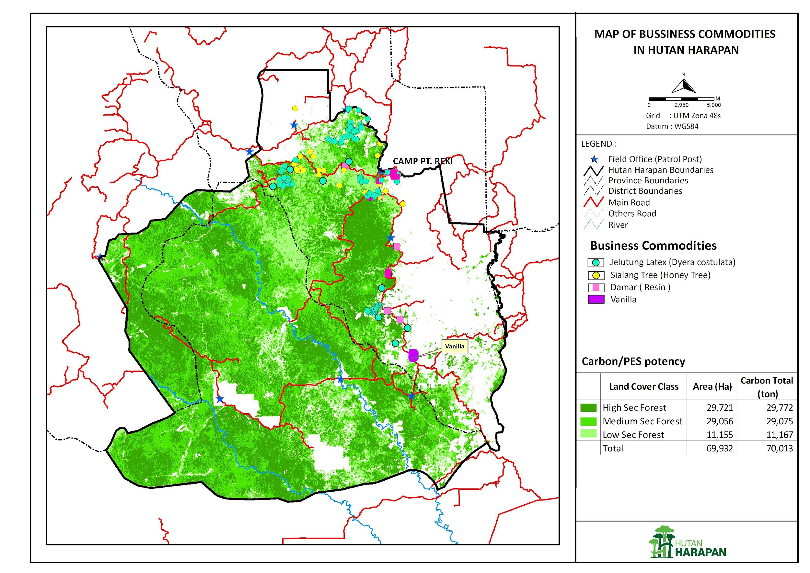

Slide 4
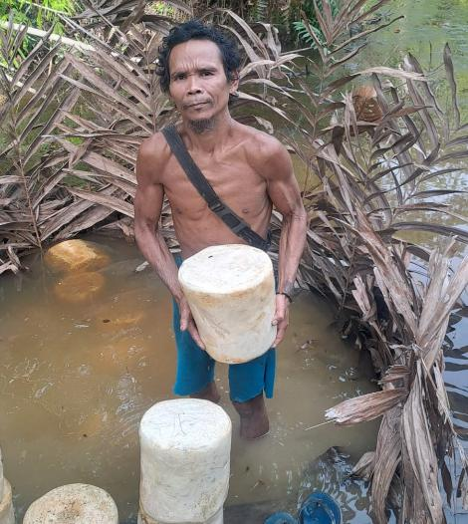
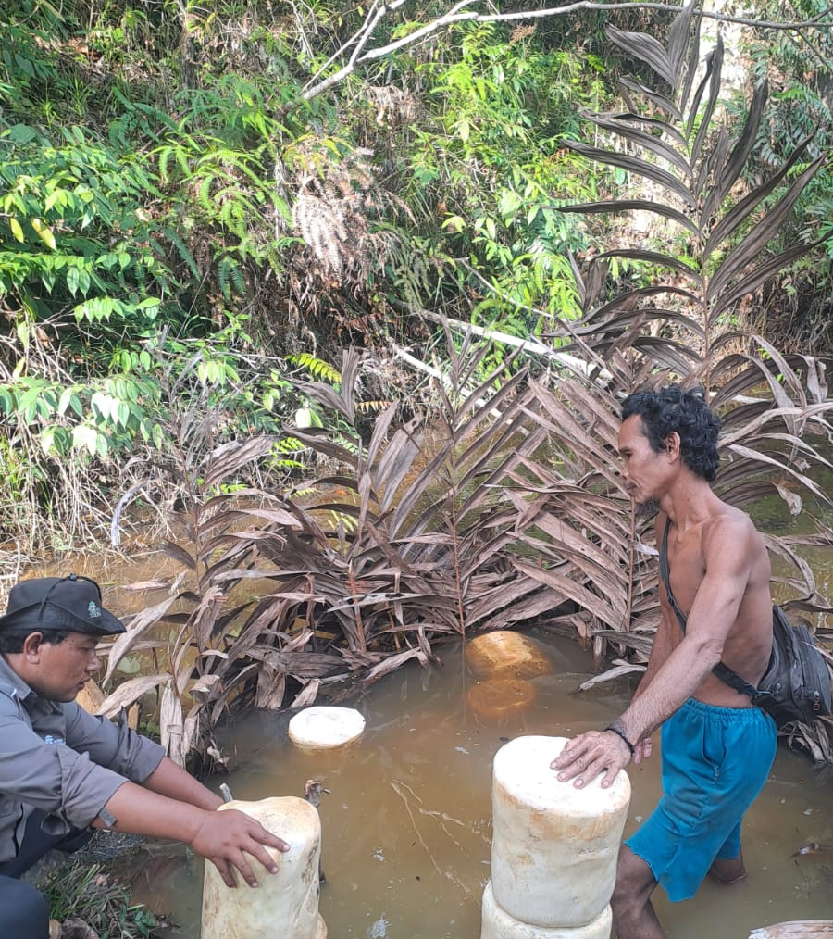
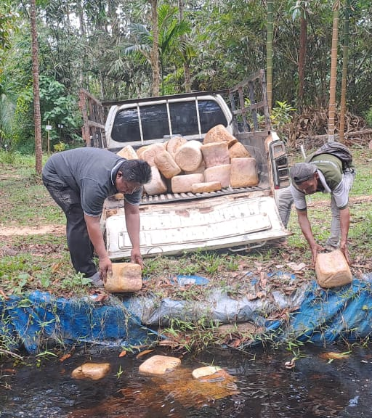
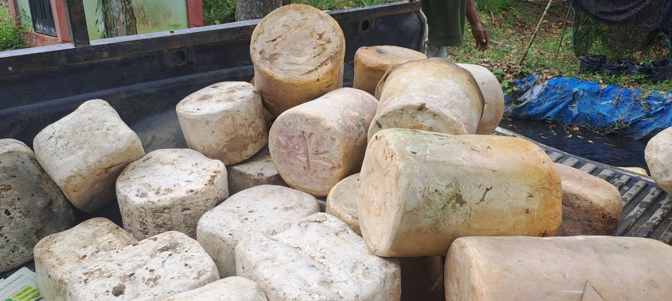
Summary of 5 Commodities Activities

Slide 5
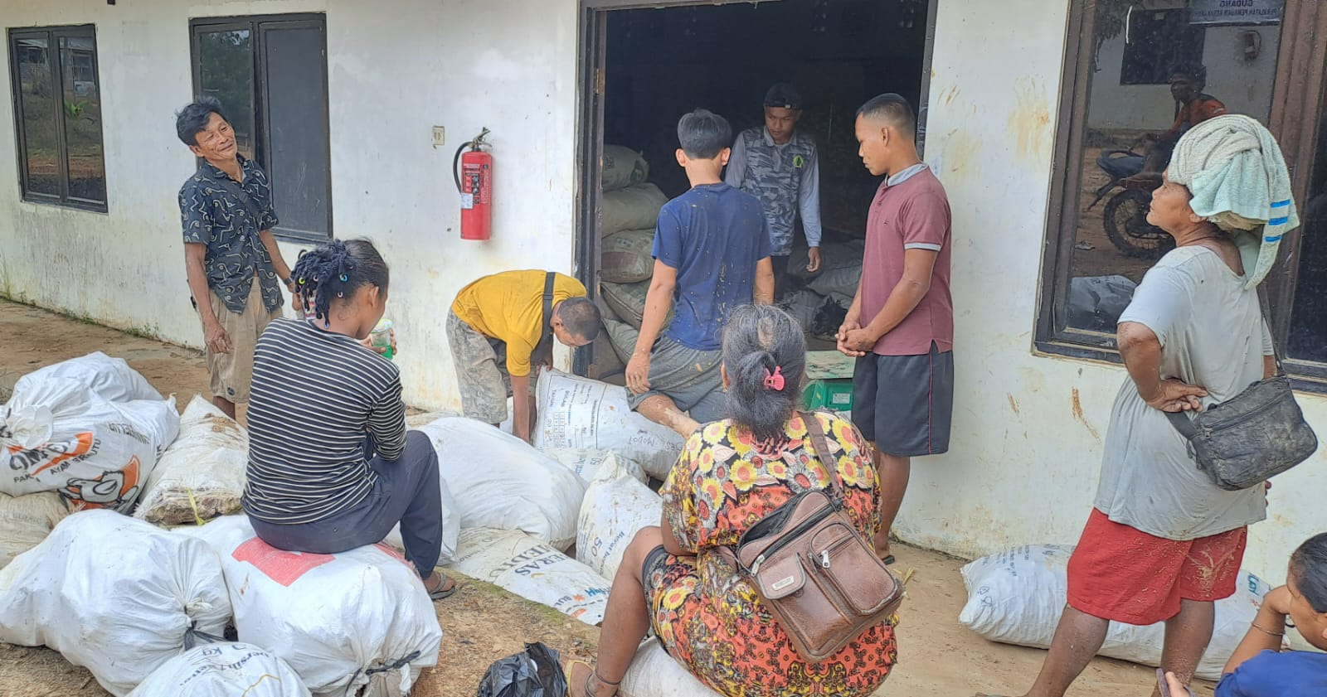
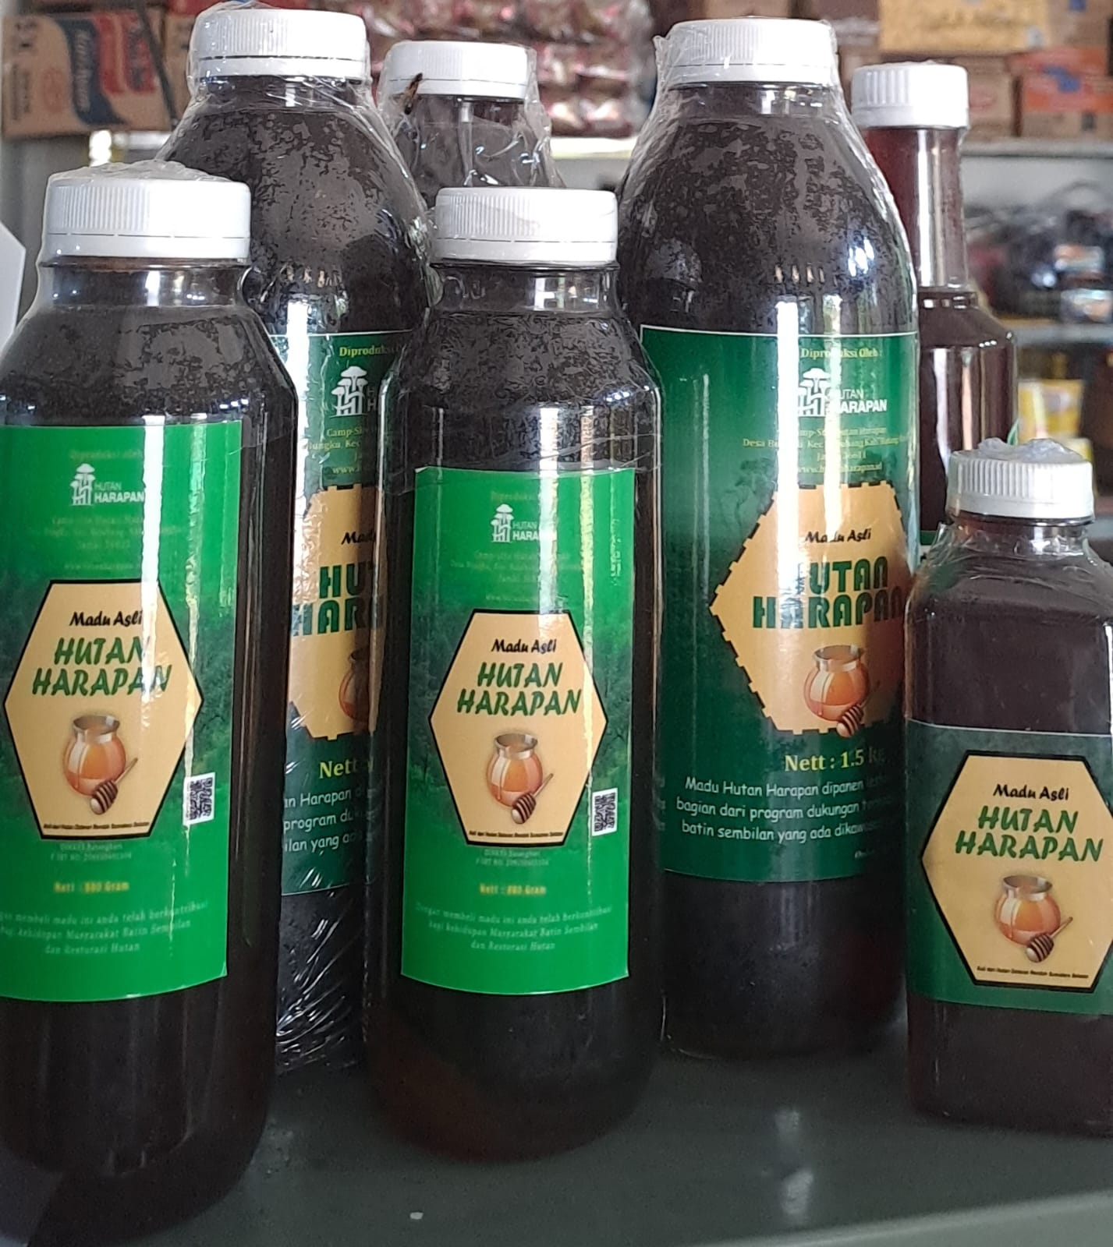
Business Update
Resin, Jelutong Latex, Pinang & Honey:
Resin : In September 2025, we have collected over 8 tons gross of resin, 6.5 tons of which have been sold.
Jelutong : It is estimated that 1.5 tons of jelutong can be collected by the end of 2025. Through increased capacity and proper monitoring, we are targeting a minimum annual collection of 4 tons of jelutong latex.
Next year, we will maximize the collection and collection of Resin, Jelutong, Areca nut, and Gambier, establish standard operating procedures (SOPs) for collection, and find appropriate markets.
Income from Resin, Jelutong (latex) is small but provides cash for communities. Resin and Jelutung are important sources of income for the indigenous people of Batin Sembilan.
Honey production started in early 2024, and REKI purchased 1500 kg of honey to bottle and sell. Honey is processed to reduce the water content from 27% to 20–18%. Marketing is carried out through direct marketing, social media, and exhibitions and bazaars. During 2025, 190 kg were sold.
The store and canteen generate the most income at present. Providing logistics to support field activities, employees and the surrounding community.

Slide 6
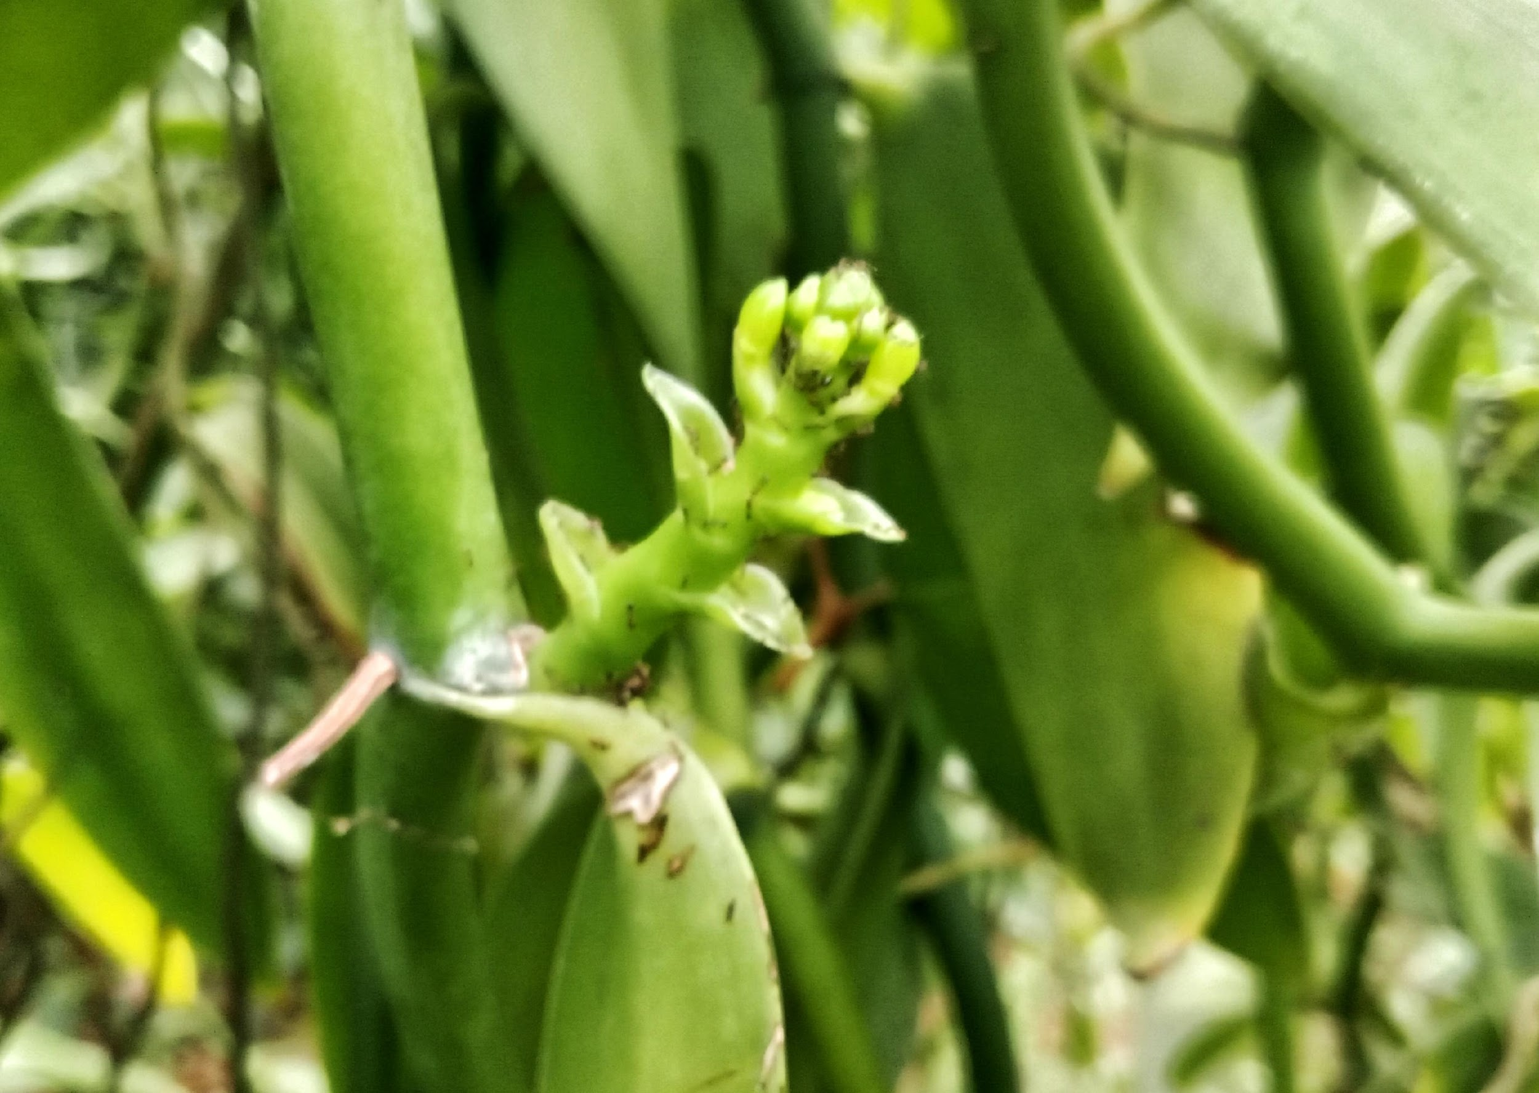
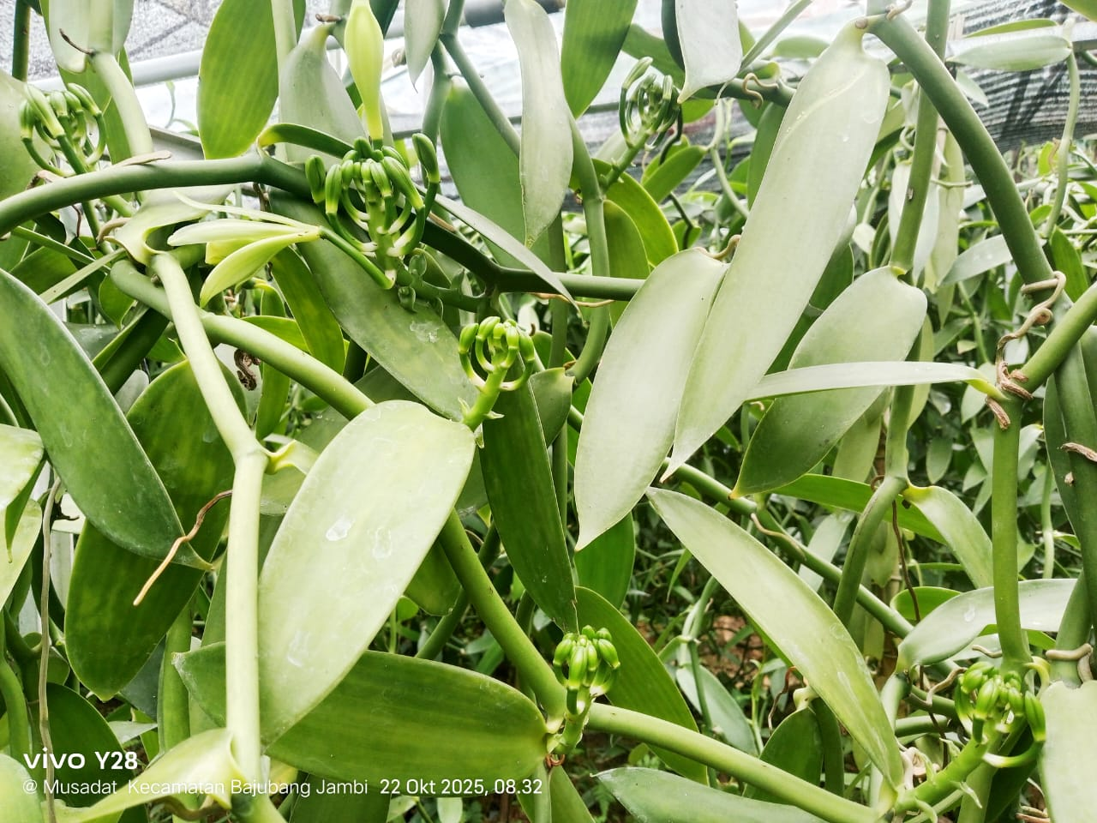
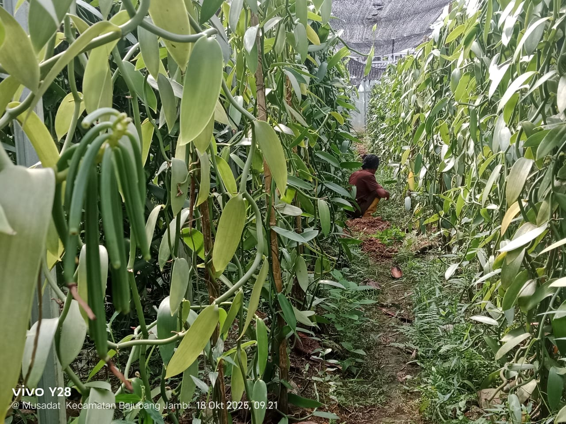
Vanilla Update
Vanilla plants began planting in 2021 in the REKI area and continue to be developed in several planting locations: shade house plots, revitalization blocks, and the Basecamp area. Total number of vanilla plants is 20,030, covering a land area ​​4.65 hectares.
In 2024, several plants start to flowering and bear fruit, the team carried out the pollination process and harvest in April 2025 was 800 grams (30 bunches of fruit), the size of the fruit was not the same.
Team capacity building: From April 9-15, 2025, training was provided on cultivation and post-harvest processing of vanilla, then in July the team implemented the plant stressing process in shade house and revitalization development block.
In September – October was 30 flower stalks appeared and 5 of the stalks have been successfully pollinated. Most of them are still under monitoring and waiting for the flowers to bloom.
A revitalization of vanilla cultivation of 3 ha in Sungai Jerat was carried out with funding support from KADIN for 10 months, and continued support using PBI - MBJ 2025 budget until the end of 2025

Slide 7
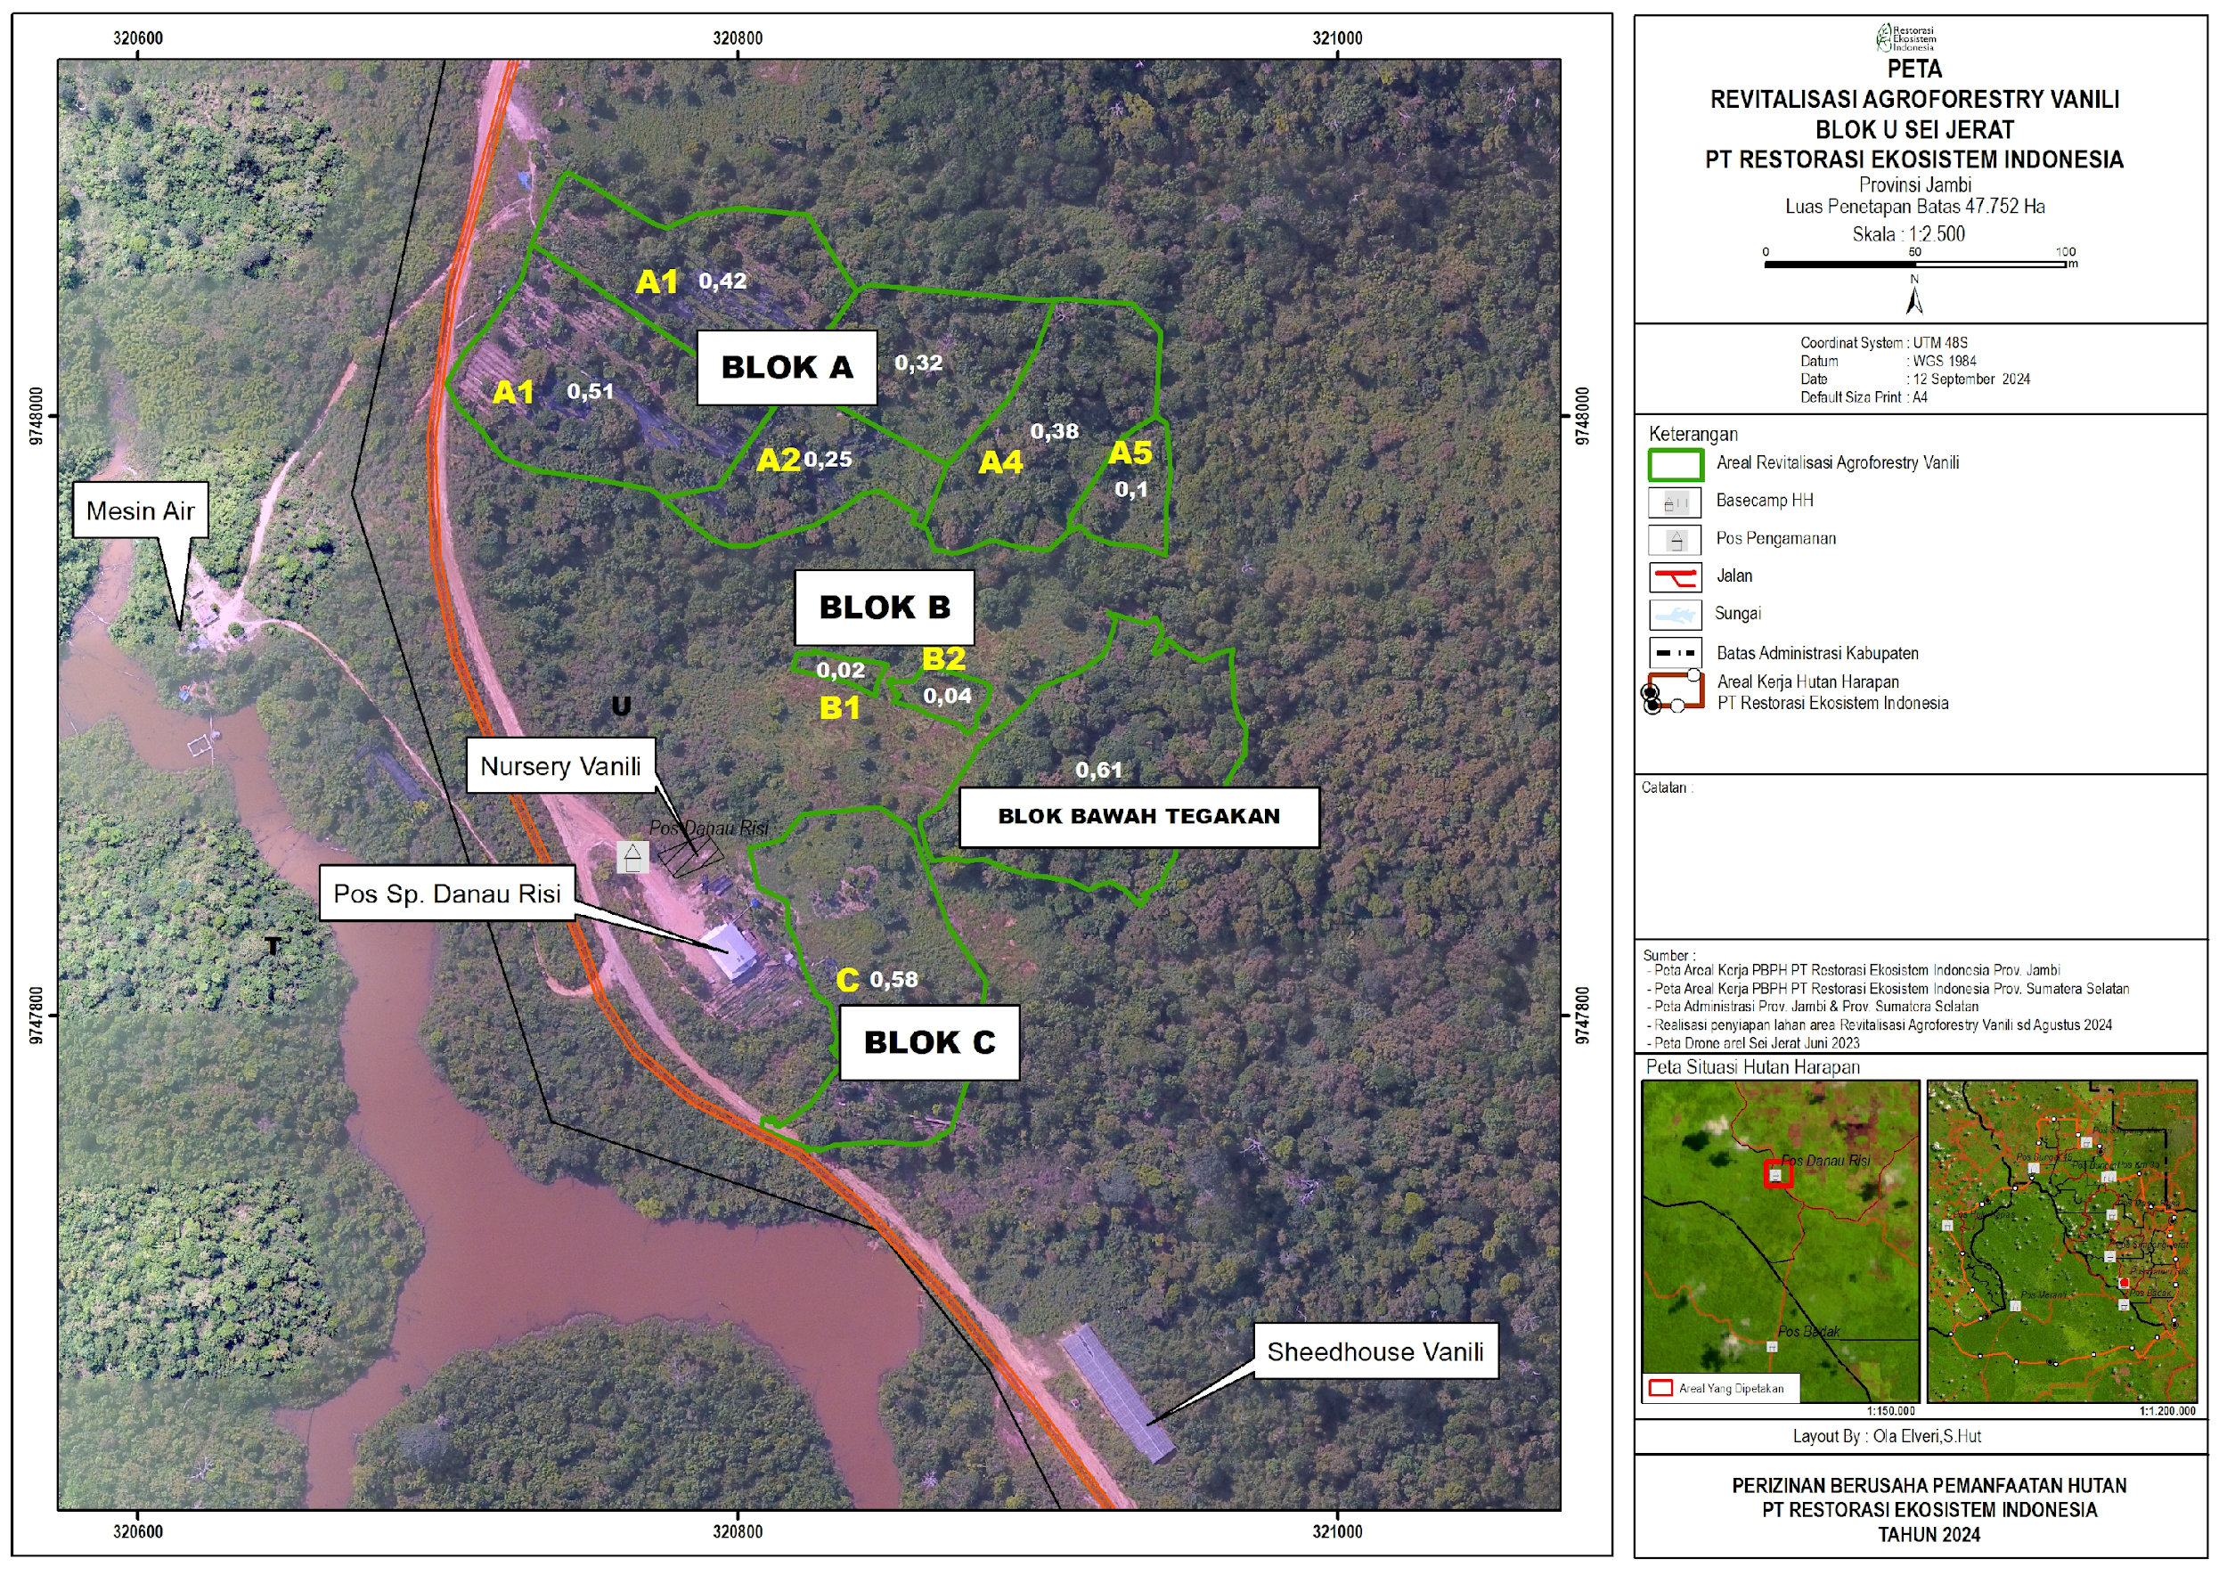
An existing 3,67 Ha Vanilla Agroforestry divided into 4 Block A, B and C.
Block A : 1,98 Ha
Block B : 0,06 Ha
Block C : 0,94 Ha
Basecamp Area 1,0 Ha

Slide 8
Vanilla Update
BLOK | Planting area (Ha) | Planting year | Number of Vanilla Plants | Remark
Shade House | 0,05 | 2021 (April ) | 352 | Vanilla grew well, in 2024, several plants began flowering, yielding 800 grams. In July-August 2025, we carried out stressing process. Some vanilla plants flowered in September. Observations through October identified 30 flower clusters. Some flowers have been pollinated. the fruit can be harvested in 9-10 months.
T11 & T12 |  | 2021 (July) | 240 | Currently, plant growth is quite good compared to the initial planting period. This year, only 41 plants were identified as mature enough to flower and suitable for the flowering stimulation process, but as of October 2025, only two stems had emerged. Most of the plants are still in the vegetative growth phase. The plants are expected to enter the fruiting period in 2027.
BLOK A | 1,98 | 2023 (Februari) | 12.926 | Planted in stages, currently the plants are growing well, the plant is 2 years old, it is estimated that the plant will start bearing fruit in mid-2027.
BLOK B | 0,06 | 2023 (September) | 2.312 | The plants are growing well, it is estimated that they will start bearing fruit in mid-2027.
BLOK C | 0,58 | 2024 (Februari) | 2.200 | The plant is growing well, currently the plant is < 2 years old. It is estimated that in 2028 when the plant is 4 years old, will start to bear fruit..
Base Camp | 1 | 2024 (Februari) | 2.000 | The plant is growing well, currently the plant is < 2 years old. It is estimated that in 2028 when the plant is 4 years old, will start to bear fruit.
Total tanaman | 3,67 |  | 20.030

Slide 9
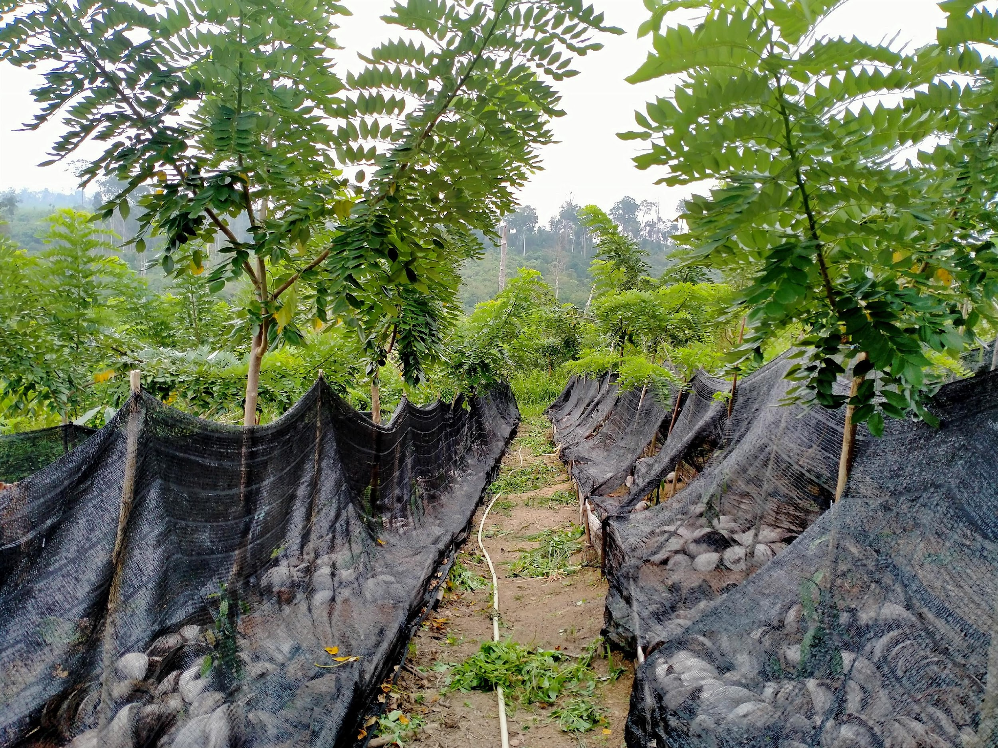
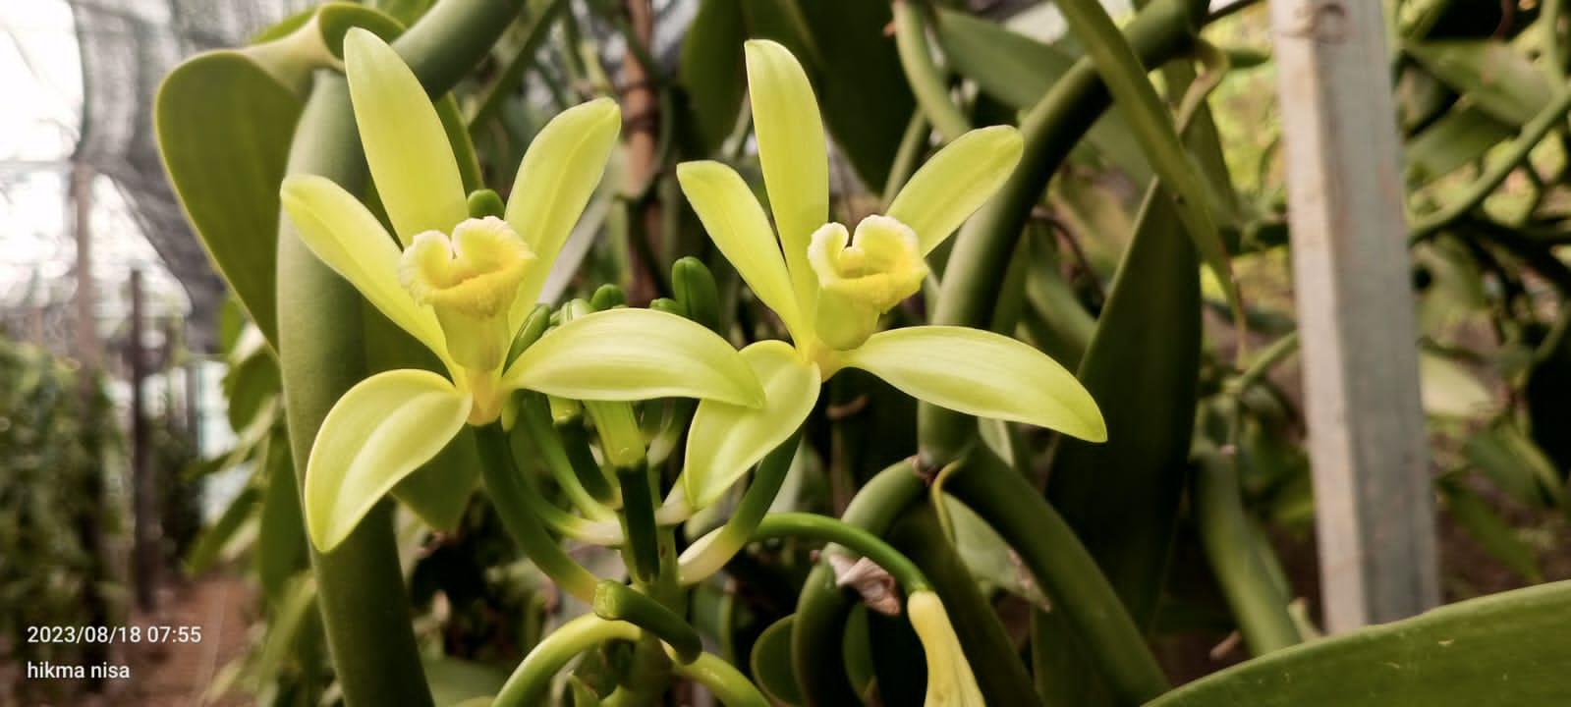
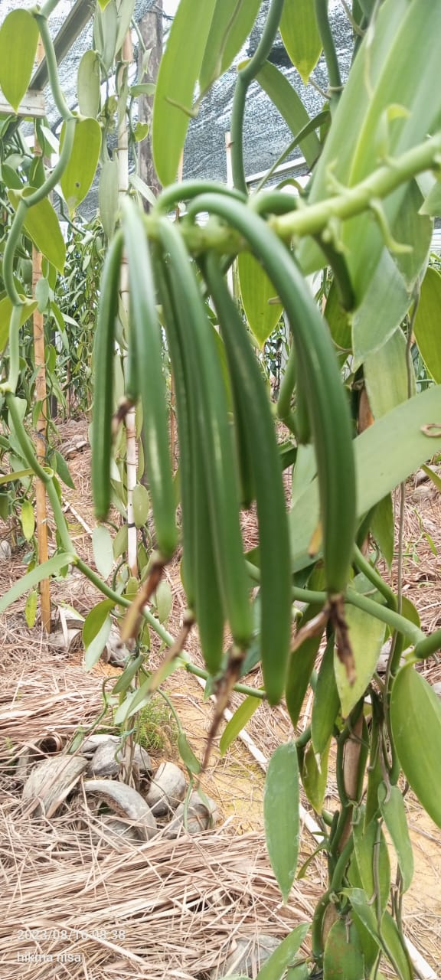
Vanilla update
  In June 2021, a revitalization of vanilla cultivation of 3 ha in Sungai Jerat was carried out with funding support from KADIN continued support using PBI - MBJ 2025 budget until the end of 2025. Targeted activities included:
    Strengthening & repairing / processing of gamal & vanilla growing places,
    Increasing staff capacity in mastering plant cultivation knowledge
    Routine maintenance of vanilla and gamal,
    Field supervision in optimizing the management of Vanilla plant cultivation
    In July 2025, flower emergence stimulation was carried out on 41 plants which were indicated to be sufficiently mature.

Slide 10
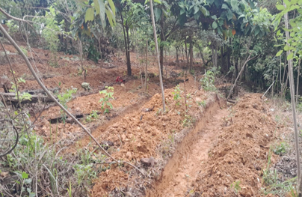
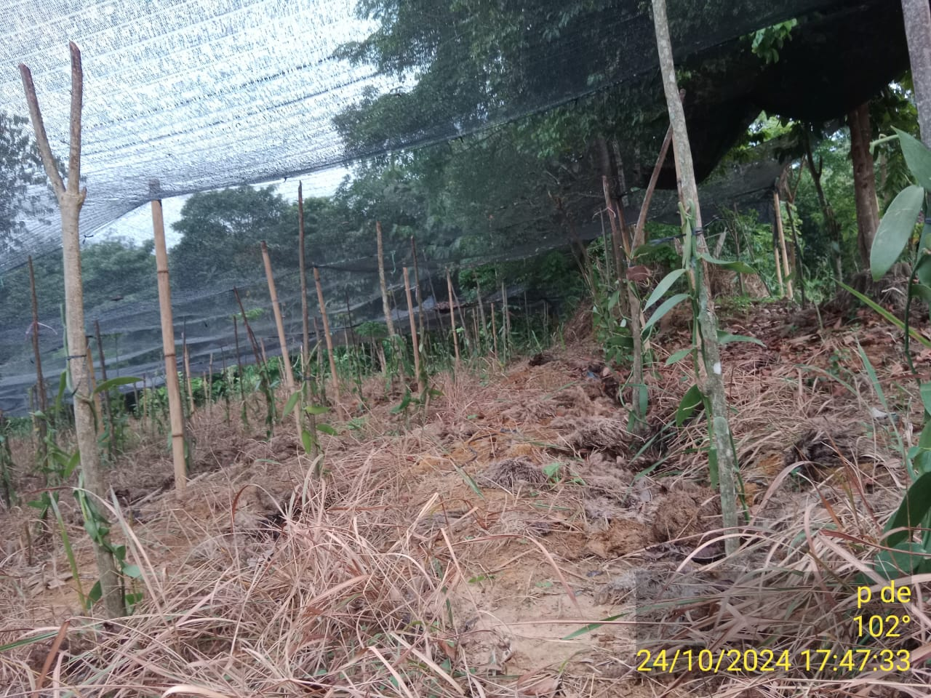
Activities of Revitalization of an existing 3-ha Vanilla Agroforestry site
Land Clearing and Repairing growth places
Land clearing has been carried out for 2.6 ha out of 3 ha targeted. Vanilla consultant have Provide the following recommendation for land preparation :
Repairing of gamal & vanilla growing places with making a trench.
Filling the trench with dolomite and palm empty fruit bunches.
Changing the location of vanilla growing places from top the trench.
Adding shading net for open areas to reduce direct sunlight to the vanilla.
Creating a map of vanilla planting blocks to facilitate monitoring.
Replanting Gamal and Vanilla
Replanting Gamal has been completed
Replanting Vanilla has been carried out: 10. 745 Vanilla stalks out of 15.000 Vanilla stalks and completed by end of November 2024 in Sei Jerat Area
Vanilla development has been carried out in the basecamp area since 2024, currently the total area more or less 3.67 ha and the total number of plants is 20,030 plants.
Successful growth rate of 90 %

Slide 11
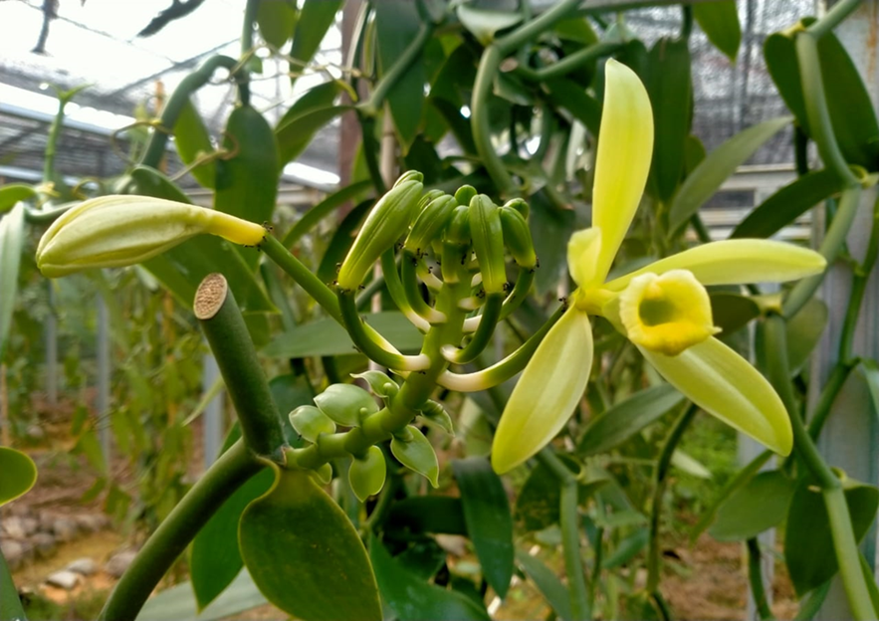
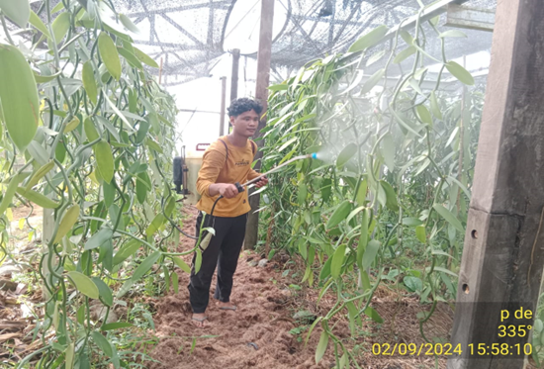
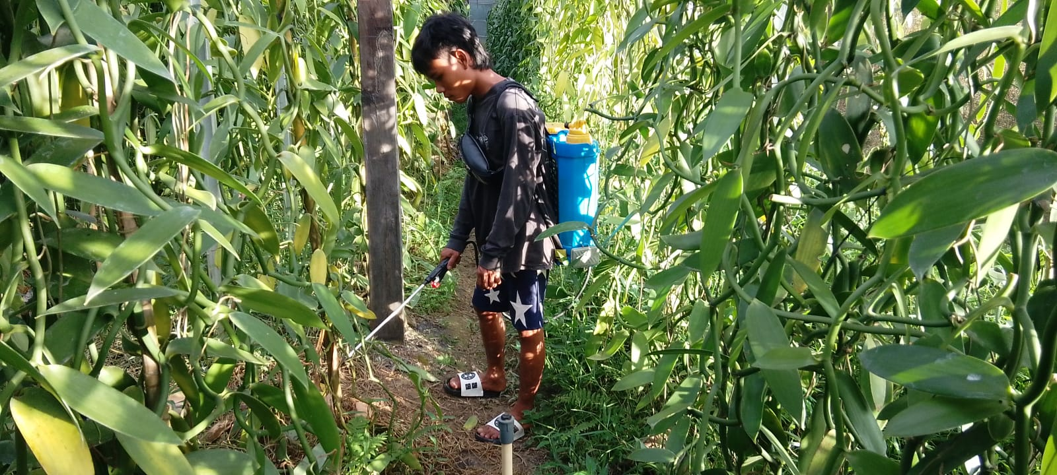
Summary of Revitalization of an existing 3-ha Vanilla Agroforestry site
Harvesting
Vanilla harvesting had already been carried out on 307 sticks before the revitalization initiative has commenced.
Stressing and pollination is carried out on vanilla that is > 3 years old and has large and healthy stems.
Stressing and pollination which is currently carried out on 3 cluster, Block A 32 stick, Blok B 23 stick and shade house 30 stick
Shade House
Maintenance of Vanilla in shade house are controlling pest and diseases by implementing organic pesticide (biofolan), routine fertilization every three months and watering every afternoon in the dry season.

Slide 12
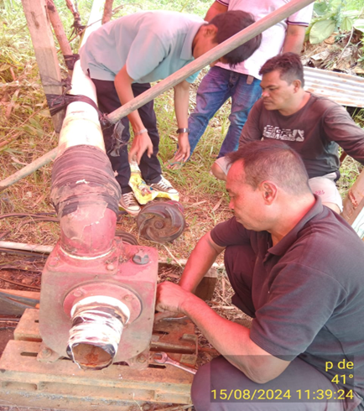
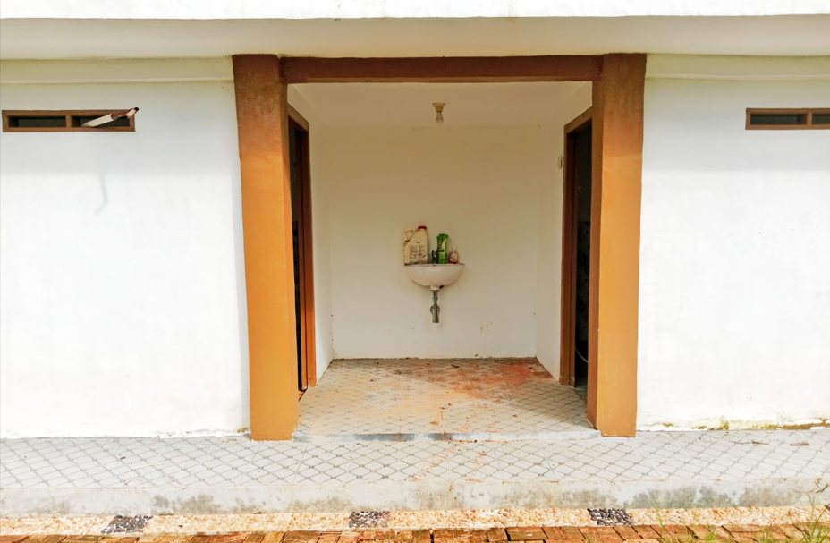
Summary of Revitalization of an existing 3-ha Vanilla Agroforestry site
Irrigation repair
1 unit of water machine house, 2 unit of water machine and 1 unit tube (tedmon) is available for watering vanilla
The pipes that convey water from Lake Risi to vanilla block are working well.
Renovation of Working Pos and Warehouse
Construction of 2 toilet units for working post has reached 100% (construction of walls and casting the deck is complete).
The construction of 1 warehouse unit (6 x 3 meters) is in progress.

Slide 13
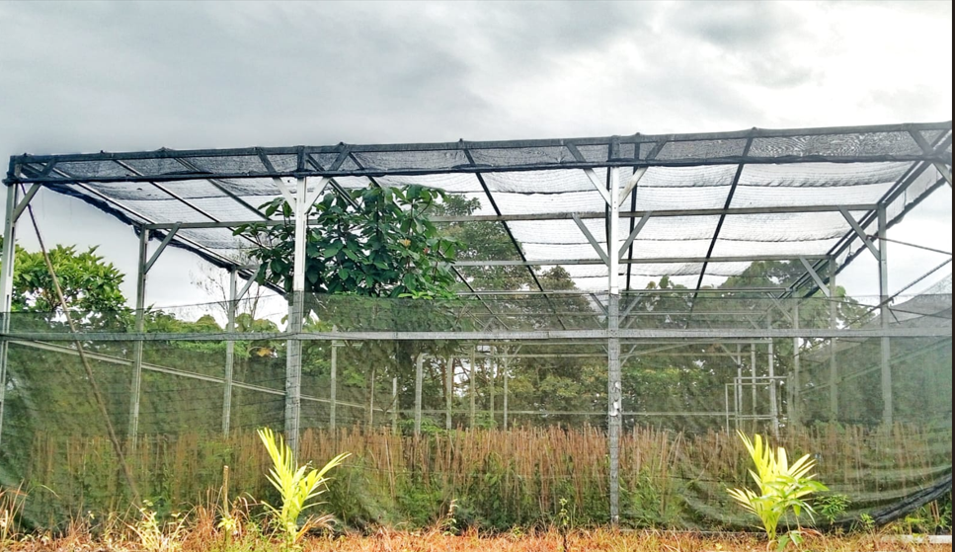
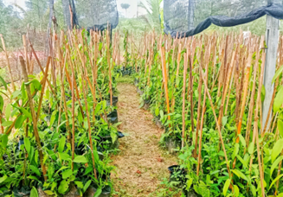
Summary of Revitalization of an existing 3-ha Vanilla Agroforestry site
Vanilla Nursery
Construction of 1 unit of nursery has been completed (10 x 18 meters) with 2 water pipes for watering the seedlings.
Vanilla Nursery
Filling soil into polybags as media for planting vanilla seedlings has been carried out for 5.000 polybags (completed)

Slide 14
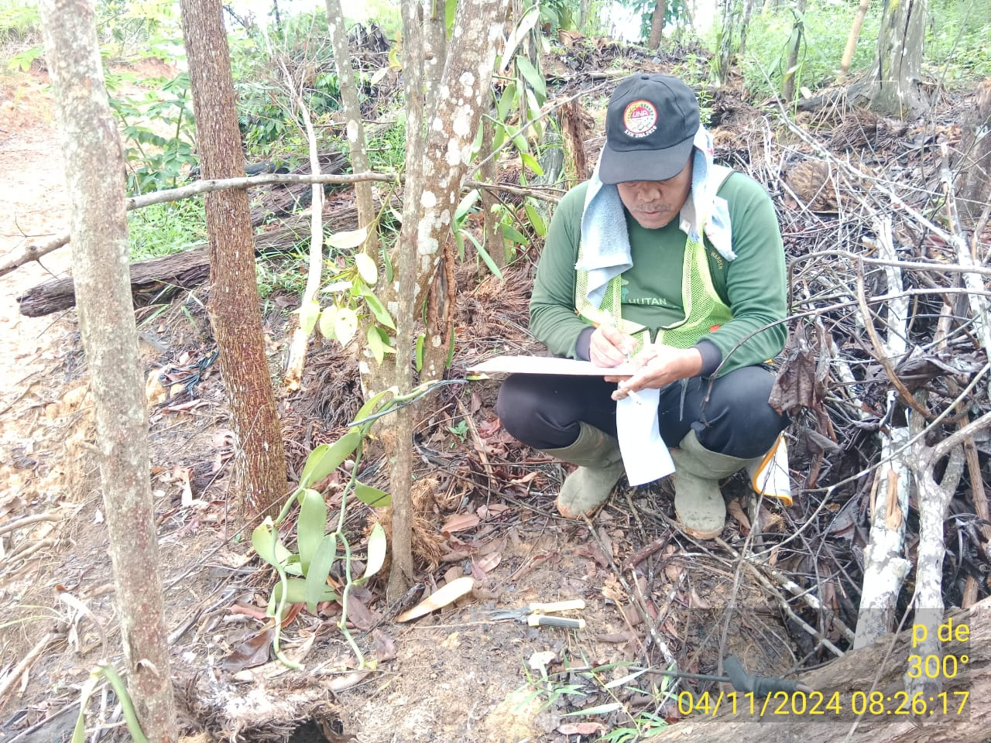
Summary of Revitalization of an existing 3-ha Vanilla Agroforestry site
Growth Montoring
Vanilla growth monitoring training has been carried with coaching one on one by R&D staff. The Kobo Toolbox application has also been used to collect the vanilla growth data.

Slide 15
Vanilla Fermentation Training in Hutan Harapan

Slide 16
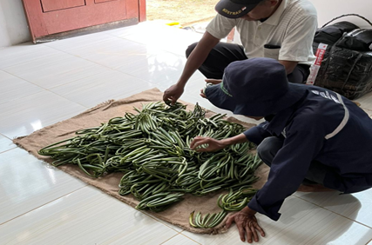
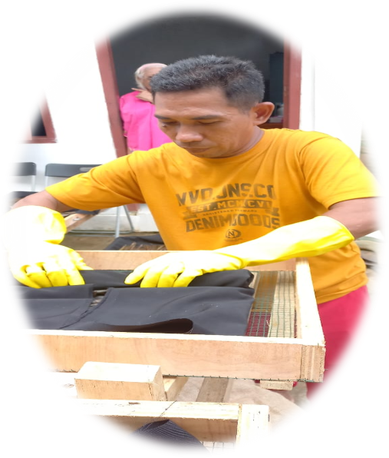
Fermentation Update
Vanilla fermentation training was conducted in April 2025 with the Business Department staff by Ibu Nuning.
The total amount of vanilla purchased was 70 kg. The first purchased of 40 was fermented without training, whereas the second purchased of 30 Kg was fermented following the proper procedure.
The fermentation process is complete, with 10 kg of vanilla (Grade A = 1 Kg, Grade B = 1 kg, the rest are grade C and D)

Slide 17
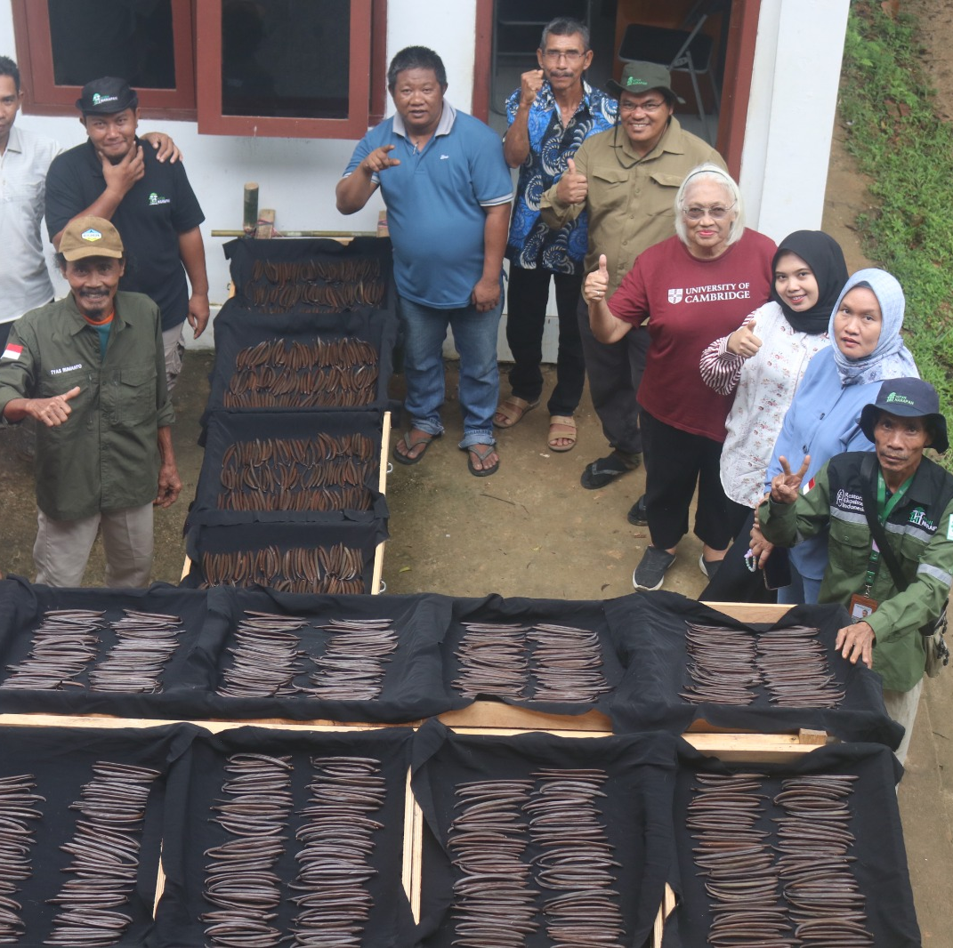
Challenges in the fermentation process
The vanilla beans purchased were not mature enough to be harvested, so the fermentation results were not optimal.
The rainy season during the drying process resulted in suboptimal drying.
The daily room temperature data for the fermentation process is not yet in accordance with the theory.

Slide 18
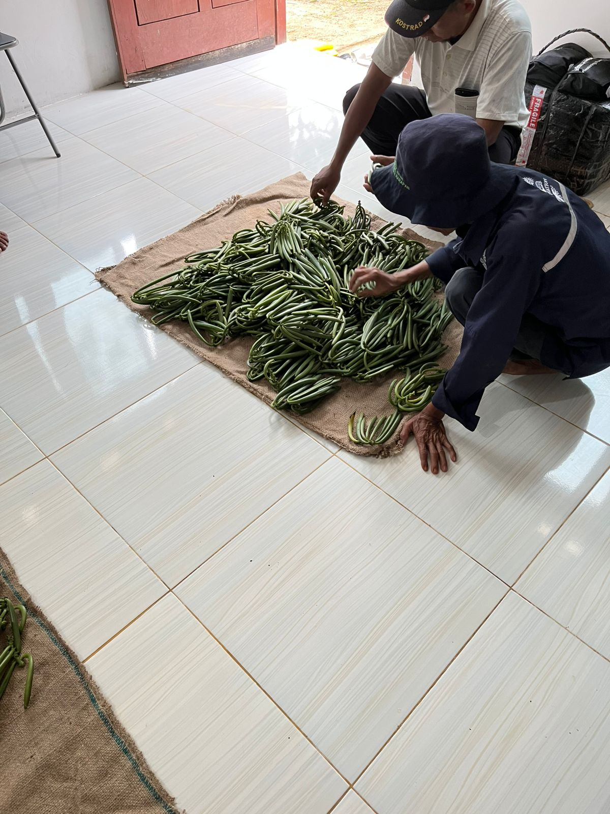
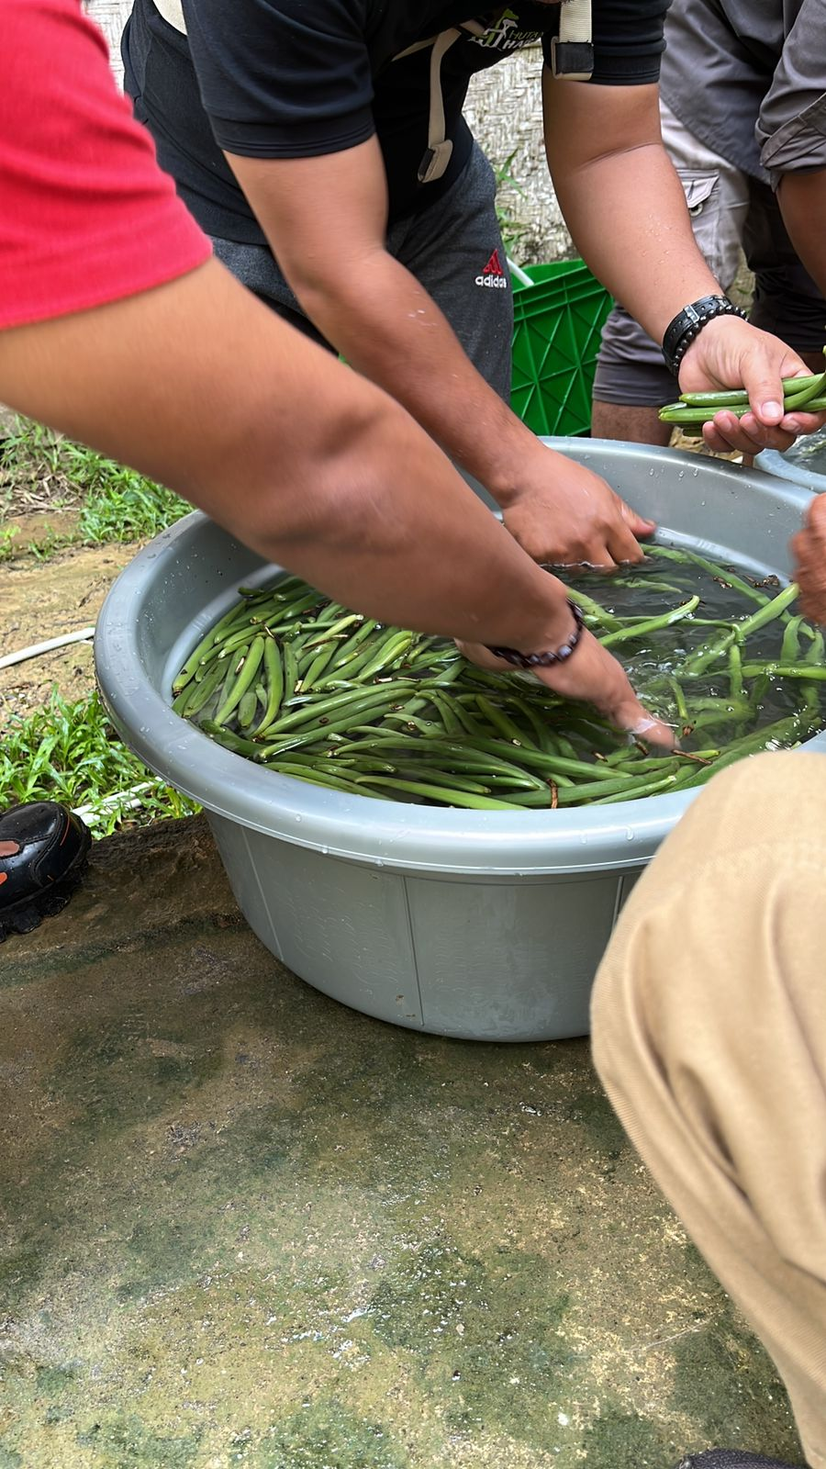
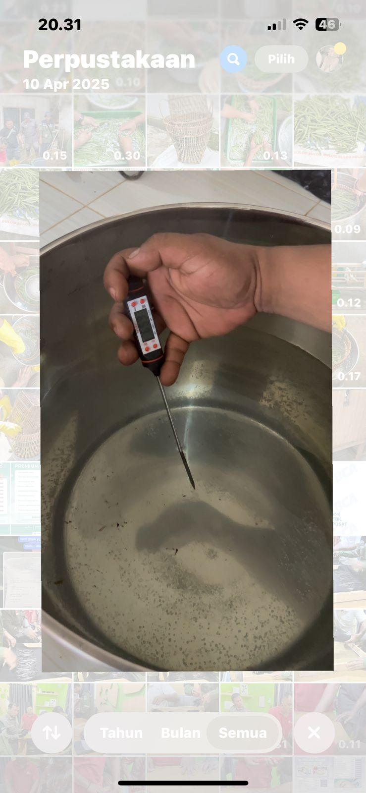
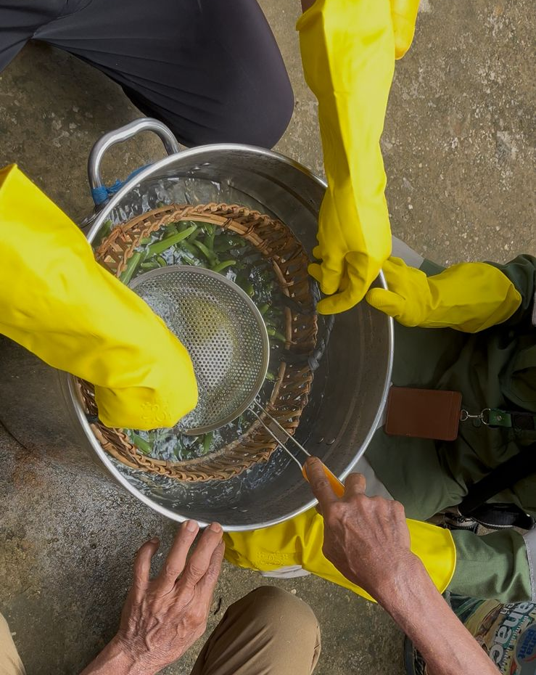
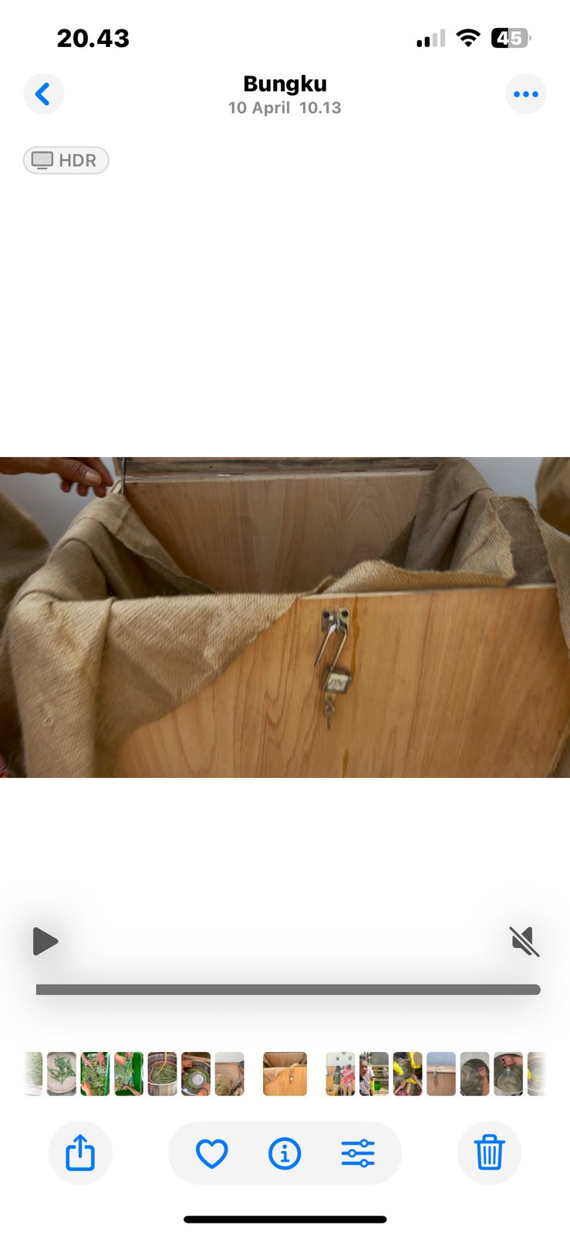
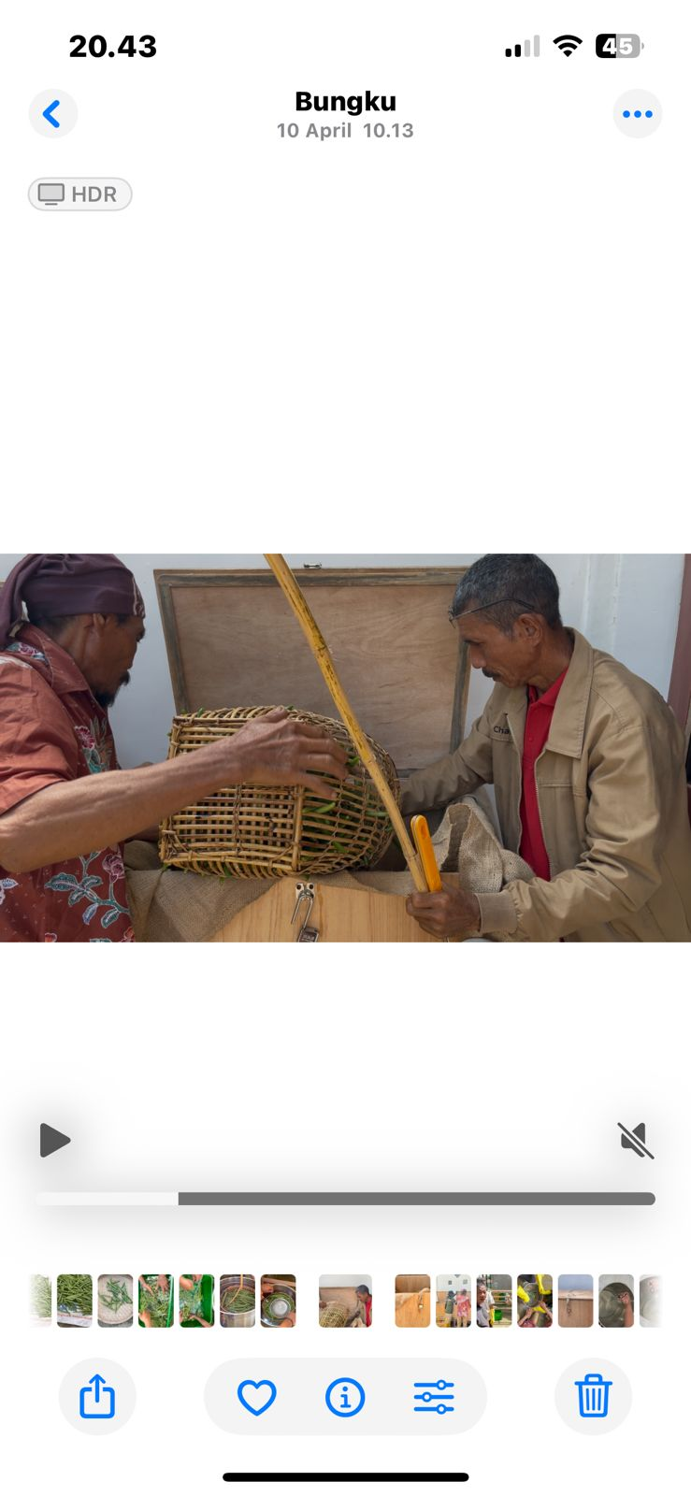
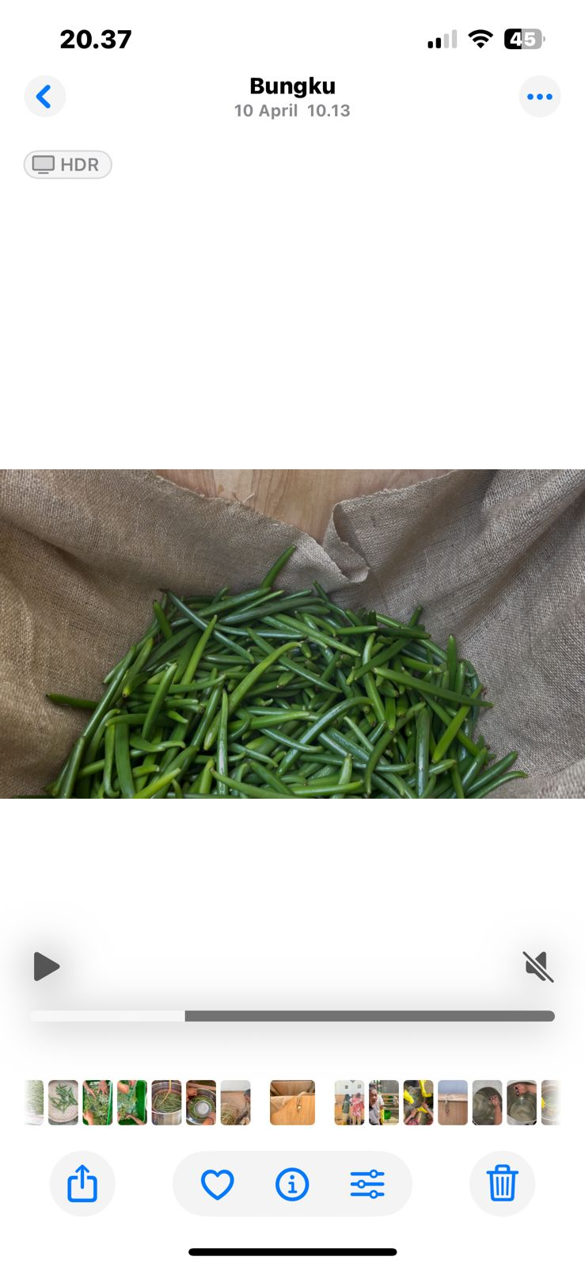
POST-HARVEST MANAGEMENT PRACTICE TRAINING PROCESSING VANILLA
STAGE 1: HARVESTING & SORTING VANILLA:
Vanilla pods can be harvested 8-9 months after pollination..
Vanilla pods should be picked when it is fully ripe and not too old, to maintain its quality.
Vanilla pods must be picked carefully to avoid damaging the pods and reducing their quality.
STAGE 2: BLANCHING / (HOT WATER SOAKING); Optimal water temperature 60-70°C for 1.5 - 5 minutes,
STAGE 3: FERMENTATION/SWEATING: Requires a temperature 45-65°C and high humidity are required. This stage stimulates the enzymatic reaction in the pods, which produces vanillin and turns the pods brown and oily. Fermentation Duration: 48 hours.

Slide 19
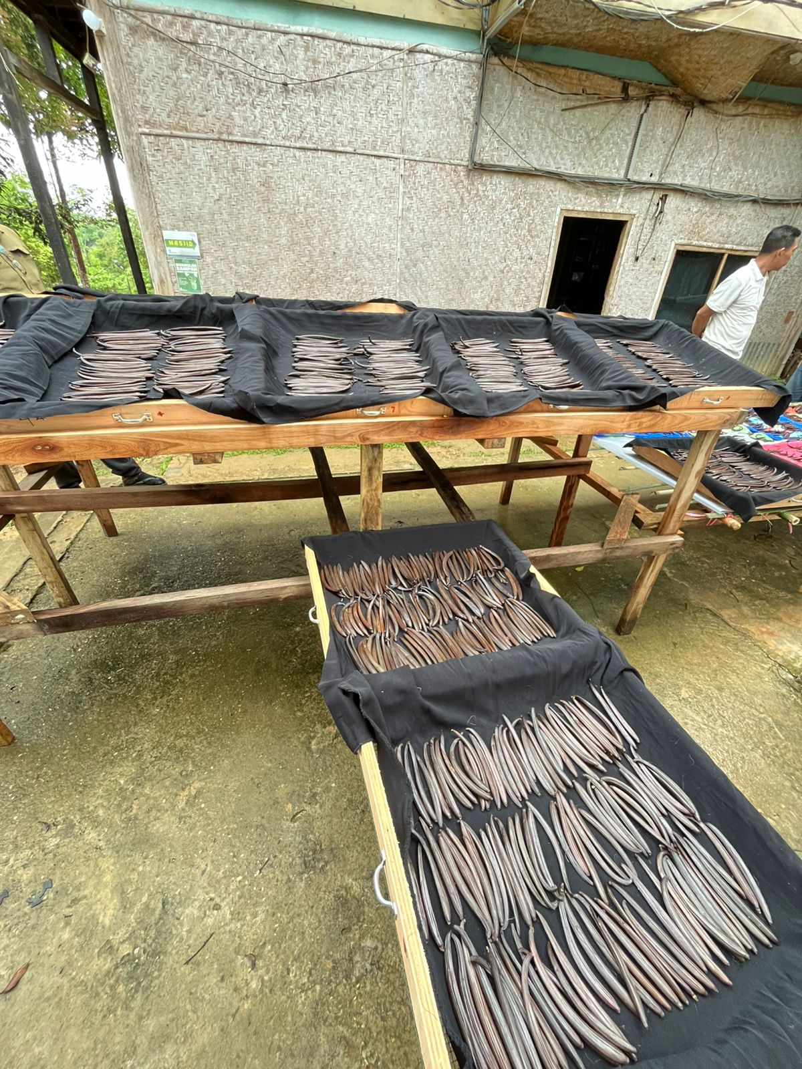
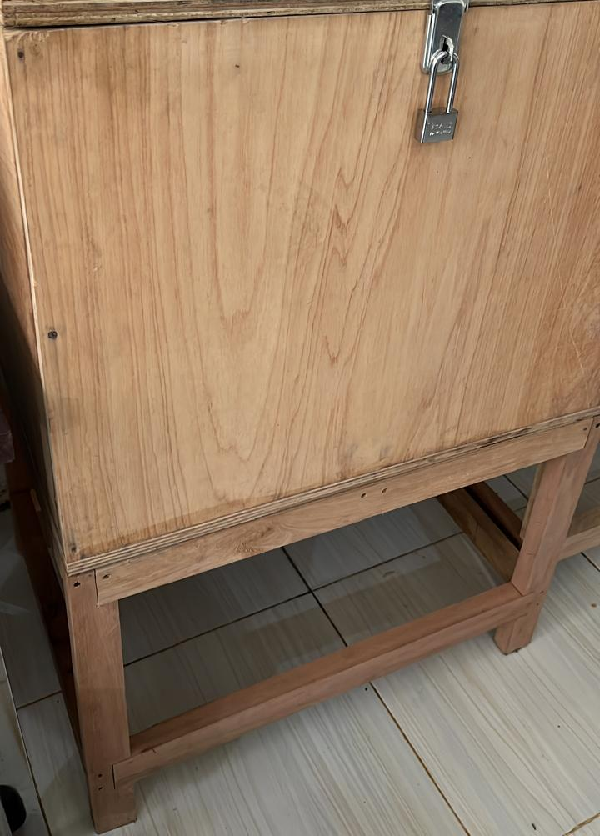
STAGE TAHAP 4 : SUN DRYING
First, drying in direct sunlight (4 hours), then air-drying for two weeks.
This process reduces the water content and prevents the aroma from being affected. Drying too quickly can cause the vanilla to break and lose its essential oils.
STAGE 5: STORAGE ; Containers must be clean and sterile to prevent contamination; Dried vanilla fruit is stored in zip-lock plastic to maintain quality, put it in a cardboard box; The ideal storage temperature is between 15-25 degrees Celsius, with a relative humidity of around 60-70 percent.
Results:
73.2 kg of vanilla pods were used for the practice, 10% of the stems were sorted, and the shrinkage after fermentation was 70-80%. The fermented dried pods currently total 10 kg. Further sorting will continue to reduce the quantity due to mold growth on some of the dried pods.
Fermentation Constraints:
The number of fruits used during the experiment was 73 kg. more than 50% of the vanilla pods used for the fermentation experiment practice were young, less than 9 months old (not yet at their maximum age).
The room temperature in the Hutan Harapan storage warehouse was 27-30 degrees Celsius with a humidity of 77- 82%. The drying process was conducted during the rainy season, resulting in suboptimal conditions.

Slide 20
Challenges in the fermentation process
The vanilla beans purchased were not mature enough to be harvested, so the fermentation results were not optimal.
The rainy season during the drying process resulted in suboptimal drying.
The daily room temperature data for the fermentation process is not yet in accordance with the theory.

Slide 21
Key Recommendations from Ibu Nuning
Continue vanilla agroforestry in a focused, adaptive way —not by expanding, but by deepening impact where it already works.
Shift to a “consolidate and strengthen” approach rather than “scale up,” while actively seeking new funding models.

Slide 22
5. Follow Up
Continue maintenance of vanilla plants with Good Agricultural Practices (GAP)
Engage with communities to plant vanilla.
Improve capacity of the team cultivating vanilla
Fundraising to support 3 ha of vanilla and additional area with community
Continue to improve the quality of the current community businesses

Slide 23
