Slide 1

Update: land and building taxes
Restoring the Forest for Future Needs
Patron’s Meeting 5-6 November 2025

Slide 2
Land and Building Tax Ring Fenced Funds
Land and Building Tax is paid through the 2025 fiscal year.
There is a balance of Euro 13,495 (IDR 209,171,298-) in the bank account.
There are interest penalties outstanding totalling Euro 118,615.

Slide 3
Land And Building Tax Outstanding with Penalty end of Oct 2025

Slide 4
Follow-up Steps
Because the land and building tax 2025 payment has been completed, the remaining balance of EUR 13,495 will be used for the same purposes as proposed in October 2024, as the following three items are still ongoing:
Final payment of EUR 3,072 for PT REKI and KEHI audit services
ERP system for HR and finance – maintenance and training (EUR 460)
Operational costs related to AWPB 2025 to cover part of the RKT/RKU activities (EUR 9,963)
Payment of taxes is now included in the Annual Workplan and Budget for 2026.
Recommend no further action regarding unpaid Interest Penalties.

Slide 5
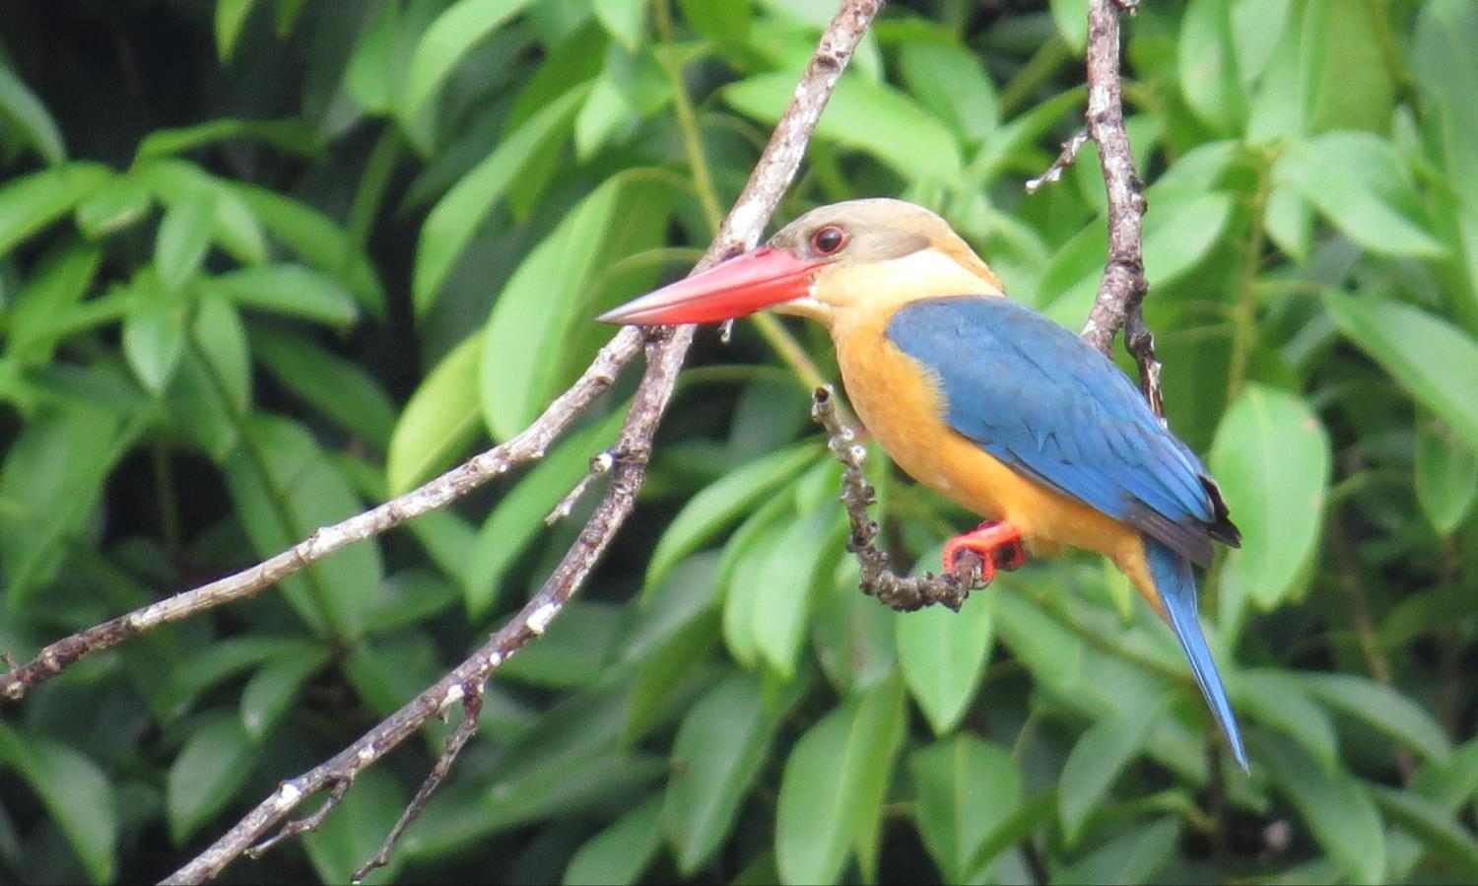
Restore More
Thanks
Terimakasih
THANK YOU

