Slide 1
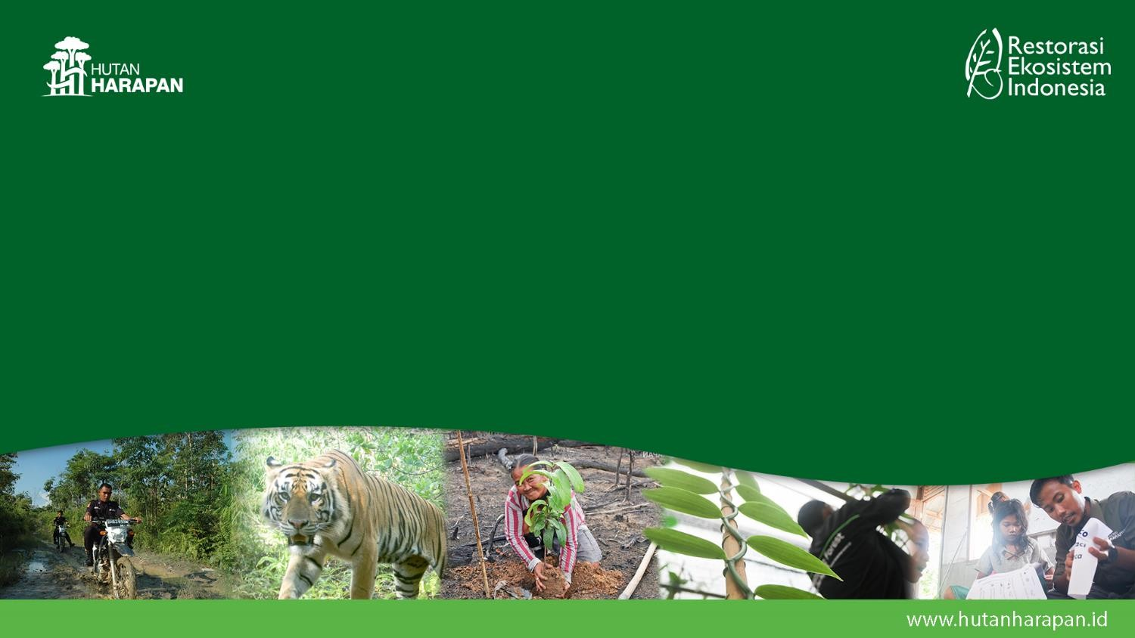
Forest Restoration & Monitoring
Patron’ Meeting 5-6 November 2025

Slide 2
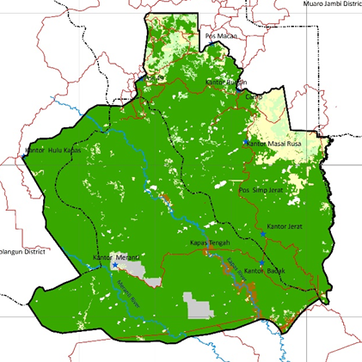
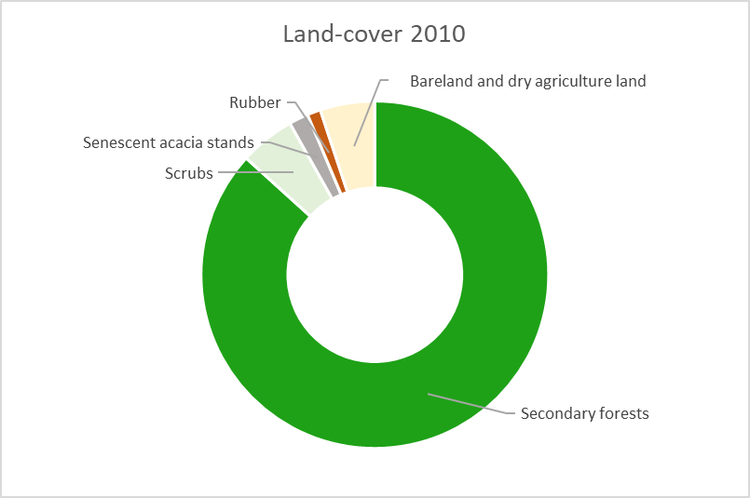
Forest Cover in 2010
In 2010 when REKI obtained the full ERC management rights 86% of the concessions or 84,276 ha is secondary natural forest

Slide 3
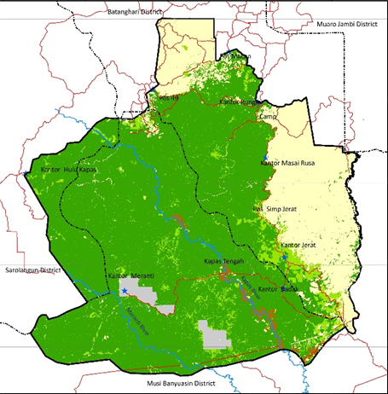
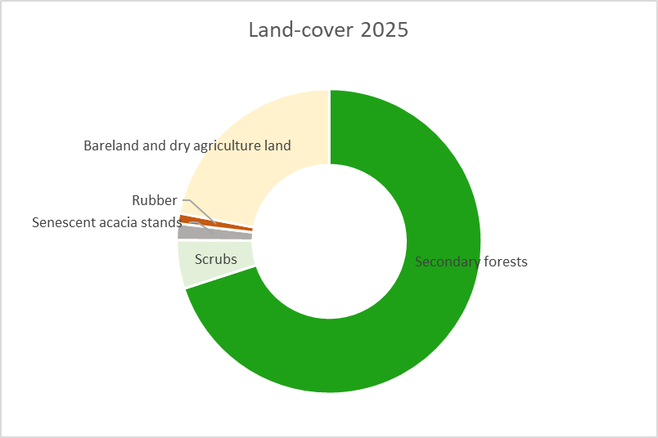
Forest Cover in 2025
As of Sept 2025, 69.5% of the concession area, or approximately 68,219 hectares, consists of secondary natural forests. This reflects a 19.1% reduction—equivalent to around 16,064 hectares—over the past 14 years

Slide 4
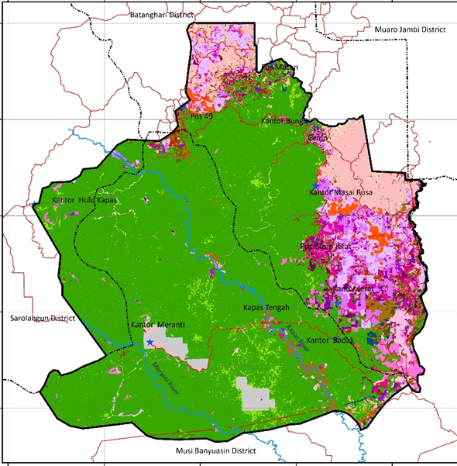
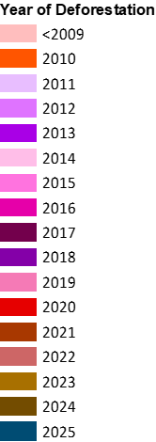
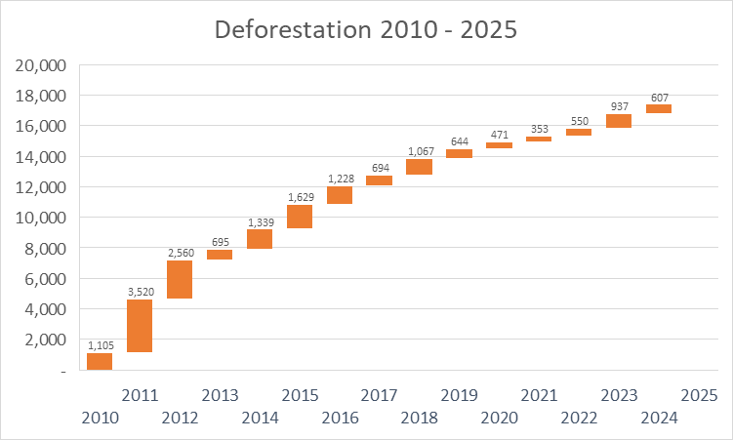
Forest Loss 2010 - 2025
Since full ERC management rights were secured in 2010, approximately 17,623 hectares of forest have been lost.

Slide 5
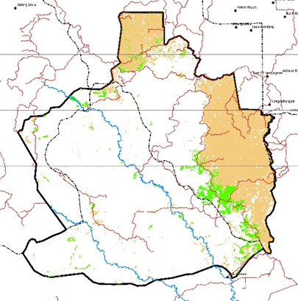
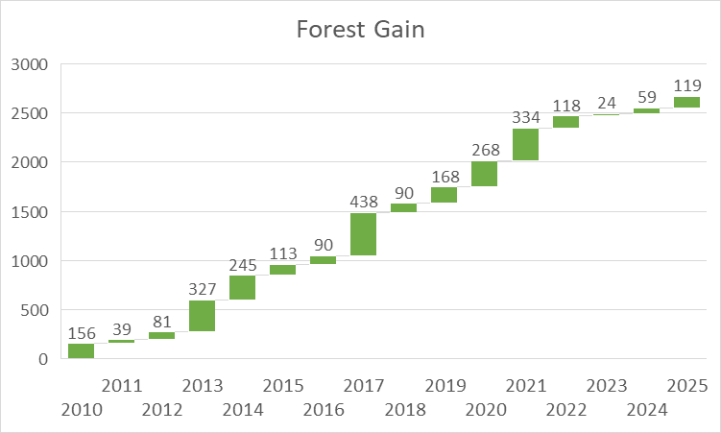
Forest Gain 2010 - 2025
An estimated 2,669 hectares of forest gain have been monitored between 2010 and 2025.
Forest regrowth has been observed in previously the deforested areas.
177

Slide 6
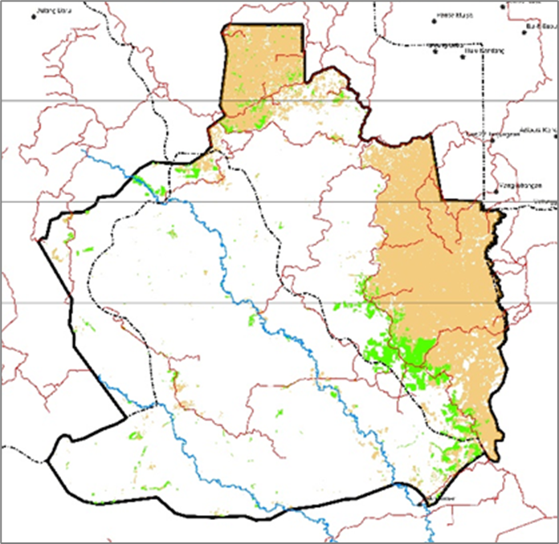
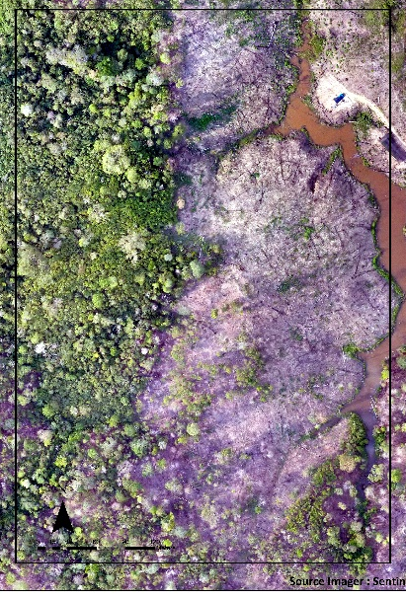
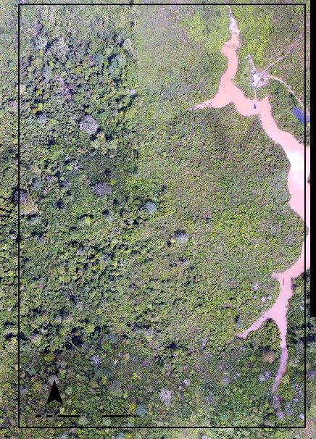
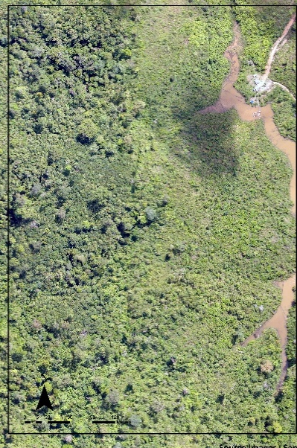
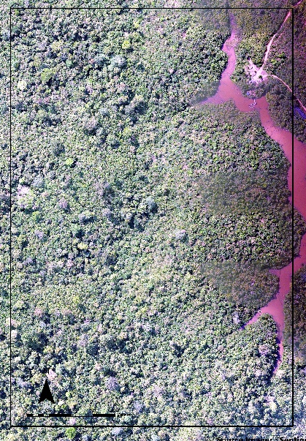
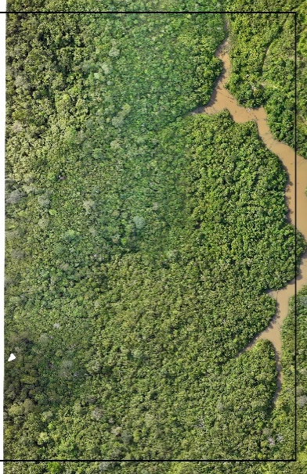
Forest REGROWTH monitoring PLOT
2020
2021
2022
2023
2025

Slide 7
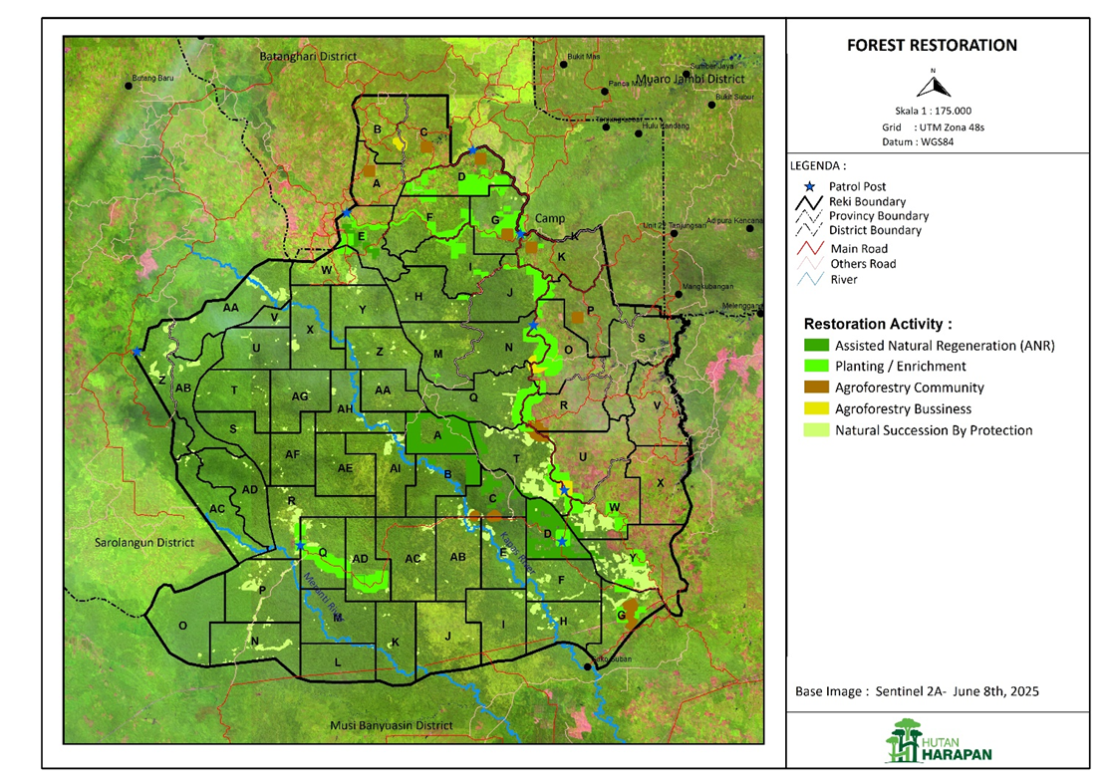
Forest Rehabilitation & Restoration
In addition to the forest gain (2,669 ha) due to forest protection, rehabilitation and restoration efforts have been implemented in about 5,805 ha areas of degraded lands and secondary forests.

Slide 8
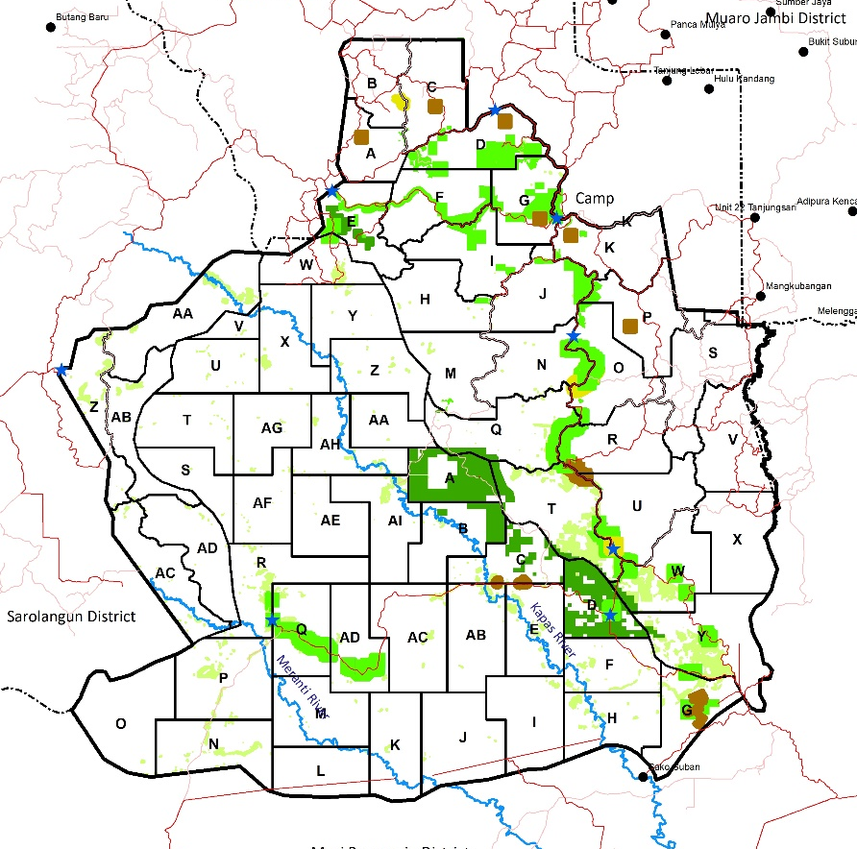
Forest Rehabilitation & Restoration
Rehabilitation plantings have targeted deforested areas along forest edges and other degraded lands, providing additional protection for the core forest.
Agroforestry development for land rehabilitation has focused on community partnerships within forestry concessions.
Accelerated natural regeneration has been implemented to assist the restoration of secondary forests within the core forest areas.

Slide 9
Land-use Management Concept
Broad land-use categories
Management objectives
Rehabilitation & restoration
Protection of forest resources and concession areas
Assisted or accelerated natural regeneration (ANR)
PROTECTION AREAS
To conserve natural forest and biodiversity, ensuring a strong foundation for developing environmental service initiatives.
Sustainable utilization of environmental services
Environmental recovery (forest restoration and rehabilitation)
Biodiversity protection
Carbon storage and sequestration
Ecotourism
Plantings in degraded areas
Sustainable collection of non-timber forest product
Natural succession by protection
PRODUCTION AREAS
To transform degraded forests and lands into productive land uses that deliver ecological, economic, and social benefits.
Land-use stabilization (reclaim & negotiations)
Mixed species plantings or enrichment for NTFPs production
Sustainable utilization of NTFPs
Sustainable utilization of forest areas
Agroforestry partnerships with communities

Slide 10
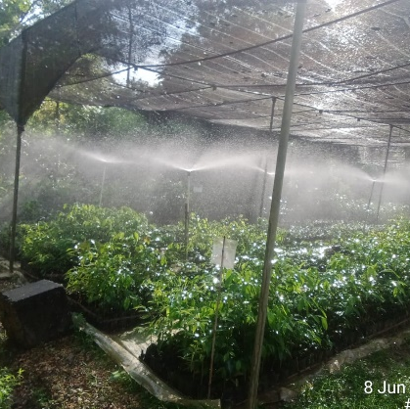
Tree Nursery
The tree nursery plays a central role in forest rehabilitation and restoration by producing seedlings of local endemic species (Dipterocarpaceae), multi-purpose tree species (e.g., fruit trees), and non-timber forest product (NTFP) species such as vanilla and gambier or white catechu.
Including species listed as threatened on the IUCN Red List—such as Ironwood (Eusideroxylon zwageri), Hopea mengerawan, various Dipterocarp species, and Aquilaria malaccensis, which is also listed under CITES Appendix II.
As of today, a total of 23,957 seedlings are available in the tree nursery, of which 16,519 are ready for planting.
Since 2010, a total of 1,126,322 seedlings have been planted and/or distributed to communities.

Slide 11
