Slide 1

UPDATES ON:
1)Operation to Curb Illegal Drilling Activities in KM 52, Hutan Harapan, 10-14 February 2025
2) Mitigating the IMPACT of THE CONSTRUCTION OF THE PT MBJ COAL Hauling ROAD
3) JinDI South Survey
4) Forest Area Enforcement Task Force (PKH) Activities
Patron’s Meeting 5-6 November 2025

Slide 2
Background to Encroachment and Illegal Drilling
Early Encroachment and Reclamation (2011-2014): Encroachment began in a small area in the North in 2011. By 2014, approximately 137.3 ha had been opened. PT REKI successfully reclaimed the area and expelled perpetrators, significantly reducing deforestation in the subsequent five years.
Renewed Encroachment and Deforestation (2020-Present): A slow but steady increase in deforestation began in 2020. By 2023, approximately 138 ha of forest had been lost. Currently, a total area of 380 ha has been encroached upon.
Motivations and Methods of Encroachment: The primary objectives of encroachers are illegal drilling and palm oil cultivation. Encroachers exploit the indigenous "Orang Rimba" people from Bukit 12, using them as a front to claim land under the guise of traditional land rights.
Facilitators and Outcomes: Encroachers receive support from local businessmen and government officials. A black market for oil operates from these illegally established sites.

Slide 3
Outcomes of Law Enforcement Measures
Environmental Rehabilitation & Protection:
  Area reclaimed, and restoration planting initiated.
  No further encroachment in this area.
  All illegal wells sealed.
  Palm oil seedlings destroyed.
  Ongoing patrolling of the area
  Road access cut from neighbouring concessions in the north
  Upgrading of concession boundary road: drainage pipes and cut and fill to level the road
Social & Human Rights Considerations:
  Orang Rimba indigenous peoples safely return to Bukit 12.
  All law enforcement activities adhered to national and international human rights codes.

Slide 4
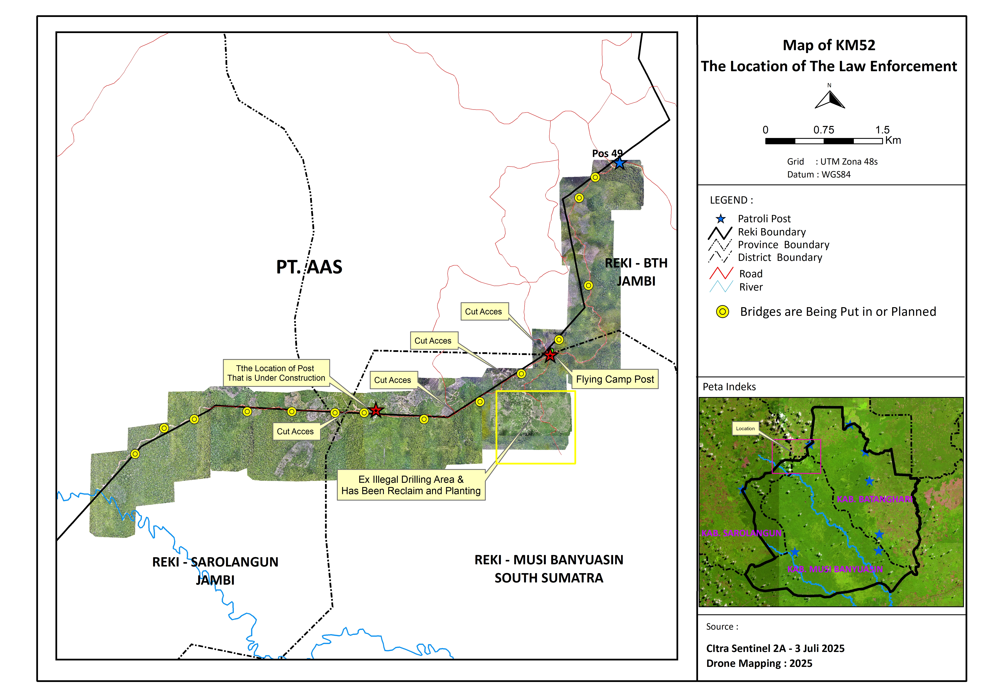

Slide 5
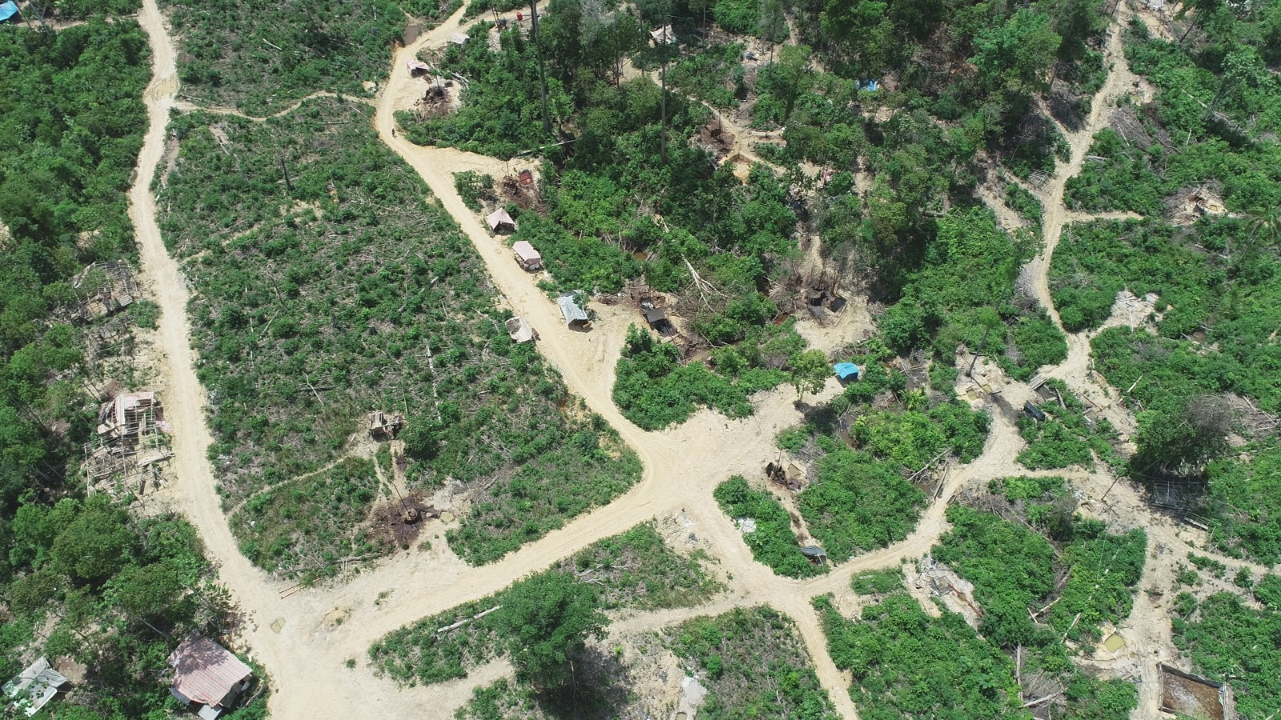
Drone shot of KM 52 prelaw enforcement in Feb 2025.
The blackened areas are locations of active or inactive oil rigs.

Slide 6
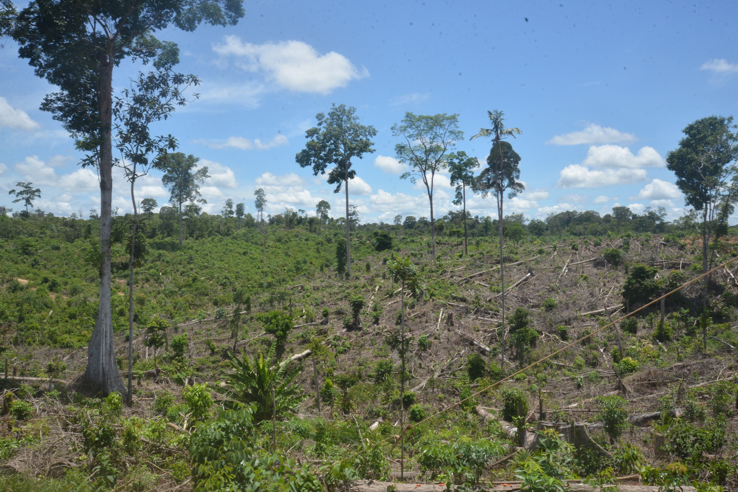
Land clearing at
KM 52

Slide 7
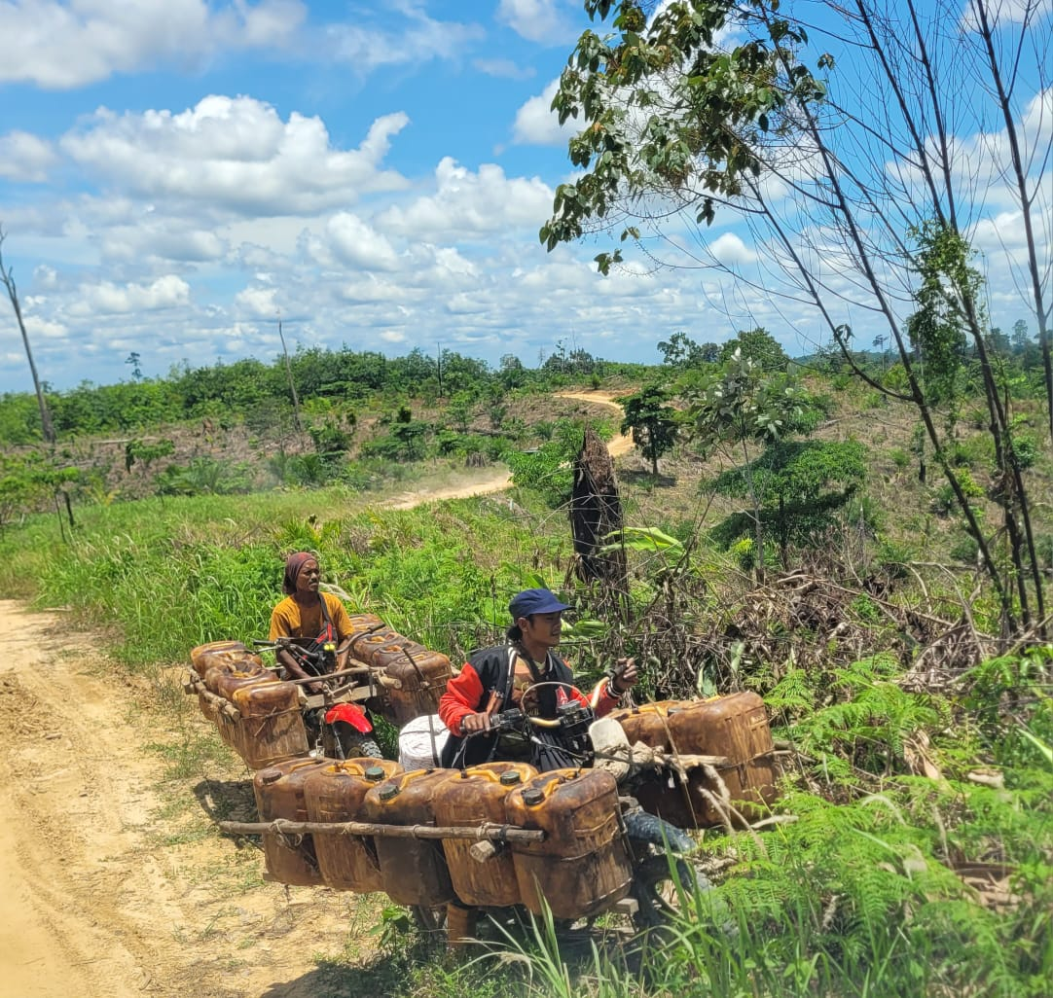
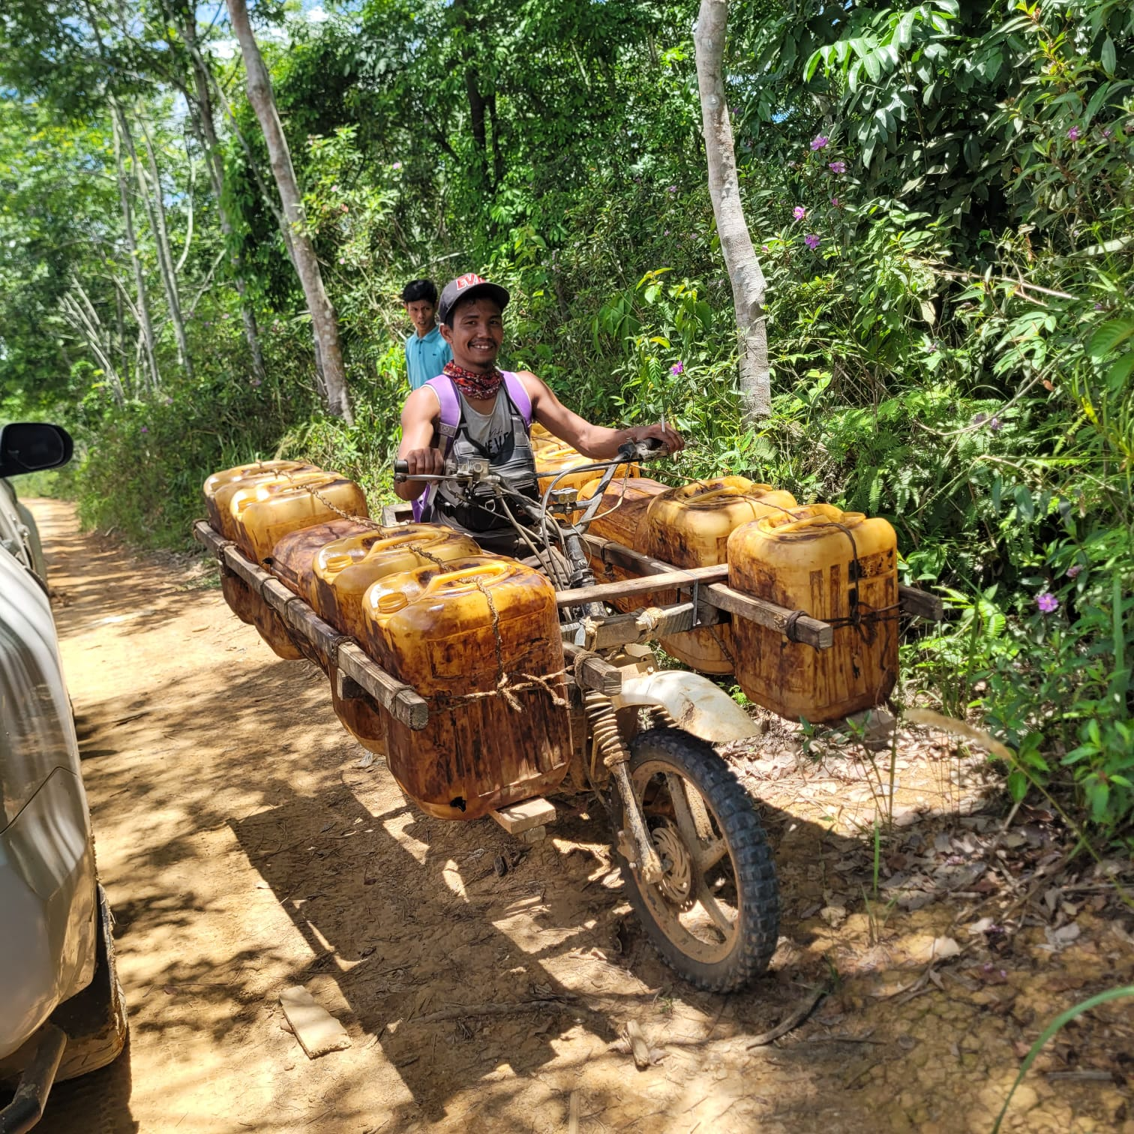
Transportation of oil from the well site to a middleman is done by motorcycle. From there it will be taken to an artisanal refinery. The oil is sold at roadside stall or is sold to contacts in Pertamina, the state owned oil company. One driver could make up to 6 shipments a day.

Slide 8
Law Enforcement Measures: 10-25 February 2025
Initial Challenges and Diplomatic Efforts: PT REKI's initial persuasive approach to stopping encroachment had very limited impact. After months of negotiations with the governments of South Sumatra and Jambi, a law enforcement operation was successfully carried out.
Law Enforcement Operation (February 10-14, 2025): All illegal oil rigs were either destroyed or removed. All encroachers have left the area. Palm oil is currently in the process of being uprooted.
Independent Monitoring and Human Rights Compliance: An independent monitoring team was contracted as part of the joint operation to oversee the implementation of law enforcement measures. During the monitoring, the Independent Monitoring Coalition Team found no abuse of procedures related to human rights standards or excessive force by the Illegal Drilling Operation Team during field enforcement.

Slide 9
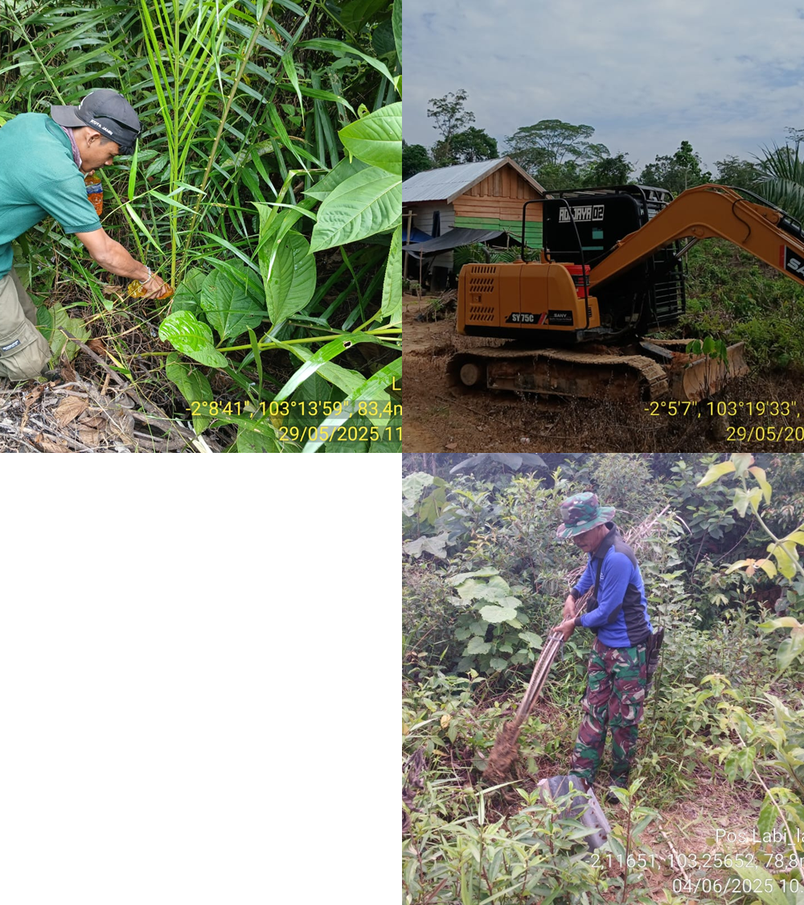
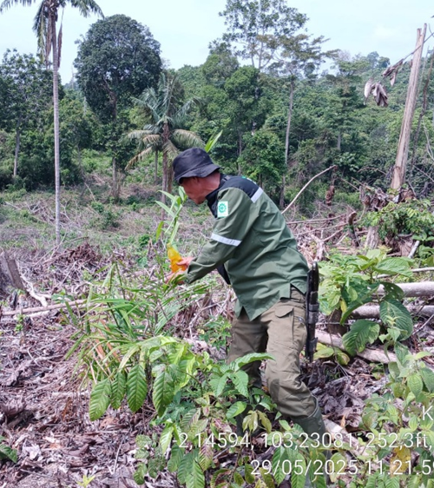
Key illegal activities observed and addressed included:
Persistent Land Clearing and Oil Palm Planting: New land clearings (e.g., 0.4 ha, 0.3 ha, 0.5 ha) and fresh oil palm plantings were consistently found at KM 52 and KM 45, with re-planting observed even after prior enforcement**]. The team actively uprooted or destroyed oil palm seedlings (e.g., 50 seedlings on May 28, ~65 seedlings on May 29, 9 seedlings on June 3, 10 seedlings on June 4)
Heavy Equipment Trespassing: At Simpang Macan, heavy equipment was found entering PT REKI's concession, reportedly for house foundation work with claims of local RT permission. The team issued warnings, ordered the equipment's removal, and faced resistance from individuals asserting customary land rights, leading to tense confrontations (May 29, May 31, June 2)

Slide 10
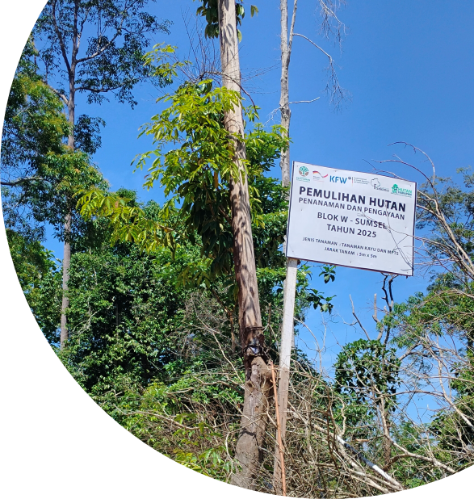
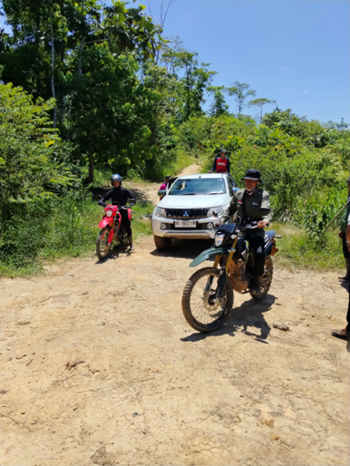
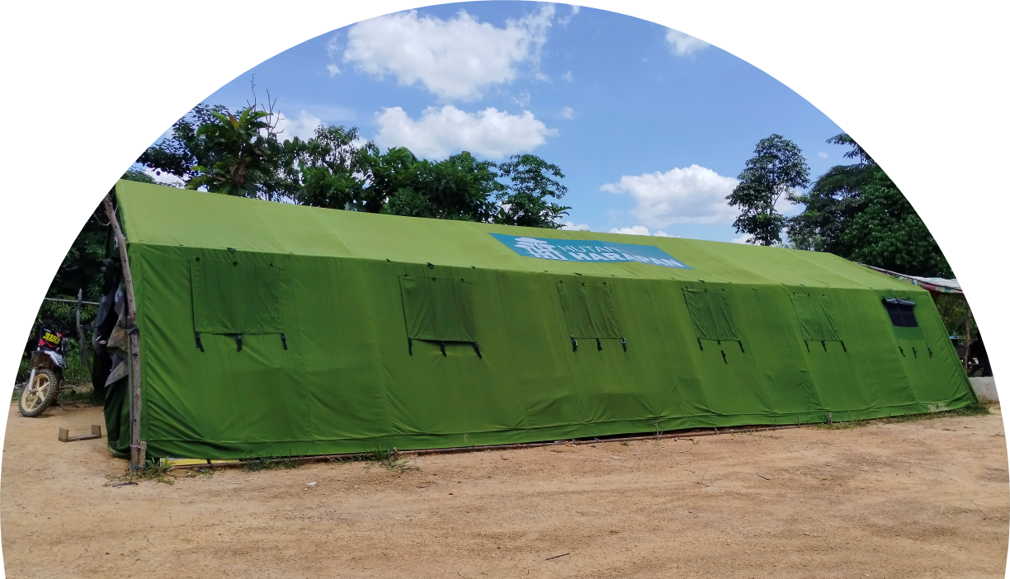
Post-Law Enforcement Activities

Slide 11
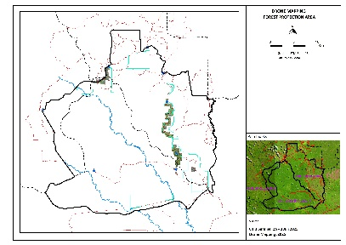
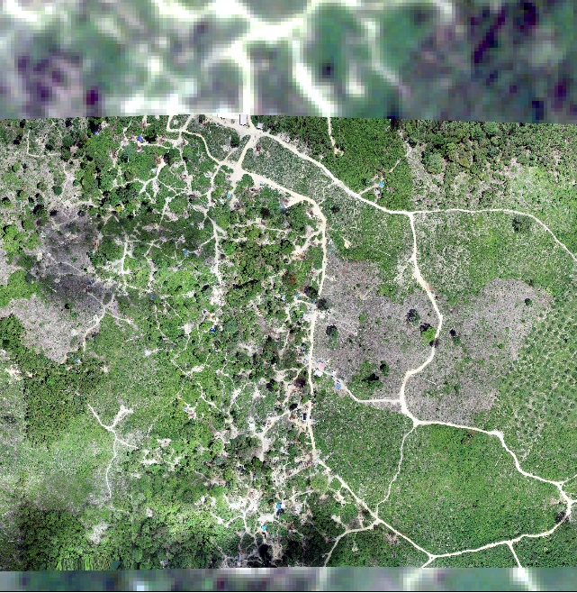
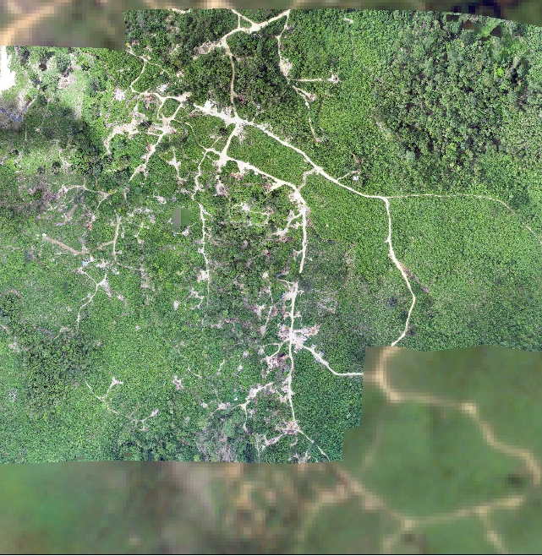
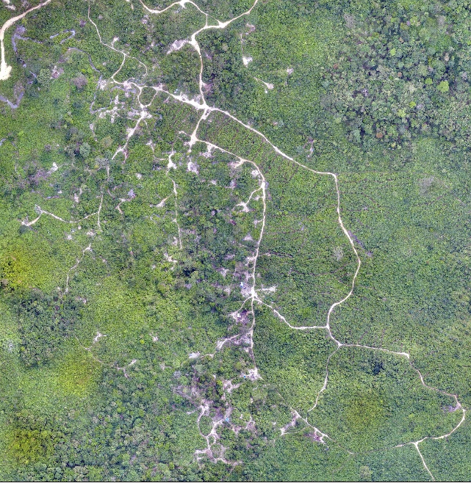
Succession Sequence Km52 (Ex Illegal Drilling)
2024 – Before law enforcement
2025 – Law Enforcement Feb 2025
2025 – Post Law Enforcement/Restoration

Slide 12
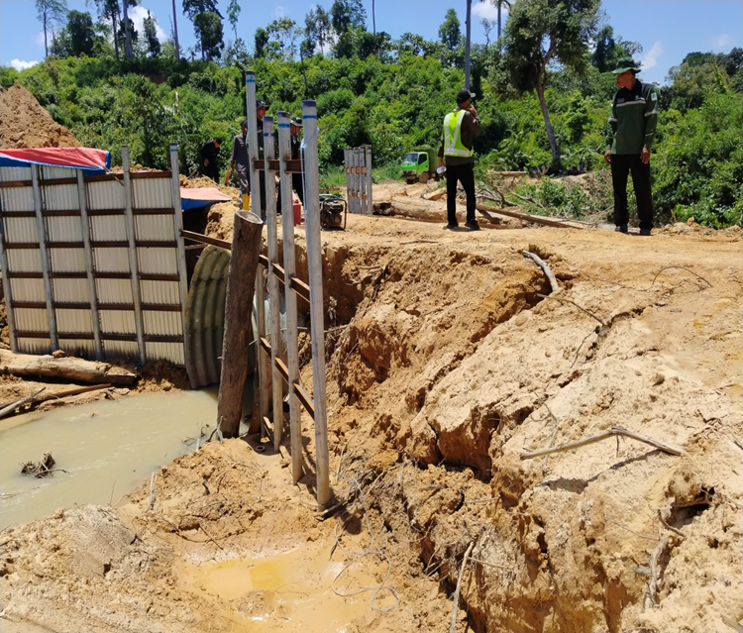
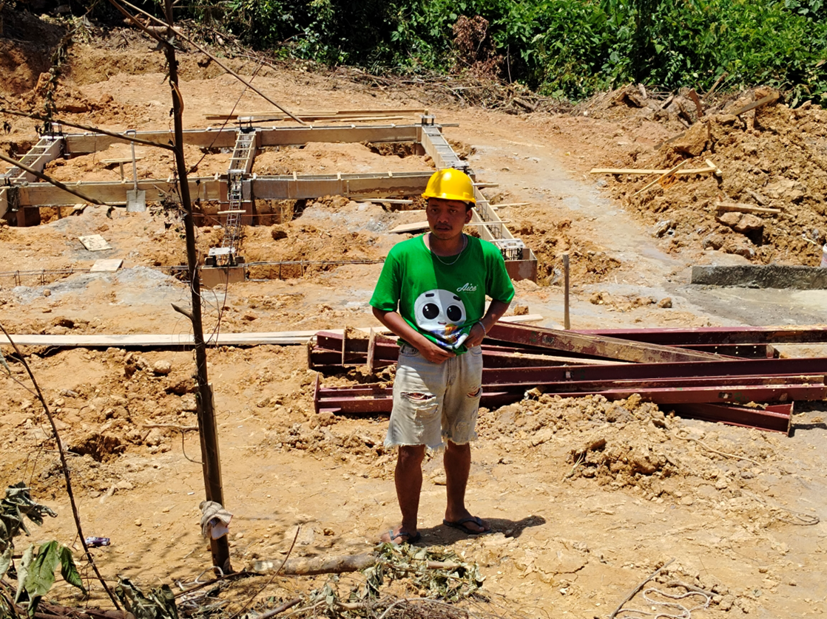
Improving access, reducing erosion and improving protection
At least 13 drainage pipes and bridges are planned along the boundary road to reduce erosion.
A new patrol post is being build at km 49.

Slide 13
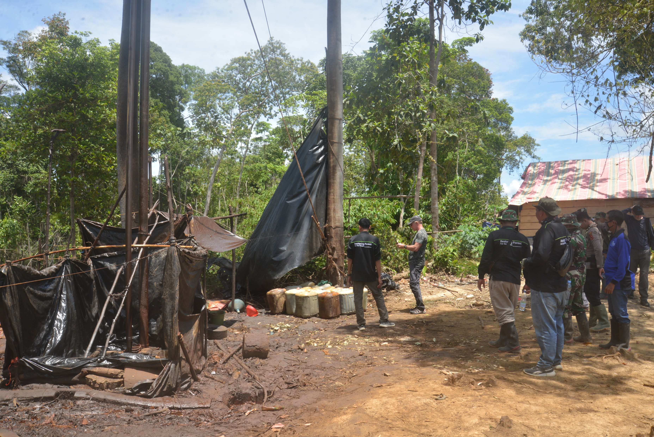
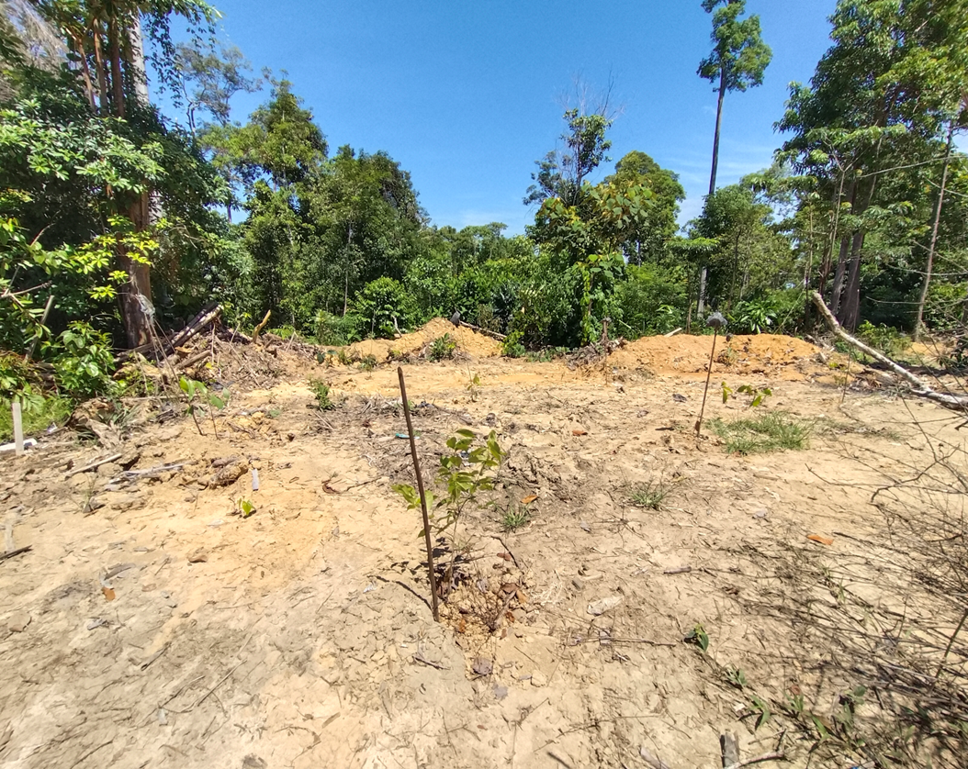
After
All wells were closed and plowed over. Restoration efforts are under way by planting multiple tree species
Before

Slide 14
Follow up: Post Law Enforcement
  Permanent placement of personnel and control in the former illegal drilling areas, because there are still parties who are trying to return to the location.
  Ongoing clean-up of encroached area of non-forestry plants and other illegal findings, as well as stopping land buying and selling activities.
  Replanting will continue in the encroached area.
  Feedback from the parties on media publications related to the success of the illegal drilling law enforcement, among others; (1) considered to be able to provide encouragement and an example of a model approach to the parties to carry out control in other areas for similar cases, and at the same time be a warning to related individuals who carry out similar illegal activities; and (2) appreciation to PT REKI which has shown its seriousness in handling the case.

Slide 15
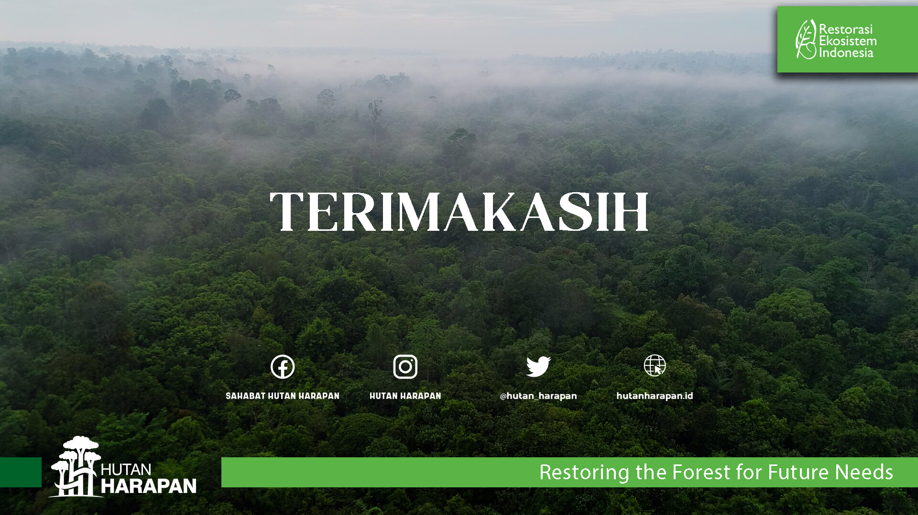

Slide 16
2: UPDATE
Mitigating the IMPACTs of THE CONSTRUCTION
OF THE PT MBJ COAL Hauling ROAD
Patron’s Meeting 5-6 November 2025

Slide 17
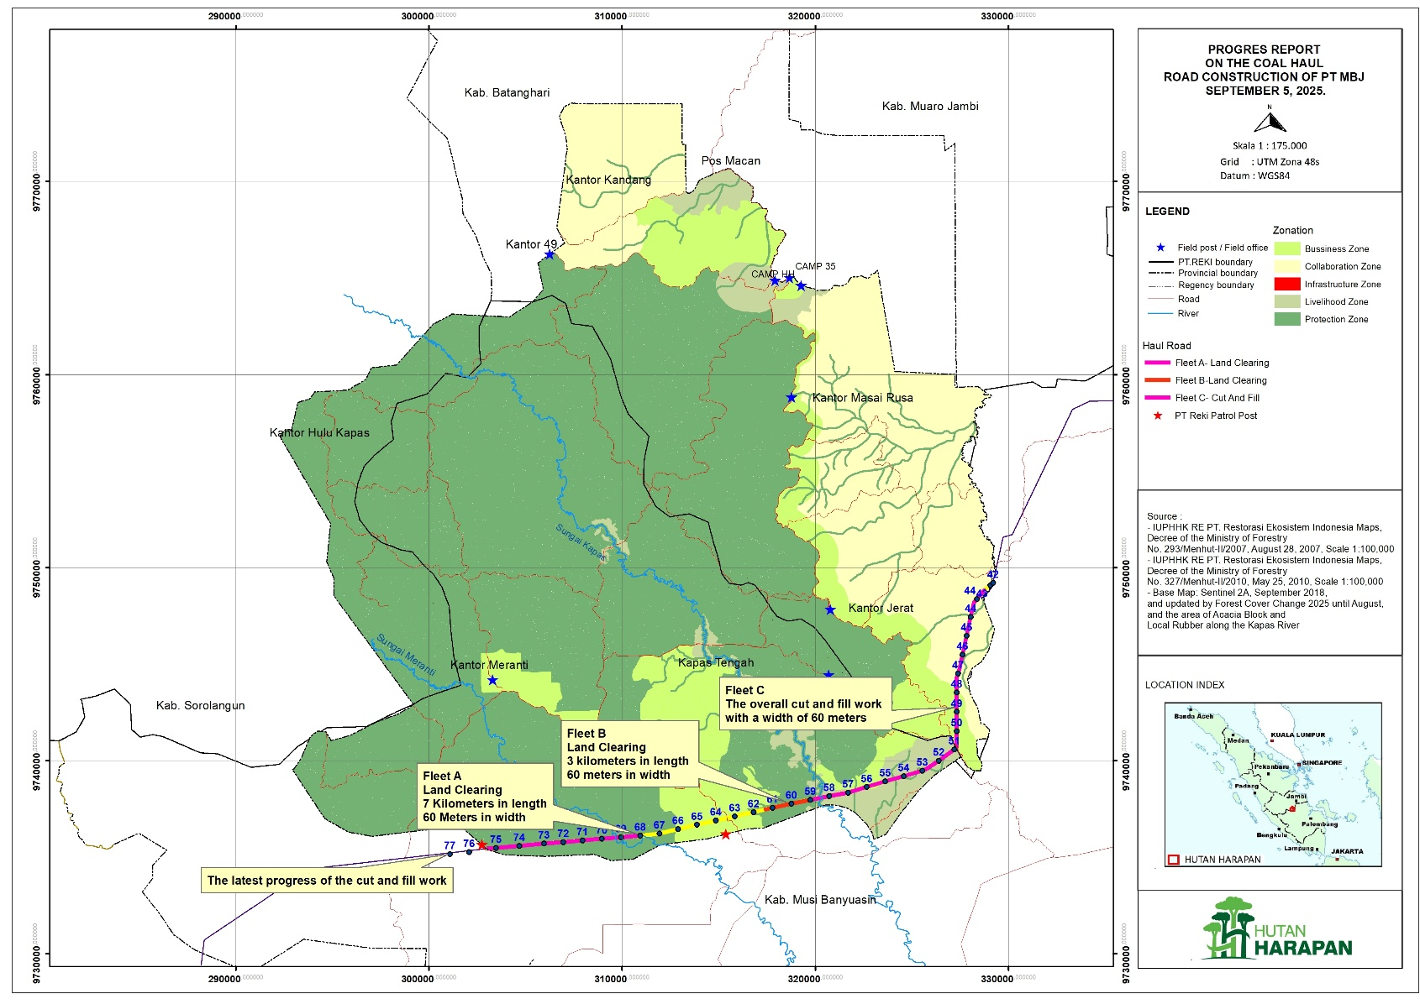
Update Pengerjaan Coal Road PT MBJ
(30 September 2025).
Fleet A: Land clearing has been carried out on all mining roads up to Sei Meranti. Cut and fill work is ongoing, most recently in the PT BPP area approximately 2 km to the REKI boundary, as well as the construction of a temporary bridge in Sei Meranti.
Fleet B: land clearing 3 km from Sei Kapas towards Sei Meranti (KM 59 – KM 61).
Fleet C: Cut and fill work is still being carried out on all mining roads, as well as the construction of a temporary bridge in Sei Kapas.

Slide 18
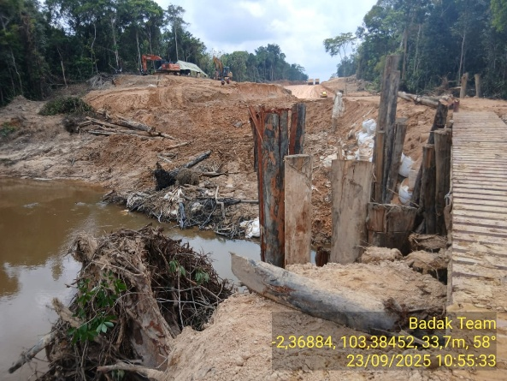
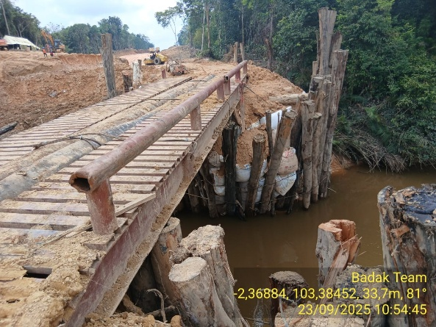
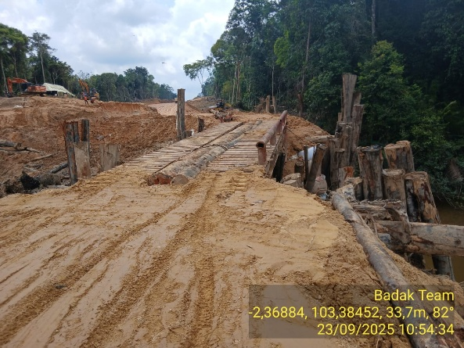
Documentations of Coal Road Update -
Kapas River

Slide 19
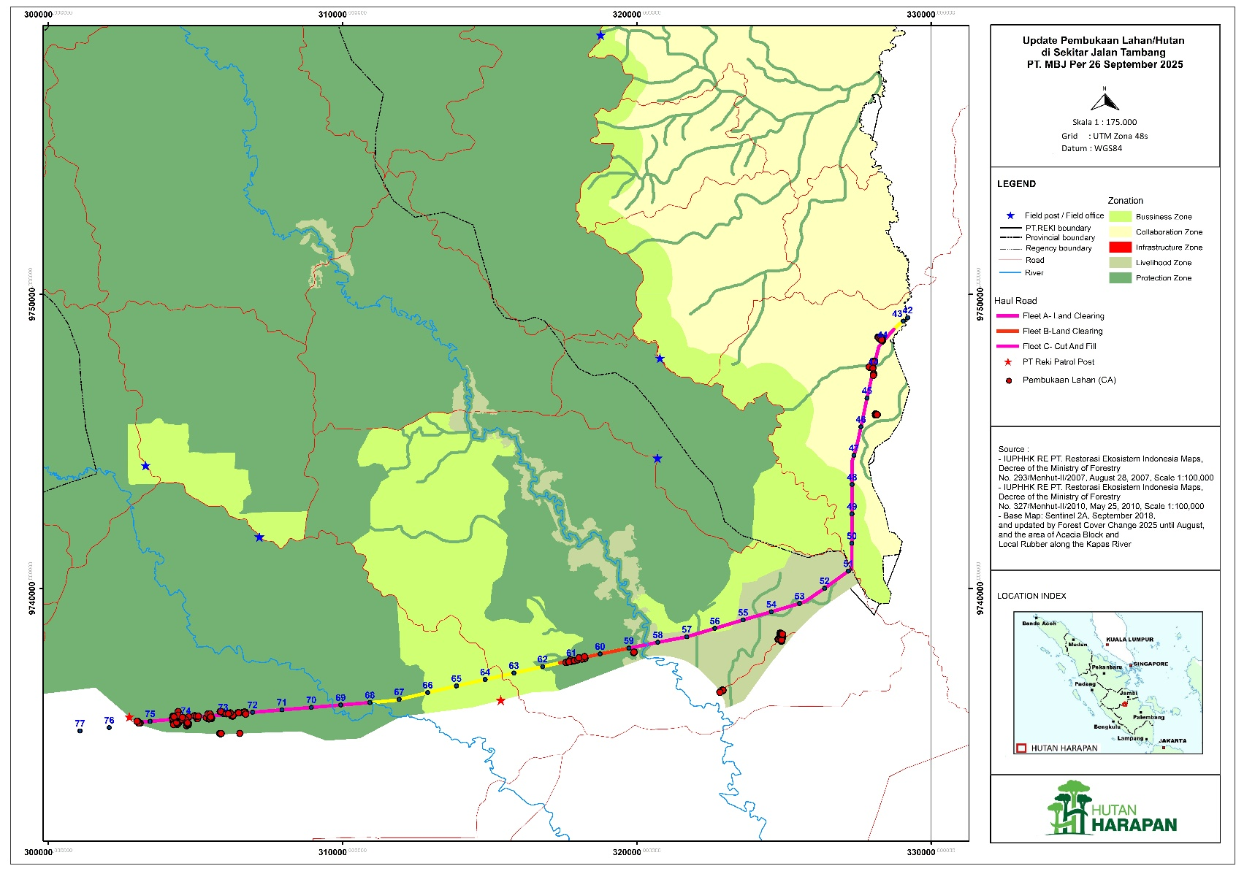
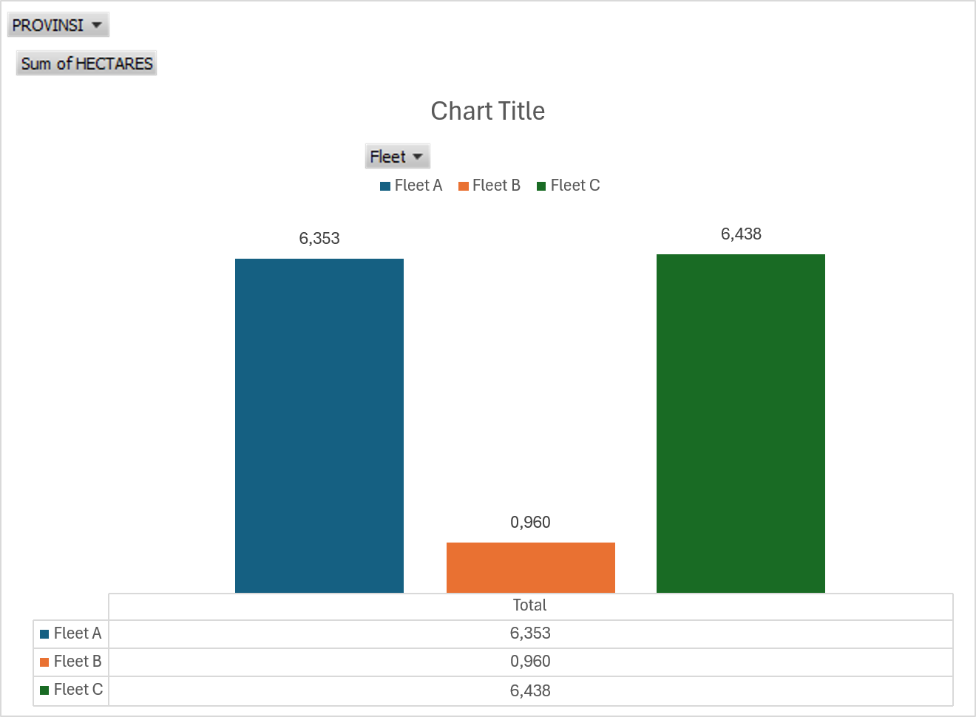
Map of Land/Forest Clearing Update
(26 September 2025)

Slide 20
Update - Security and Findings of Illegal Activities
Fleet A / Zona 1 (KM 68 - KM 75)
  PT REKI Security Team still conducts routine patrols. Patrol results: No illegal activity was found.
  18 September 2025: The Patrol Team installed warning/advice signs (4 units).
  24 September 2025: The Patrol Team installed warning signs (5 units).
Fleet B / Zona 2 (KM 58 - KM 67)
  PT REKI Security Team still conducts routine patrols in this area. Patrol results: No illegal activity was found.
  10 September 2025: The Patrol Team installed warning signs (5 units) towards Sungai Kapas.
  13 September 2025: The Patrol Team installed warning/advice signs (3 units) in the Sungai Landai area.
  22 September 2025: The Patrol Team installed warning signs (2 units) towards Sungai Kapas.
  24 September 2025: The Patrol Team installed warning signs (4 units).
Fleet C / Zona 3 (KM 42 - KM 57)
  PT REKI Security Team still conducts routine patrols in this area and re-monitors locations where land clearings were identified in previous patrols.
  23 September 2025:
    The Patrol Team carried out re-monitoring at coordinate points X. 324808 and Y. 9739319 location ID BD2251, found an area of ​​± 1 ha of open land that had been planted with oil palms with a planting age of ± 2 months, 1 hut unit, along with a worker named Junaidi (60 years old), living in Sako Suban. Based on the information, the owner of the land and hut is Rosehan alias Luncuk, who lives in Sako Suban.
    Action: The perpetrator was given a stern warning and advised to immediately stop/not continue the activity and leave the location. The perpetrator was willing to leave the location.
    The discovery of a banner that reads Land Claim of the PDNRI NGO and the Independent Press Journal with an area of ​​110,000 m2 at coordinates X: -2.37697 and Y: 103.34544.

Slide 21
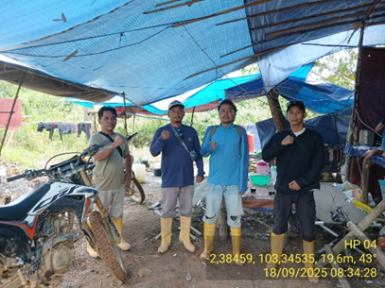
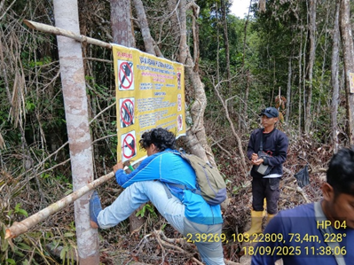
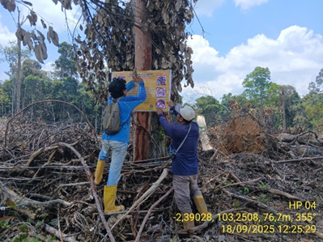
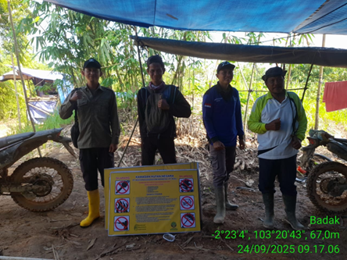
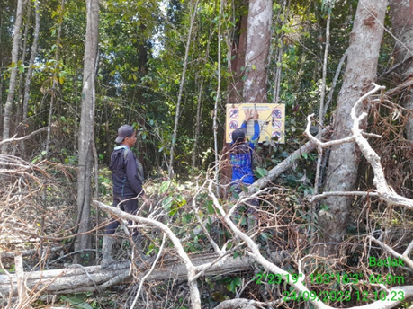
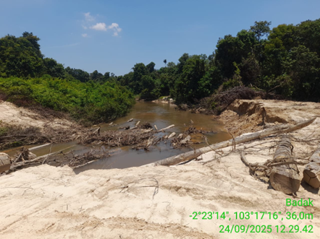
Documentation of Patrol Activities in Fleet A

Slide 22
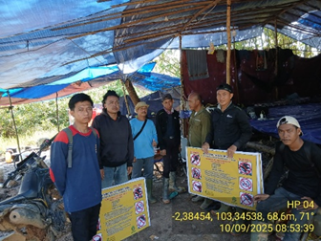
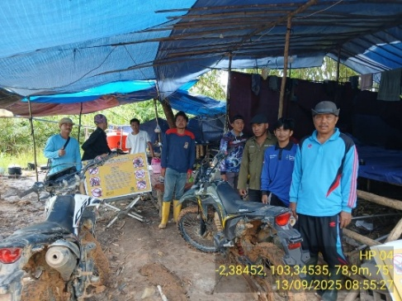
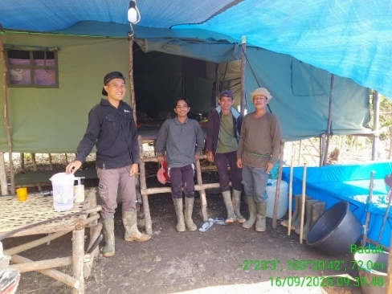
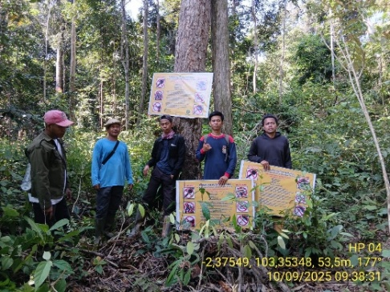
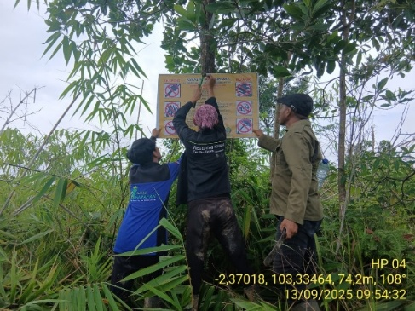
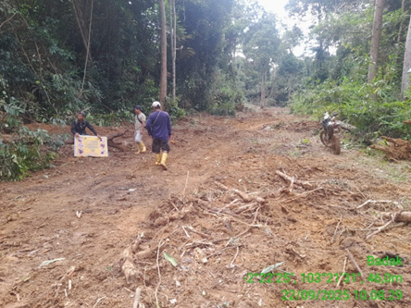
Documentation of Patrol Activities in Fleet B

Slide 23
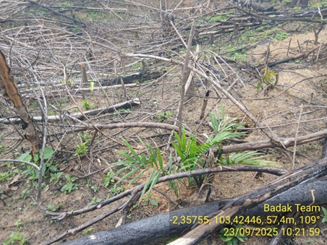
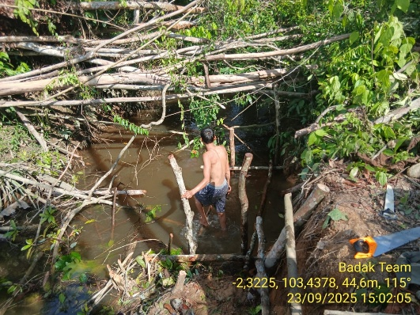
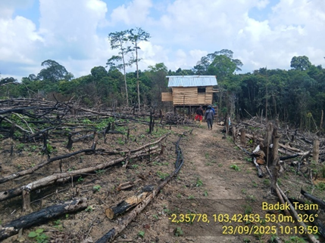
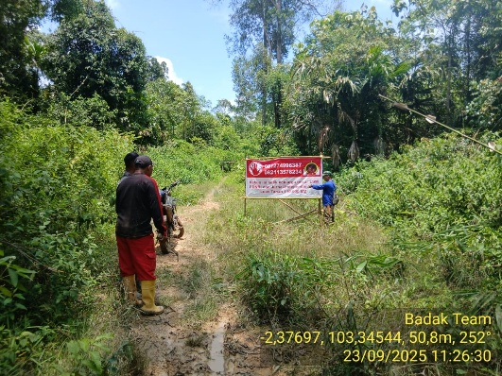
Documentations of Patrol Activities and Illegal Findings in Fleet C

Slide 24
Business to Business
20 September 2025: Joint patrol between the Flying Camp Team from Fleet B/PT REKI and the Environmental Monitoring Team from PT MBJ. Patrol results: no illegal activity was found at Fleet B.
29 September 2025: Monthly Meeting PT REKI and PT MBJ, points of meeting:
  Mitigating the impact of PT MBJ's mining road on illegal activities:
    PT REKI and PT MBJ agreed to conduct joint monitoring regarding the implementation of the commitments/obligations stated in the Amdal.
    The technical team of PT REKI and PT MBJ will prepare and discuss the Joint Security SOP.
    Installing signs prohibiting further illegal activities in the Fleet A area.
    Arrange a joint patrol schedule.
    To accelerate the construction of the Joint Security Post (PT REKI, PT MBJ, and PT BPP), PT REKI will invite both parties to discuss and implement the construction.
    Follow-up action will be taken to terminate illegal access to Fleet C.
    Mitigating the impact of PT MBJ's mining road on wildlife:
      There will be installation of signs prohibiting hunting and information boards regarding further animal crossings in the Fleet A area.
      PT REKI and PT BPP will coordinate with the South Sumatra BKSDA to follow up on the results of the FGD on the biodiversity study and specific directions for the draft corridor design.

Slide 25
Business to Business
  Detailed Engineering Design (DED) of PT MBJ mining road:
    The technical team will immediately coordinate to share further data related to design points and hold discussions to ensure matters of concern to PT REKI are addressed.
    Community empowerment:
      PT MBJ and PT REKI agreed to focus the empowerment program on target groups (Pe'I Group and Mat Atam Group).
      PT REKI and PT PT MBJ and PT REKI agreed to develop an empowerment program at KTH Suban Sepakat and Suban Mas.
      PT MBJ will dig a well in the Pe'i Group which is part of the water treatment program.
      After completing the excavation of the well, PT MBJ will continue construction of the MCK.
      PT MBJ will continue providing basic food assistance which started in early September 2025 to the Mat Atam Group (4 families).
      PT REKI will conduct health checks and provide medical assistance to the Mat Ata Group.m.
      Pemenuhan kewajiban Amdal PT MBJ
        PT MBJ will convey important points related to the reclamation plan after the preparation of the revised Amdal document is completed.
        PT MBJ and PT REKI agreed to conduct joint monitoring to ensure that mining road construction remains within the IPPKH corridor.
        PT MBJ will share orthophoto data with PT REKI.
        PT REKI and PT MBJ will continue to strengthen cooperation between the parties.

Slide 26
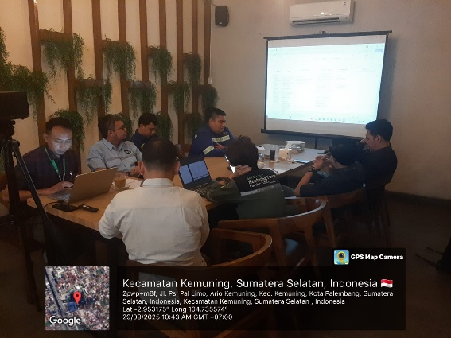
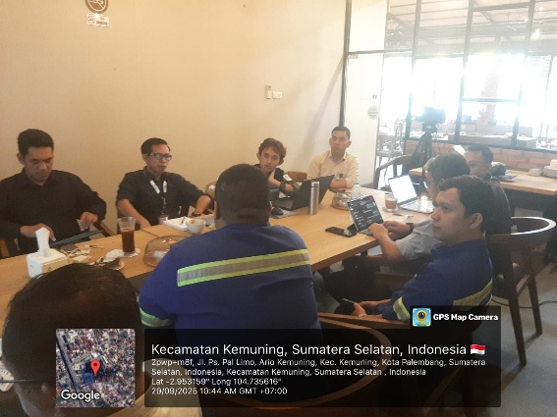
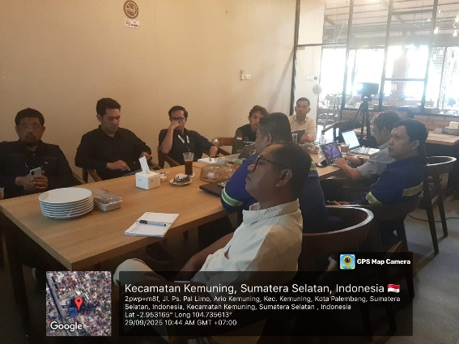
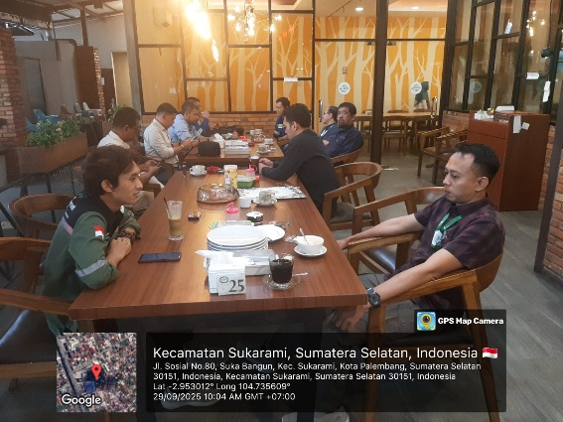
Documentations of B2B (Monthly Meeting)

Slide 27
Stakeholder Engagement
12 September 2025: FGD with the parties (PT REKI, PT MBJ, PT BPP, BKSDA, BPHL V, Forestry Service, Meranti Harapan Collaboration Platform/PKMH, Directorate of Conservation and Genetics/KSG, Directorate of Ecosystem Recovery and Preservation Area Development/PEBAP, Indonesian Elephant Conservation Forum/FKGI, Our Tiger Forum, IPB, UNSRI, Tropical Biome/Elephant Expert, Durrell Institute of Conservation and Ecology – KENT University) in order to follow up on the results of the joint field survey (PT REKI, PT MBJ, BKSDA, BPHL V, and the South Sumatra Forestry Service on July 28-32, 2025), the points of the FGD results are :
  The development of corridors is not only concerned with tigers and elephants, but also with other protected animals.
  It is necessary to conduct spatial analysis and identify the risk impacts of road and corridor construction.
  A small team needs to be formed to detail the corridor development plans from each party (PT REKI, PT MBJ, and BKSDA).
  It is necessary to form a monitoring team and a task force team to handle conflicts or mitigate negative interactions between animals and humans.

Slide 28
Follow-up (1)
PT REKI:
  Fleet A / Zona 1, Fleet B/Zone 2, and Fleet B/Zone 3:
    Routine patrols and action against illegal activities (warning, and eviction).
    Installation of signs.
    Joint patrol between the parties (PT REKI, PT MBJ, and/or PT BPP) or within the framework of PKMH.
  Team placement and establishment of a new Flying Camp in Fleet C to strengthen security (currently the Team has made preparations to set up a flying camp tent, but this cannot be done because the Sei. Lalan road access is inundated/flooded, the number of personnel to be placed is ± 10 personnel/a combination of the TRC Team and the Badak Team), has started to be implemented on September 23, 2025.
  The team will be supported by 1 double cabin operational car and an additional 3 two-wheeled vehicles that will be permanently placed at the location.
  Patrol route repairs (renting one mini excavator) from base camp – Sei. Jerat – Fleet C/Kel. Pei have been completed.
  Constructing foundation and footing structures for the Field Office at Fleet B .
  Enforcement or legal process by TRC (warnings, evictions, demolition of huts, reclaiming, and/or law enforcement).

Slide 29
Follow-up (2)
B 2 B:
  Termination of illegal access to Fleet C that has been identified, and termination of entry access to Fleet A with the assistance of heavy equipment from PT MBJ.
  Cooperation to support the construction of the Field Office at Fleet B from PT MBJ's heavy equipment.
  Cooperation to follow up on the results of the monthly meeting on September 29, 2025.
Stakeholders:
  Coordinate with BKSDA regarding the follow-up of the FGD results on September 12, 2025, and also to encourage PT MBJ to immediately implement the FGD results.
  Joint patrol with the South Sumatra Forestry Service or Kepolisian Musi Banyuasin to handle illegal activities in Fleet A, Fleet B, and Fleet C (South Sumatera Area), planned October 2025.
  Encouraging the acceleration of the creation of Joint Posts (PT REKI, PT MBJ, PT BPP).

Slide 31
3. Update: Jindi south 3d Seismic survey
Patron’s Meeting 5-6 November

Slide 32
Background to 3D Seismic Survey (1)
Jindi South Jambi B. Co. Ltd (JSJB) is the third-party/private contractor that won the oil and gas block tender held by the Central Government (Ministry of Energy and Mineral Resources cq SKK Migas). This means that the oil and gas block is owned by the Indonesian government, under the Ministry of Energy and Mineral Resources, and is managed by SKK Migas.
The oil and gas blocks that have undergone workover and well testing (such as Bungin 1 and Bungin 2) have been designated as National Strategic Projects (PSN), including the location of new wells (Seismic Survey results).
Based on the productivity scale of the gas wells, the following conclusions were reached:
  The Bungin 1 well is in the mid to low range.
  The Bungin 2 well is in the moderate to good range.

Slide 33
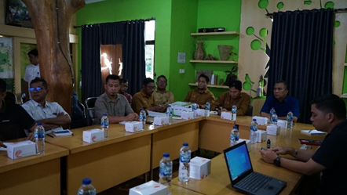
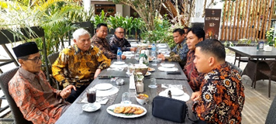
Background to 3D Seismic Survey (2)
The Seismic Survey by JSJB is a request/in order to implement a directive from the Government (SKK Migas), and will be carried out by JSJB's partner, PT BGP.
It is Phase 2 of the development of the oil and gas block, specifically the Bungin area within the PT REKI PBPH area (following well testing of the Bungin 1 and Bungin 2 oil and gas wells).
PT BGP is scheduled to begin the entire 3D Seismic Survey in mid-to-late October 2025 and will last for 6-9 months.
September 17, 2025: JSJB presented the planned 3D Seismic Survey to the PT REKI Operations Team at the Hutan Harapan Base Camp and submitted the UKL/UPL documents related to this activity.
September 28, 2025: Meeting between JSJB and the Deputy Regent of Batang Hari in Jambi in order to convey the 3D Seismic Survey plan in the Batang Hari Regency area.

Slide 34
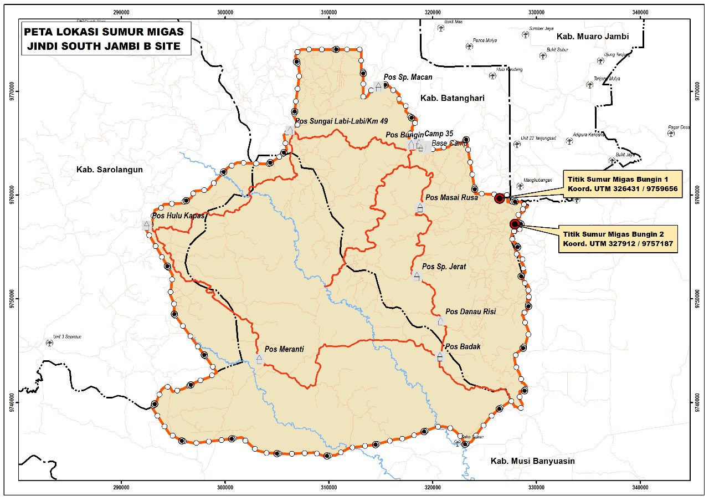
Background
In 2000 the management of Block South Jambi B was taken over by Conoco Philips until the end of its contract period on 24 January 2020.
Jindi took over the management of Block South Jambi B and the handover of Block South Jambi B was carried out on 25 January 2020. with the initial plan to develop the Bungin field and Teluk Rendah Gas Plant field.
Jindi has targeted to begin exploitation of the wells in 2028

Slide 35
3D Seismic Survey Area
The seismic survey will be carried out in the ​​existing palm oil plantation area.
Plots within the protection zone and/or forested areas of PT REKI will be excluded from the seismic survey plan.
The total area proposed by JSJB within the PT REKI PBPH area is 8,574 ha
The area within the green area/protection zone of PT REKI that will be excluded from the 3D Seismic Survey plan is 879 ha.
Therefore, the total area within the existing oil palm plantation area to be surveyed, after subtracting the protection zone, is 7,694 ha.

Slide 36
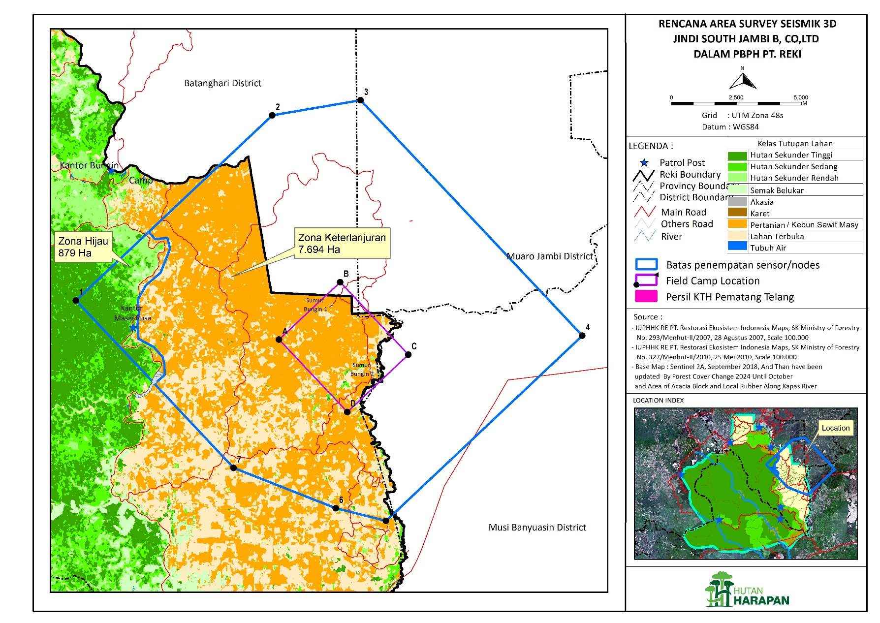
Plot Area Seismic Survey
Legend
Boundary of Survey area
Pematang Telang Farmer group

Slide 37
3D Survey
In 3D surveys, seismic sources and geophones are distributed across a grid spanning the area of interest.
Seismic waves generated from the sources propagate in all directions, and the reflected waves are captured by an array of geophones spread throughout the grid.
The data collected from this extensive network of sensors is processed using advanced algorithms to produce a three-dimensional image of the subsurface.

Slide 38
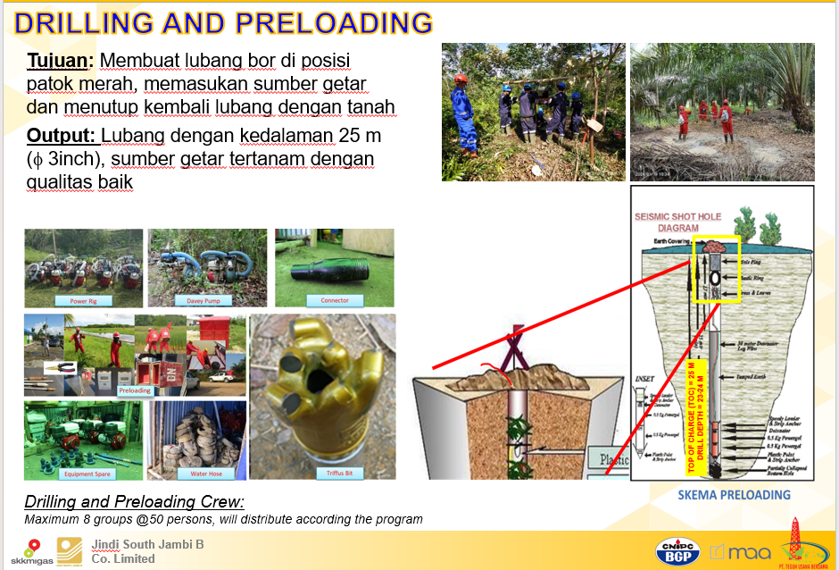
Drilling and Preloading Seismic Survey
The hole is created by drilling.
The vibration source (Dayagel) is inserted into the hole and then sealed.
A sensor (Quantum) is then installed above the hole to capture/record the vibration source.

Slide 39




Restoration plan after the Seismic Survey
Remove survey stakes along the survey route for collection and destruction.
Remove bridges on the route or road (unless requested by the company/landowner).
Dismantle camps or other seismic survey facilities.
Close with a letter of completion of the seismic activity between the landowner/village/company and the contractor.

Slide 40






Safety Mesures during the Survey
Line Safety Assessment (LSA) in the survey area.
Worker safety
Fire prevention
Ensure there are no human-wildlife conflicts
Waste Control

Slide 41
Potential Impacts of the Seismic Survey
The 3D Seismic Survey Area also includes the Pematang Telang Forest and Farmers Group (NKK) plot, covering 49.92 hectares of residential and garden plots, with 35 members. This activity could impact the residential and garden plots of the Pematang Telang Forest and Farmers Group members. According to the JSJB Team, drilling errors or non-compliance with the 3D Seismic Survey plan could lead to plant death at the site.
Analysis of the biodiversity surrounding the area was conducted, specifically regarding the impact on the roaming areas of tigers and elephants, key species. Monitoring results revealed tiger and elephant tracks in the area, particularly in the forest and on the main road around Masai Rusa.
Bird monitoring in 2025 revealed that the area contains threatened bird species, including the hornbill, pheasant, great leaf-billed cica, blue-winged thrush, and Malayan coffee-bird. In addition, 16 protected bird species (Ministerial Regulation of the Environment and Forestry Ministry No. P.106 of 2018) were identified, including the Green Pitsnake, Golden-rumped Shama, Blue-winged Leafbird, Diard's Leafbird, Black-rumped Shama, Princess Leafbird, King Argus, Great Leafbird, Malayan Parakeet, White-rumped Shama, Pomegranate Pitsna, Casumba Leafbird, Tanau Lory, and Hornbill.
The 3D Seismic Survey plot proposed by JSJB is part of an area already under enforcement by the Forest Area Enforcement Task Force (PKH). According to the signed Minutes, the PKH Task Force has reclaimed 7,493.15 hectares of forest within the PT REKI work area. Following the determination of the area under control, PT REKI has submitted a revised application to the PKH Task Force to 12,193 hectares.

Slide 43
4. UPDATE: Forest Area Enforcement Task Force (PKH) Activities in PT REKI Concession Area
Patron’s meeting 5-6 November, 2025

Slide 44
Presidential Regulation 5/2025 on Forest Area Enforcement
1. Presidential Regulation 5/2025 on Forest Area Enforcement (Penertiban Kawasan Hutan)
Issued on 21 January 2025, the regulation seeks to reinforce ongoing government efforts to formally delineate forest boundaries estimated to 99.6 million hectares.
It targets plantations, mining, or other activities in forest areas outside of forestry activities, in protected forest areas, conservation areas, and production forests.
One of the main objectives of this Presidential Decree is to optimize state revenues (Article 2 (1).
2. Features of the Regulation:
Establishes a dedicated Forest Area Enforcement Task Force (Satgas Penertiban Kawasan Hutan) - directed by the Minister of Defense and operationally led by the Deputy Attorney General for Special Crimes—
The task force has the authority to reclaim unlawfully used land and impose administrative sanctions such as fines and asset recovery. These sanctions are designed to deter illegal conversion and incentivizes compliant, sustainable stewardship of ecosystem services.
By establishing clear legal status, it is expected to reduce tenure conflicts, improve governance for communities and companies. Investors will be encouraged to design and implement Payments for Ecosystem Services (PES) schemes built on carbon, biodiversity, and other high-value ecosystem services.

Slide 45
Forest Area Enforcement Task Force and HH
28 June 2025: PT REKI staff met with the Task Force at the Jambi Prosecutor's Office to discuss encroachment in PT REKI. As a first step the Task Force agreed to install signs in PT REKI prohibiting encroachment and other illegal activities.
30 June 2025:The Task Force installed signs in Kunangan Jaya 1 (North region of PT REKI area) and Tanjung Mandiri (East region of PT REKI area). The signs read: The non-forestry plantation land of 7,493.15 ha in the (PT REKI) PBPH area is under the control of the Government of the Republic of Indonesia c.q. Forest Area Order Task Force (PKH). It is prohibited to enter the land without permission, damage, loot, steal, embezzle, collect plant/vegetation products, sell or control without permission from the authorities.
03 July 2025: Socialization and discussion with the Tanjung Mandiri community related to the installation of PKH signs in the PT REKI area held by the government which was attended by the following government officials consisting of: South Bahar sub-district head; South Bahar Police Chief Commander of the Sungai Bahar Military Command Post; Head of Tanjung Lebar Village; Head of Hamlet 3; Tanjung Lebar Village; Head of Hamlet 5, Tanjung Lebar Village.
  Meeting was intended to listen to community concerns regarding the installation of forest area regulation signs without prior notification and outreach.
  The government will convey the problem to higher government departments for discussion.
  The government will encourage the Task Force to explain directly to the public.
  The government has advised the public not to panic and to continue their activities as usual, and that the government will not immediately take over land without a solution to this problem.

Slide 46



Location of Task Force Signs.
Kunangan Jaya 1.
Tanjung Mandiri.

Slide 47
Task Forest and HH (1)
KfW is concerned that the activities of the PKH may violate the IFC standards on Environmental and Social Sustainability especially when dealing with communities. Bernd Unger to provide feedback to KfW about PKH as part of his mission visit. As stated in the mission report:
The mission was unable to speak to anyone in charge of the task force. PT REKI’s attempts to obtain information from the provincial and district level officials have not been successful. The local government agencies appear not to know much about PKH’s activities or at the very least are not willing to share them with PT REKI.
The taskforce has erected two signboards in the eastern area of Hutan Harapan. The information on the signs is general in nature. The population takes note of the warning but is waiting for action. Since nothing has happened since the signs were put up in May 2025, the population is losing faith that the task force will actually take action. Among other things, this means that the population continues to plant oil palms (in the eastern part of Hutan Harapan).

Slide 48
Task Forest and HH (2)
PT REKI has been approached by individuals and groups of farmers enquiring whether they could sign a cooperation agreement with PT REKI. As a result of the uncertainty about the future plans of the Task Force, PT REKI has delayed the signing of two more community cooperation agreements (CRMAs) because it is unclear whether the existing cooperation agreements will be recognized in the future.
Information published on the Ministry of Forestry's website about the activities of the PKH task force (https://kehutanan.go.id/news/article-78) highlights that the aim is to eliminate illegal activities (especially oil palm cultivation) from forest areas. In September 2025, oil palm plantations covering almost 360 hectares were extinguished in the Gunung Leuser National Park area. According to the article, the population had apparently left the area voluntarily.

Slide 49






Documentation

