Slide 1

Forest Protection Department
Patron’s Meeting 5-6 November 2025

Slide 2
Outline
Priority Patrolling Areas
Facilities and Infrastructure for Forest Protection
Forest Fire Detection and Prevention
Challenges

Slide 3
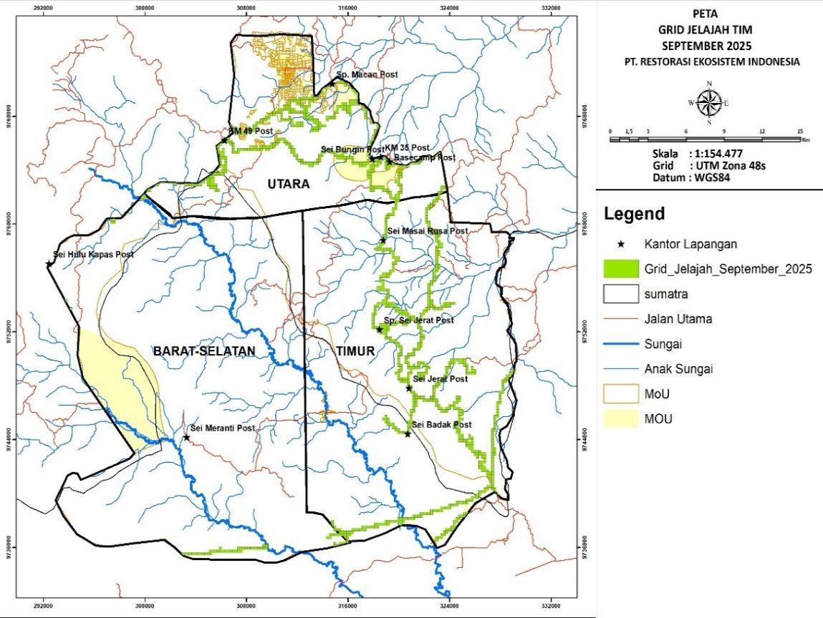
Priority Patrolling Areas
North Area: Patrols to control illegal drilling activities and encroachment
East Area: Patrols to prevent encroachment into the protected zone
South: Patrol of coal hauling road to prevent encroachment and illegal logging.

Slide 4
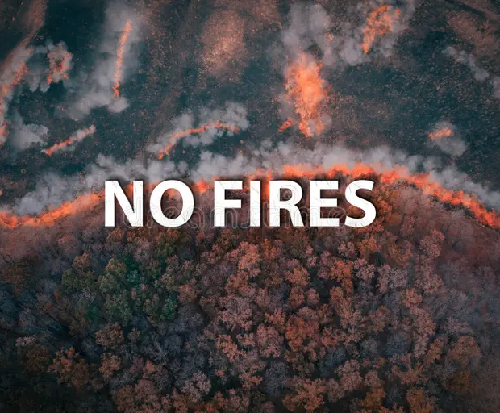



Main Threats to Hutan Harapan
Encroachment: This threat has increased due to the construction of the coal road.
Illegal Drilling: Although the illegal drilling has stopped in KM 52, there are still attempts by individuals to enter again.
Illegal Logging: This threat has increased with the construction of the coal road.
Forest Fires: Although this year the threat of forest fires was low, HH needs to be prepared for the dry season.

Slide 5
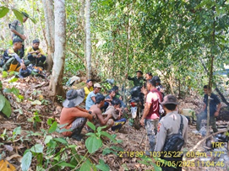
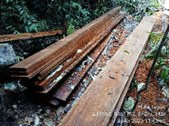
Forest Protection Activities (1)
Forest Conservation and Protection
1. Patrolling and Surveillance: Regular patrols to prevent and detect forest crimes, such as encroachment, illegal drilling, logging and poaching
2. Fire Prevention and Suppression: Measures to prevent forest fires, including firebreaks, monitoring, and rapid response to outbreaks.
Law Enforcement and Regulation
1. Enforcement of Forest laws: Enforcement of laws and regulations related to forest protection, including land use, logging and hunting.

Slide 6
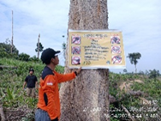
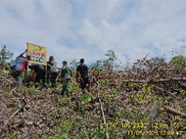
Forest Protection Activities (2)
Community Engagement and Education
1. Community Outreach: Engagement with local communities to raise awareness about forest conservation and involve them in protection efforts especially as Community Wardens.
2. Education and Training: Provision of education and training on sustainable forest management and conservation practices in collaboration with Communications and Livelihoods Development departments.
3. Collaboration with Stakeholders: Collaboration with government agencies, NGOs, neighbouring concessions and other stakeholders to ensure effective forest protection.

Slide 7
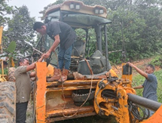
Forest Protection Activities (3)
Other Activities
1. Infrastructure Maintenance: Maintenance of forest infrastructure, such as roads, trails, and buildings.
2. Emergency Response: Response to emergencies, such as forest fires or natural disasters, to minimize damage to forests and communities.

Slide 8
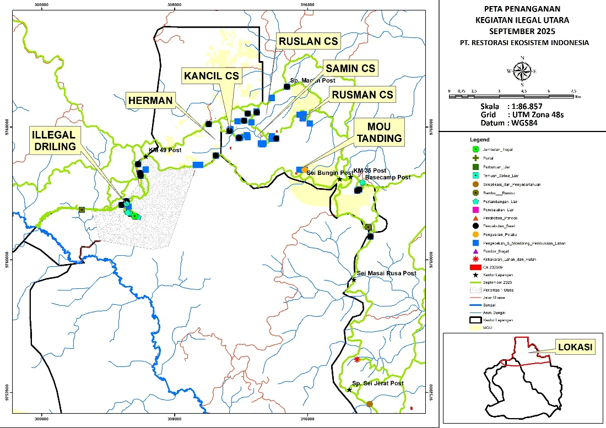
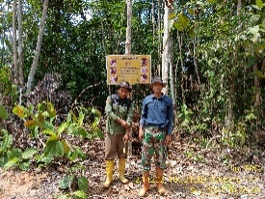
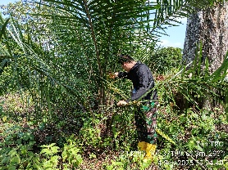
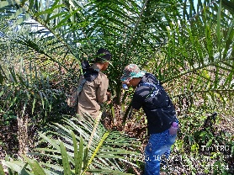
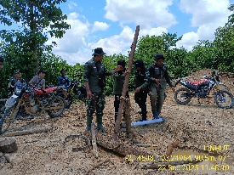
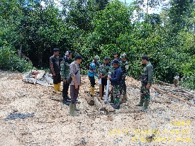
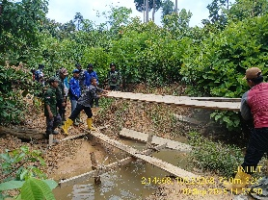
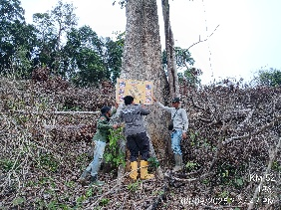
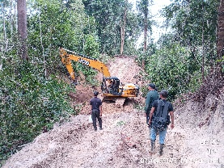
Activities in North Region of Core Zone Area (September 2025)
(1) Encroachment
Reclaim 22 times with covering a total area of 22 ha in the Illegal Drilling areas at KM 52, KM 47, the Kancil CS group, Alam Sakti group, and Ruslan group.
Destruction/removal of oil palm trees aged 1–2 years with 17 times covering 16 ha.
Warnings and/or evictions carried out 2 times (2 perpetrators were warned to leave the location).
Disconnection/removal of 1 illegal bridge.
(2) Illegal Drilling Enforcement activities in the illegal drilling area at KM 52 included closing 8 illegal oil wells.
(3) Wildlife Poaching Warning and eviction conducted once against 2 individuals caught hunting birds.
(4) Installation of Signs and Public Awareness
Installation of prohibition signs at 2 locations (2 signs) in the Bungin and Maklah river areas.
Conducted one public awareness (socialization) activity in the KM 52 illegal drilling area.
Map of Change Alert and Response in North Region on September 2025

Slide 9
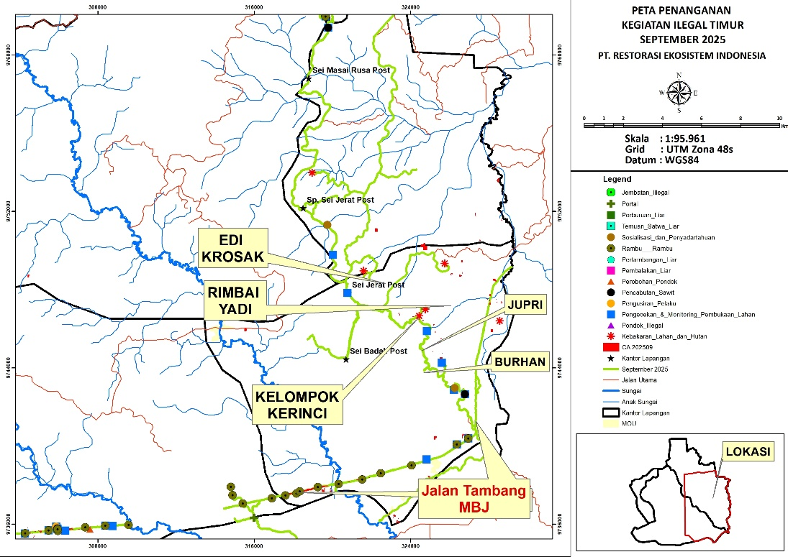
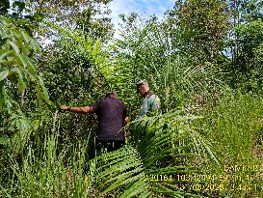
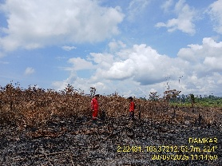
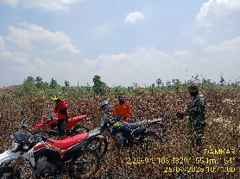
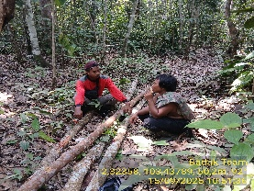
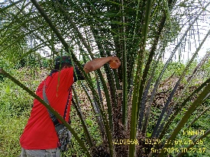
Activities in East Region of Core Zone Area (September 2025)
(1) Encroachment
Reclaim 5 times covering an area of 8 hectares in the Burhan group area.
Destruction/removal of oil palm trees aged 1–2 years 2 times and covering 4 ha.
Warnings and/or evictions carried out once (2 perpetrators were warned to leave the location).
(2) Forest Fire There were 5 hotspot alerts detected around the Jerat and Badak areas. Field verification found signs of previous burning in shrubland, and one hotspot was confirmed by the patrol team as a burned area.
(3) Installation of Signs and Public Awareness Conducted 2 public awareness (socialization) activities in the Burhan and Masai Rusa areas.
Map of Change Alert and Response in East Region on September 2025

Slide 10
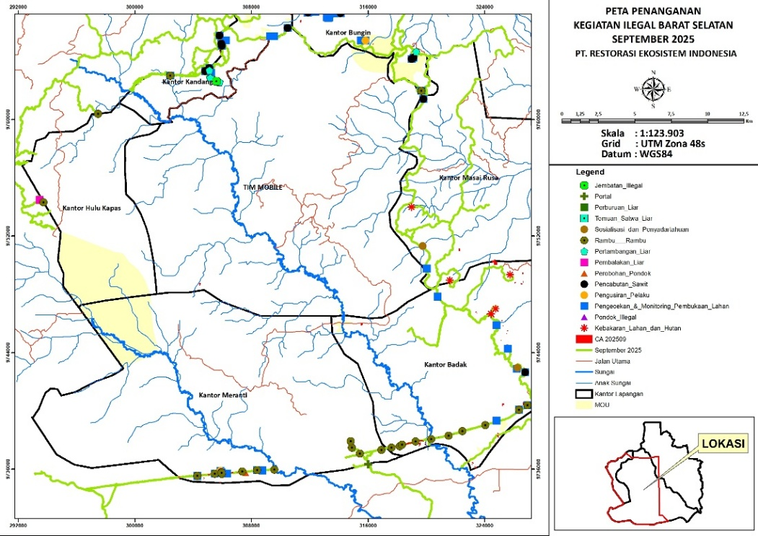
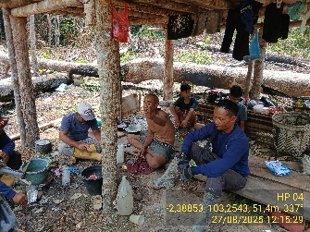
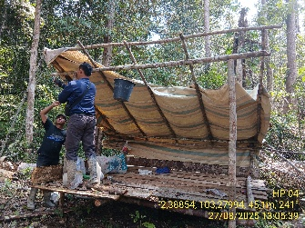
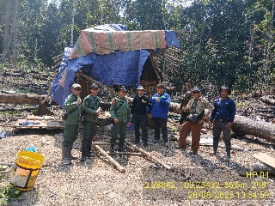
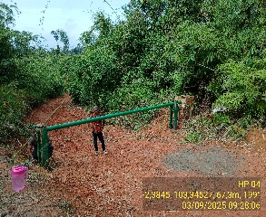
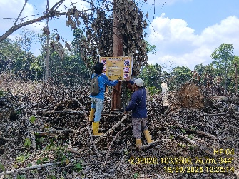
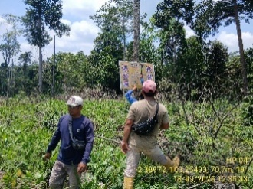
Activities in South and West Region of Core Zone Area
1) Forest Clearing
Reclaim 3 times covering an area of 2 hectares in the coal road areas of Fleet A and Fleet C.
Destruction/removal of oil palm trees aged 1–2 years conducted once covering 1 hectare.
Warnings and/or evictions carried out once (2 perpetrators were warned to leave the location).
Demolition of 2 huts in Fleet A.
Installation of one access gate (portal).
(2) Illegal Logging
Enforcement conducted once.
Warning and eviction carried out once against 3 illegal logging perpetrators.
(3) Installation of Signs and Public Awareness Installation of prohibition signs at 23 locations, totaling 25 signs, along the coal roads of Fleet A, Fleet B, and Fleet C.
Map of Change Alert and Response in South and West Region on September 2025

Slide 11
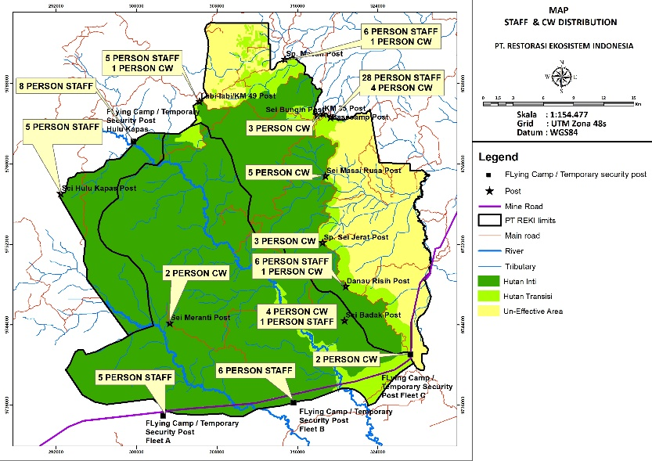
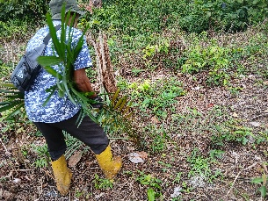
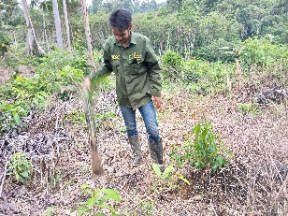
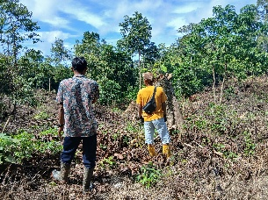
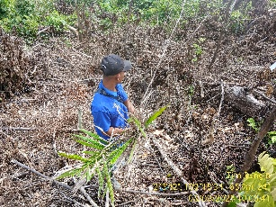
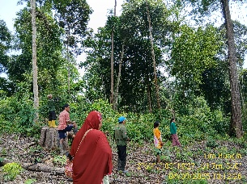
Community Warden Forest Patrols
(1) KM 52 and Simpang Macan Group
Conducted monitoring of encroachment from KM 49
to KM 52.
Eviction of illegal drilling perpetrators.
Installation of warning signs.
Enforcement of illegal drilling activities.
Enforcement of oil palm removal totaling 150 trees.
Road access closure.
(2) KM 35 Group Guarding the KM 35 access gate to monitor illegal movement of
vehicles, goods, and people.
(3) Masai Rusa Group Monitoring land clearing activities in the post-fire 2023 area
and observing newly opened land.
(4) Simpang Jerat Group
Monitoring post-fire 2023 areas.
Guarding the Simpang Jerat access gate to monitor illegal movement of vehicles, goods, and people.
Routine monitoring of forest restoration planting areas after the 2023 forest and land fires (Karhutla).
(5) Simpang Desa Group Conducted routine monitoring of PT MBJ road construction activities.

Slide 12
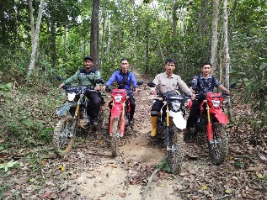
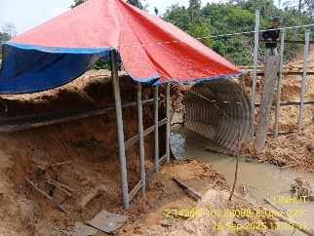
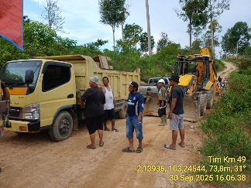
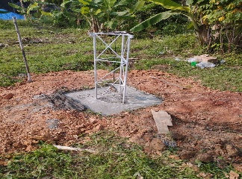
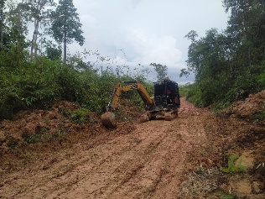
Facilities and Infrastructure for Forest Protection
(1) Road and Bridge Repairs
Jambi Region
The road repair target for the Jambi region in 2025 is 60.17 km.
As of the end of August, 38 km have been completed.
During September 2025, 26 km of repairs were carried out from Base Camp to Tangki 8, Sei Jerat.
Bridge repair and pipeline installation at Makelah Bridge are currently in progress.
South Sumatra Region
The road repair target for the South Sumatra region in 2025 is 20 km.
As of the end of August, 12.5 km have been completed.
During September 2025, a new road was opened in Block W, South Sumatra, covering 3.5 km.
(2) Condition of Field Office Facilities Functioning Optimally
Procurement of a post at Flat B Flying Camp KM 32 is in progress — material orders have been placed and work will begin once road access improves for site and post foundation preparation.
Construction of a tower at Danau Risi Post is currently underway.
Construction of the Hulu Sungai Kapas Post is in progress, including site preparation, material delivery, and foundation work.
The establishment of a temporary post (Flying Camp) at Sungai Sembilu Flat C has been completed and is now operational.
(3) Condition of Work Equipment Functioning Properly and Supporting Patrol Activities
15 units of CRF motorcycles are in good condition and operational; 1 CRF unit is under repair.
2 units of Honda Revo motorcycles are in good condition, while 3 units are under repair.
An additional 6 CRF motorcycles have been procured.
Bulldozer repairs are in progress.

Slide 13
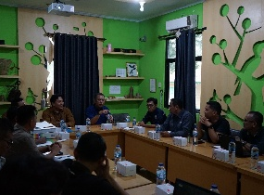
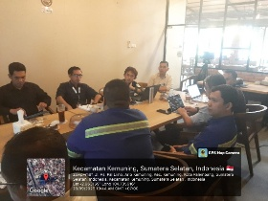
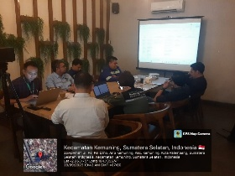
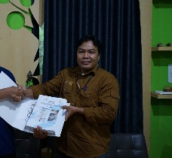
Networking With Stakeholders (September-October 2025)
September 17, 2025, Jindi South Jambi B. Co. Ltd. presented its 3D Seismic Survey plan to the PT REKI Operations Team at the Hutan Harapan Base Camp and submitted the UKL/UPL documents related to this activity.
September 17, 2025, a joint patrol with PT AAS, PT REKI, and KKIWARSI took place at the border between PT REKI and PT AAS.
September 25, 2025, a meeting with journalists/contributors from the Society of Indonesian Environmental Journalists (SIEJ) regarding the issue of artisanal mining as regulated by the Minister of Energy and Mineral Resources (ESDM) Regulation Number 14 of 2025.
September 28, 2025, a meeting between PT REKI and Jindi South Jambi B. Co. Ltd. and the Deputy Regent of Batang Hari at Rumah Kito Resort, Jambi, regarding the planned 3D Seismic Survey of Natural Gas Potential in the Batang Hari area (PT REKI's area).
September 29 2025, Monthly Meeting between PT REKI and PT MBJ in Palembang.
October 2 2025: Meeting with South Sumatra Forestry Agency

Slide 14
Forest Fire Detection and Prevention
Rainfall has been high throughout the year.
Since the rainfall has been high the fire threat has been mainly low since January.
Firefighting cooperation with communities around the forest and provincial task force is ongoing
Fire fighting training with provincial government was held in early October 2025
The Forest Protection Department invested in new fire fighting equipment.
Fire Danger Levels

Slide 15
Challenges:
North: 1) Preventing the return of illegal drilling activities in the KM 52 area after law enforcement operations; 2) Pressure from encroachment activities by the Batin Sembilan groups (Kutar, Basri, Herman, Ruslan, Kancil, and Rusman) that threaten the core and transition forest areas.
East: 1) Efforts to expand encroachment areas by perpetrators entering transition forest areas; 2) The circulation of negative narratives, particularly those voiced by village officials, that the area to the left of the road from Halilintar to Simpang Desa/Pe'I is land that can be cleared and cultivated.
South: 1) Mining road that is increasingly open and freely used by the community without security from PT MBJ; 2) Illegal logging activities in Zone 2 / Fleet B.
West: Illegal logging activities.

Slide 16
